Slide 1
TIF 201: Managing Risk & Protecting Public Resources
Schane Rudlang & Keith Dahl
September 24, 2026

Slide 2
Agenda
Pre-Establishment
Establishment
Post-Establishment

Slide 3
Pre-Establishment

Slide 4
Process
1
2
3
4
TIF Application
  Developer Escrow
  Information Gathering
  Form of Application
Financial Modeling
  Understand Financials
  TIF Estimate
  Stress Test Proforma
  Market Conditions
  Profit Analysis
Negotiations
  Strategic City Goals
  Financial Considerations
  Developer Goals
Coming to Agreeable Terms
  Principal Amount
  Length of Term
  Lookback
Pre-Establishment

Slide 5
Process
5
6
7
8
TIF Agreement and TIF Plan
  45-60 Days
  Public Hearing
  TIF Plan Approval
  Agreement Approval
TIF Note Issuance
  Cert of Occupancy
  After Construction
  Lookback on Cost
  Qualified Costs
Compliance
  Statutory Rules
  County Certification
  Decertification
Post Issuance Lookbacks
  Stabilization Lookback
  Sale Lookback
Establishment
Post-Establishment

Slide 6
TIF Application
TIF Application Form
  Process shown
  Different from the entitlements process, but parallel ok
  Developer Escrow
  What is needed to do the analysis
Developer Escrow
  Best practice is for developer to pay for all review costs
  Part of ultimate project cost
  Small in comparison
  High value for City
  Keeps the City’s finances unburdened!
Information Gathering
  Back and forth with developer
  Can be brief, or go on a long time

Slide 7
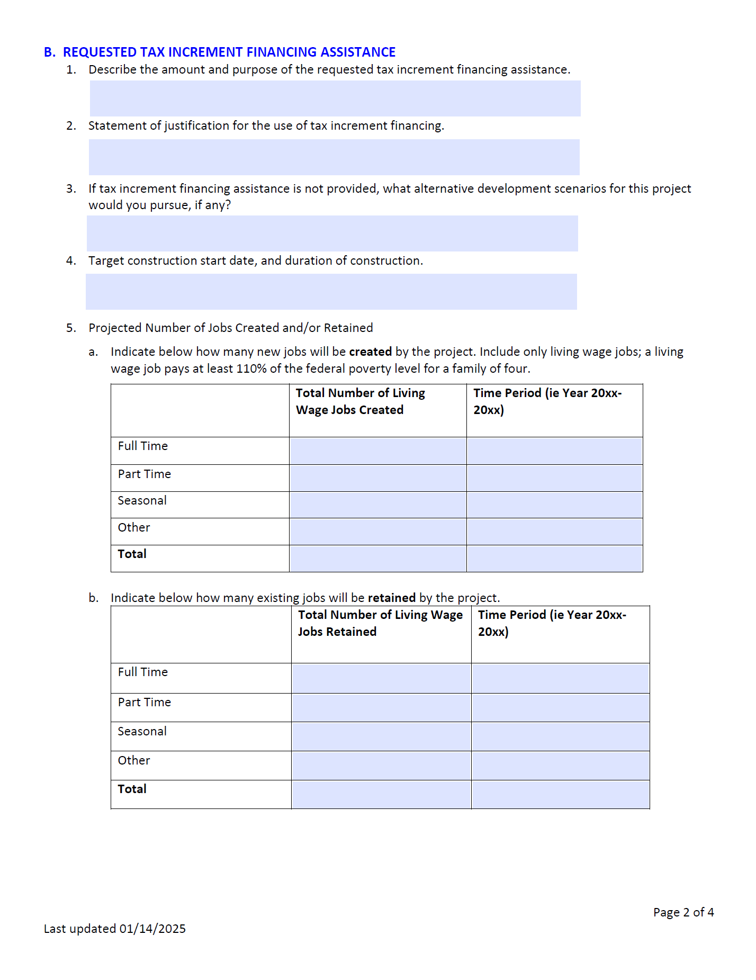
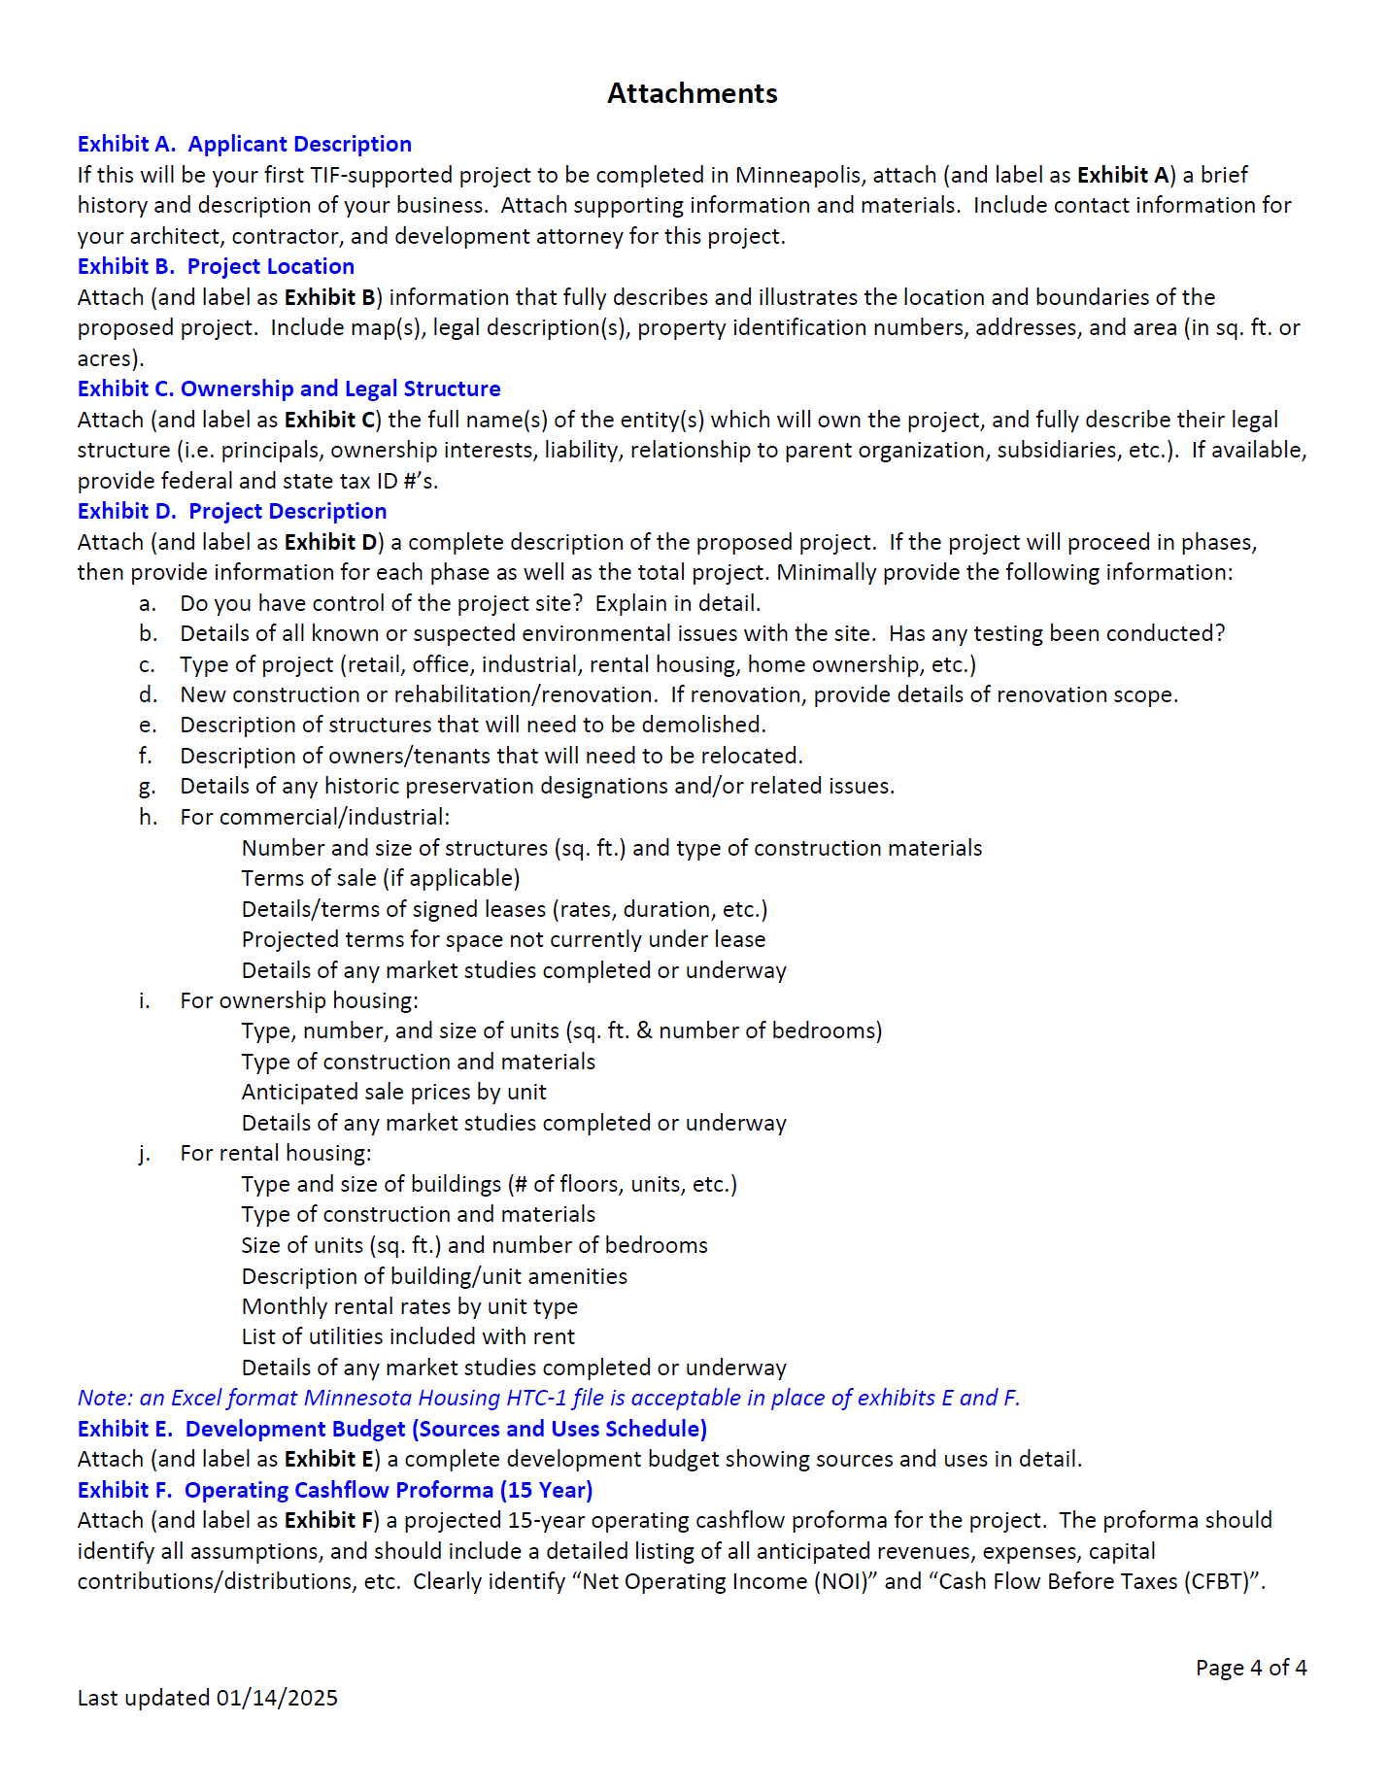
Application Example

Slide 8
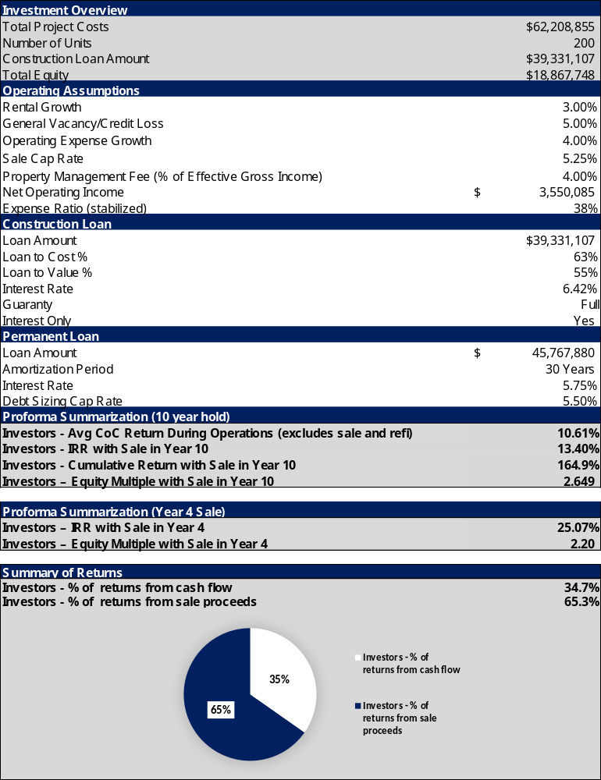
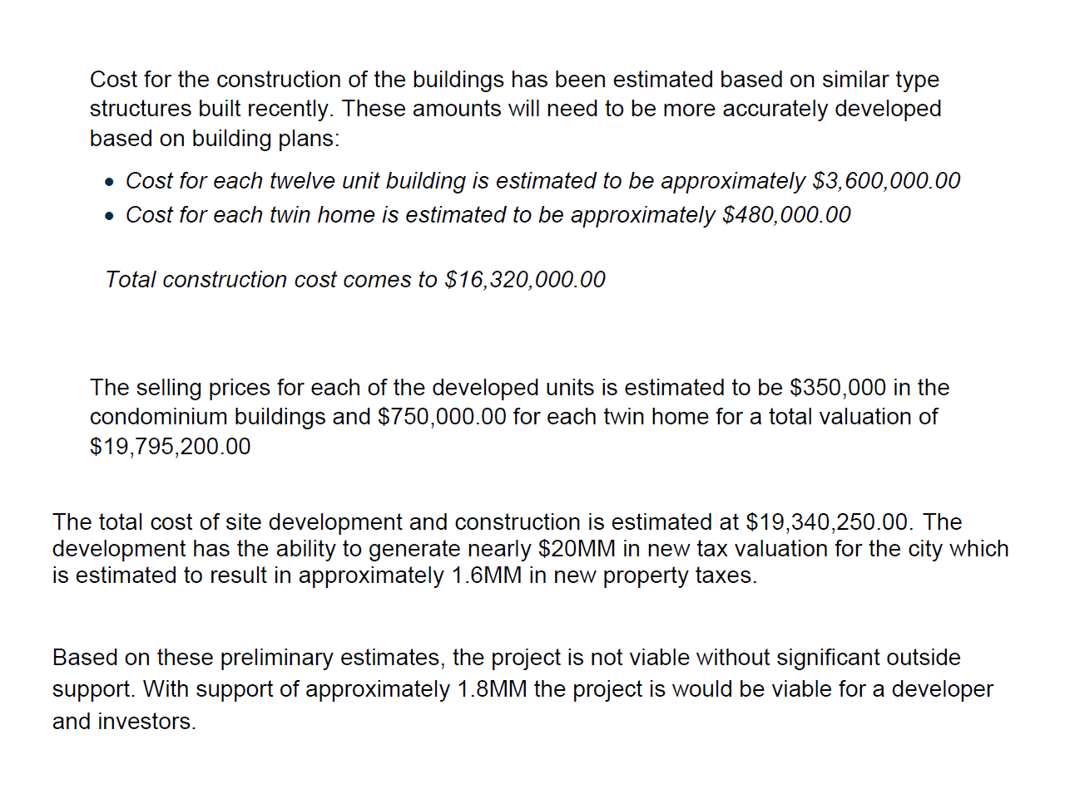
Developer Submittals
Thorough
Lacking

Slide 9
Financial Modeling
Understand Financials
  Different types of developer models
TIF Estimate
  Tax Rates
  Time of Year
  Rate Cards
Stress Test Proforma
  This is where the magic happens
Market Conditions
  CoStar
  Other projects
  Ehlers experience
Profit Analysis
  Internal Rate of Return
  Cash on Cash
  Yield on Cost
  Equity Multiple

Slide 10
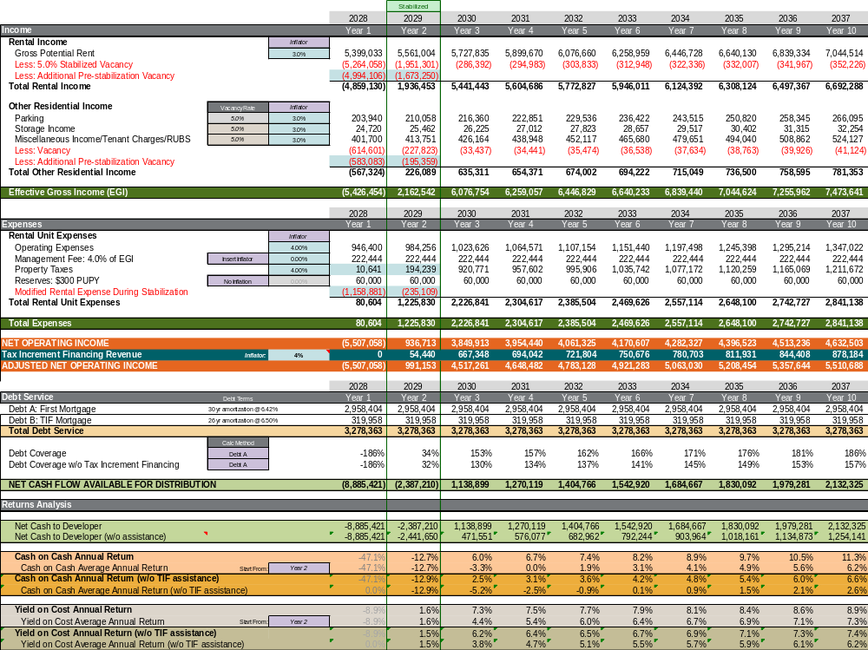
Ehlers’
Proforma
Example

Slide 11
Negotiations
Strategic Goals
  Comprehensive plan
  Area plans
  City practices
  City Policies
  Changing focus
Financial Considerations
  City budgets
  Impact on Levy and City Tax Rates
  Future benefits of project
Developer Goals
  Developers need to make money
  Compare project profits versus other types of investments
  Costs are up, rates are up

Slide 12
Coming to Agreeable Terms
Principal Amount
Length of Term
Lookbacks
Present value
Interest rate
  Tied to financing of other private project debt
May not be equal to length of TIF Plan term
Developers don’t want lookbacks
Public Policy Protection
Board concurrence
Protect funds
Real impact to save money!
Council Meeting?
Preferred to have council/board check in on terms before development agreement consideration (Term Sheet)

Slide 13
Types of TIF Obligations
Lower Risk
Higher Risk
PayGo Note
  Promise to pay, if TIF is available
  Best practice recommendation
TIF Revenue Bonds
  No GO
  Higher Rate, less principal
  Lower risk for City
Fund Balance Loan
  Paid back with TIF, but City risk
  Can be backed with developer Letter of Credit or other financial instrument
GO TIF Bonds
  General obligation of the City
  Lower rate, more principal
  Higher risk for City

Slide 14
Lookback Types
Construction Completion
Stabilization
Sale
Done at Certificate of Occupancy
Measures developer estimated cost vs actual cost
If actual cost is less than estimated cost, TIF is adjusted lower
Done after full occupancy, lease up
If financial performance is above a preset threshold, then TIF is adjusted lower
Done if project is sold
If financial performance is above a preset threshold, then TIF is adjusted lower
Watch
Developers resist lookbacks, but they are commonplace

Slide 15
Lookbacks: Why They Matter
Projections vs. real performance
  Projections are just projections
Outcomes become visible over time
  Real performance or real cost
Staff credibility tied to results
  Staff and board relationship
Past decisions influence future trust
  Build trust

Slide 16
Lookback: What Gets Measured
Project Cost
  Actual vs. estimated
Profitability
  IRR
  Cash on Cash
  Yield on Cost
  Equity multiple
TIF Generation
  Projections, versus actual TIF recieved
Job Creation and Wages
  Business subsidy policy
  Statutory requirements
Project Completion
  No money if the project isn’t complete
Agreement Compliance
  All of the above, and
  Other requirements such as park creation, sidewalks, roads, etc.

Slide 17
Establishment

Slide 18
TIF Agreement and TIF Plan
TIF Plan
TIF Agreement
Public Hearing at City Council Meeting
  County and Schools do not have decision role
Statutorily Required
Fiscal impacts to other jurisdictions
TIF Budget
TIF Budget does NOT equal TIF Note
Developer builds project
City provides TIF via a “TIF Note”
Lookbacks
Other provisions
Contains TIF Note
Council Approval - Establishment
County certification, separate step, before June 30

Slide 19
Interfund Loan
01.
Principal Amount
  Estimate the total amount of incurred and potential future expenditures
  Cushion is allowed and encouraged
Resolution needed within 60 days after making any expenditure that you want reimbursed with TIF
02.
Interest Rate
  Interest rate is capped at the annual statutory rate
  Rate may be fixed or variable
It is an “insurance policy” against negative cash balances
Just because you are authorized up to a specified dollar amount, does not mean you have to use it
Three required items need to be in an interfund loan resolution…
03.
Term of years
  Term of repayment is flexible
  Generally, based on a percentage of annual available tax increment

Slide 20
Post-Establishment

Slide 21
Your Job After Day One
Recurring duties for the life of the district
Watch
Every one of these is a documentation exercise first. If it isn’t in the file, it didn’t happen.
Track Increment
  Reconcile every county settlement against your own projection
Document Costs
  Qualified costs, administrative costs, and costs outside the district
Meet Deadlines
  The four-, five-, and six-year rules, annual reporting, decertification
Administer Agreements
  Development agreements, lookbacks, and PAYGO verification
Protect the Fund
  Segregate funds, adopt interfund loan resolutions, watch cash balances
Report & Close Out
  Annual report, annual disclosure, and a clean decertification

Slide 22
Qualified Costs Documentation
Watch
TIF may only be spent on qualified costs. Issuing a note larger than your documented costs is the real risk
01.
02.
Cover the principal amount
  Documented qualified costs must equal or exceed the principal amount of the obligation issued
Demonstrate costs have been incurred
  Invoices for work performed
  Evidence of payment for the work

Slide 23
Monitor TIF Plan Budget
Review budget periodically and modify as needed
Recommended annually
01.
02.
Revenues & Expenditures
  Documentation of all revenues and expenditures of file
Inside & Outside the District
  Documentation of costs inside and outside the District, for pooling requirements
Watch
Don’t exceed budgeted expenditures – important for excess increment calculations and spend down requirements

Slide 24
Modifying the TIF Plan
Not every change to the plan is administrative
Modifications fall into two categories
01.
02.
Requires the Full Process
  Notice, county and school district consultation, and a public hearing – same process as the original plan
  Triggered by increasing the budget, expanding the area, increasing bonded indebtedness, or increasing captured value
May Be Administrative
  Reallocating among existing budget line items may be permitted if the TIF plan expressly allows it
  The total budget may not increase, and the plan language must actually authorize it

Slide 25
Fund Structure & Audit Readiness
How does TIF show up in your financial statements?
One fund per District
  Account for each district separately. Never comingle increment between districts or with the general fund
Interfund loans, not transfers
  A negative cash balance without an adopted loan resolution is an audit finding
  The advance may not be reimbursable with increment
What auditors test
  Qualified cost documentation and pooling percentages
  The administrative cost cap for the district
  Whether your records agree with the county settlement
Watch
Increment is restricted revenue – reconcile your TIF fund balances to the annual report before it is filed, not after

Slide 26
The TIF Clock
Two different clocks run at the same time
From Certification
From First Increment
Year 4 Four-Year Rule: qualifying activity on every parcel
8 years Economic development districts
Year 5 Five-Year Rule: in-district spending must be committed
15 years Renewal & renovation districts
Year 6+ Six-Year Rule: increment only pays existing obligations
20 years Soils condition districts
Then Decertify once obligations are paid or fully funded
25 years Redevelopment and housing districts
Watch
Duration runs from the first increment. The four-, five-, and six-year rules run from certification.

Slide 27
Four-Year Rule “Knock Down Rule”
Qualifying activity must occur on each parcel within 4 years of certification
Qualifies
Demolition, rehabilitation, renovation, other site preparation, Street work qualifies only if newly built, relocated or substantially rebuilt
Does not qualify
Utility installation, such as sewer or water
Parcels with no activity are “knocked down” out of the district
No further increment; value excluded from original net tax capacity
Watch
Knocked down parcels can be brought back into the district after qualifying activity occurs

Slide 28
Five-Year Rule
Activity must occur within 5 years of certification to count as an in-district expenditure
80% minimum in-district spend
Economic development, renewal & renovation, soils districts
75% minimum in-district spend
Redevelopment districts
Counts as in-district if, within the period, any one of these occurs
01.
02.
03.
04.
Increment Paid
Bonds Issued
Binding Contract
Cost Reimbursed
Watch
Failing to meet one of these requirements means the money is deemed spent outside the district, even if it was actually spent inside

Slide 29
Five-Year Rule Exceptions
Housing district
Extra 10% pooling election
Other increment sources
Spending from a housing district is deemed “within district”
It is not subject to pooling limitations or the five-year rule
If the authority elects extra 10% pooling for affordable housing, those extra pooled dollars are deemed within the district
Increment derived from other sources are not so limited
  Interest
  Property sale proceeds
  Repayments of loans

Slide 30
Six-Year Rule
Governs increment use after the five-year period ends
Increment may be applied in only two ways
01.
02.
Pay Existing Obligations
  Increment may only pay outstanding in-district obligations and pre-existing contracts, or be used as the pooling rules allow
Retire or Return Tax Increment
  Remaining increment must prepay or defease bonds, discharge the escrow, or be returned to the County
Watch
The District must be decertified once those obligations are paid or fully funded

Slide 31
Out-District Expenditures “Pooling”
May pool outside the District , up to:
20% maximum out-district spend
Economic development, renewal & renovation, soils districts
25% maximum out-district spend
Redevelopment districts
Where and how pooled dollars can be spent?
01.
02.
03.
Project area
Any district, or none
Source district rules
Has to be spent within the Project Area
Can be spent in another TIF district of any kind, or in no TIF district
Spending must comply with all the rules that apply to the source TIF district

Slide 32
Administrative Expenditures
What is considered administrative?!
Watch
Administrative expenditures count against your Out-District Expenditure – budget for both together
1
  Services by bond counsel, fiscal consultants & economic development consultants
2
  Staff time for negotiating, preparing, accounting, reporting, and monitoring TIF Plans & Districts
3
  Publication of annual disclosures & notices
4
  Preparation of a Response Action Plan (RAP)
5
  Usual & customary maintenance & operation of properties purchased with TIF
6
  Amounts used to pay obligations to the extent those obligations were used to finance 1 – 5

Slide 33
Excess Increment
Increment that exceeds the amount needed to pay the costs authorized under the TIF plan for the year
Excess increment must be applied in one of two ways
01.
02.
Prepay outstanding bonds
  Applied to debt issued for the TIF district if permitted or by funding an escrow account for the bonds
Returned to the County
  Shared proportionally among the city, county, and school district
  Does not get shared with other taxing jurisdictions

Slide 34
Excess Taxes
Excess taxes are created when the tax rate imposed on properties in a TIF district exceeds the certified original local tax rate
( Actual tax capacity rate
−
Original local tax rate )
×
Captured tax capacity
=
Excess taxes
Shared with the main taxing districts, in proportion to their rate increases
01.
02.
03.
City
County
School District
Watch
Excess Taxes are NOT tax increment – if you see this on your tax settlement, you may put it in the general fund

Slide 35
Tax Increment Collection
Counties collect, calculate and distribute increment to cities
First-Half Increment
Second-Half Increment
May 15 Property taxes collected
October 15 Property taxes collected
June Processed by the County
November Processed by the County
July Paid to the City and reviewed
December Paid to the City and reviewed
August 1 First-half obligation payment
January Clean-up Settlement & Corrections
February 1 Second-half obligation payment
Watch
Reconcile every settlement against your increment projection – investigate variance before obligation payments

Slide 36


Annual Reporting Calendar
Recurring obligations the authority owns every year
Annual Report – August 1
  Annual Reporting Form due to the State Auditor
  Filing submitted through SAFES
  Required every year until the district is closed out
Annual Disclosure – August 15
  Annual Disclosure published in a newspaper
  Required even if all amounts are zero
  Send the published disclosure to the OSA
Watch
Missing these is not a paperwork problem – increment distributions can be withheld until you comply

Slide 37
Pay As You Go (PAYGO) Notes
Review semi-annually before payment is made
Verify before payment
  Make sure all parcel(s) have paid taxes and how much they paid.
Market values
  Check against the Minimum Assessment Agreement
  Assessors don’t always catch a Minimum Assessment Agreement
Multiple Notes
  Calculate PAYGO amount on a parcel-by-parcel basis
  Tie all obligations back to what was generated by the District
  Non-performance by one development can have negative effects on others
Watch
Review Development Agreements for defaults – remedies may allow withholding all or a portion of the increment

Slide 38
Development Agreements & Lookback
The agreement is your enforcement tool
Know your covenants
  Construction deadlines, minimum improvements, the minimum assessment agreement, job and wage goals, and any required guaranty, letter of credit, or insurance
Lookback provisions
  Recalculate the developer’s actual return once the project stabilizes, is refinanced, or is sold
  If the return beats what was underwritten, assistance is reduced or repaid
Calendar the triggers
  Lookback dates and the certificate of completion
  Guaranty expirations and letter of credit renewals
  Nothing in the agreement enforces itself
Watch
Lookback is contractual, not statutory

Slide 39
Tax Court Petitions
A property owner contests valuation and the tax court reduces market value
How a petition unfolds
Potential Issues
Owner contests valuation
Tax court reduces market value
  Overpayment of PAYGO Note(s)
  TIF District is now decertified and Fund closed
  Negative cash balance in TIF Fund
Petitions can take years to resolve
If settled, County pays the refund
Out of TIF in the next tax settlement; could result in a negative tax settlement amount for the TIF District

Slide 40
Decertification
Districts expire in two ways
01.
02.
County Action
  Automatic decertification at expiration of the maximum term of the district
  Review outstanding obligations to ensure there are no delinquent taxes or tax court petitions
City Action
  Council approves a resolution requesting the County to decertify the district early
  No outstanding obligations and/or sufficient funds on hand
Watch
All districts need to complete the Confirmation of Decertified TIF District and submit it to the OSA within 90 days

Slide 41
Top 10 Tips!
Post Establishment
Keep everything!
Document costs outside the TIF District
1
6
Segregate funds – don’t comingle
Monitor TIF District budget to actual expenditures
2
7
Adopt interfund loan resolutions
Track and monitor important TIF dates
3
8
Document all administrative costs
Review settlement statements
4
9
Document qualified TIF costs
Verify certain items prior to PAYGO payments
5
10

Slide 42


Schane Rudlang
Presenters
Keith Dahl
Municipal Advisor
  srudlang@ehlers-inc.com
  651-697-8527
Senior Municipal Advisor
  kdahl@ehlers-inc.com
  651-697-8595

Slide 43
Thank you!

