Slide 1

MNGFOA 2026
Audit 101 +
Internal Controls
A practical playbook for cities and counties
Bonnie Schwieger, Partner, CPA
September 22, 2026 | 1:00–2:00 PM
Notes:
[Sources]
- Internal source: Audit Roadmap - Updated with Top 10 Findings.pptx
- Visual on this slide was generated with Microsoft Copilot.
[/Sources]

Slide 2
TODAY’S OUTCOME
From annual event to year-round discipline
Connect the audit process, internal controls, and practical readiness.
SEE THE ROADMAP
OWN THE ROLES
BUILD CONTROLS
GOVERN AI
Understand what happens, when, and why
Separate auditor work from management responsibility
Design controls that fit staffing and risk
Apply controls to emerging AI use cases
AUDIT READINESS IS A MANAGEMENT PROCESS, NOT A DOCUMENT REQUEST.
Notes:
[Sources]
- Internal source: Audit Roadmap - Updated with Top 10 Findings.pptx
- https://www.coso.org/_files/ugd/719ba0_08f358f2c8f946fa9d26bd51d37b7117.pdf
[/Sources]

Slide 3
QUICK PULSE CHECK
What makes an audit feel hard?
Choose the issue that creates the most friction in your organization.
A
Late close or unreconciled accounts
B
Unclear ownership of requests
TABLE
VOTE
C
Limited segregation of duties
D
Missing evidence of review
E
New grants, systems, staff, or AI tools
Notes:
[Sources]
- Internal source: Audit Roadmap - Updated with Top 10 Findings.pptx
[/Sources]

Slide 4
PART 1
The annual audit process
A clear roadmap reduces surprises, rework, and last-minute pressure.
Notes:
[Sources]
- Internal source: Audit Roadmap - Updated with Top 10 Findings.pptx
[/Sources]

Slide 5
AUDIT PROCESS
The annual audit roadmap
Eight stages, with management action at every stage.
01
02
03
04
Planning & risk assessment
Interim controls
Year-end close
Fieldwork
05
06
07
08
Financial statements
Audit reporting
Public transparency
Corrective action
PREPARE AND CLOSE → REPORT AND IMPROVE
Notes:
[Sources]
- Internal source: Audit Roadmap - Updated with Top 10 Findings.pptx
[/Sources]

Slide 6
SHARED OUTCOME, DISTINCT ROLES
Auditor responsibility vs. management responsibility
Clarity prevents gaps and avoids misplaced expectations.
AUDITOR
MANAGEMENT
Plan and perform the audit
Assess risks of material misstatement
Obtain appropriate evidence
Communicate required matters
Prepare and fairly present the statements
Maintain internal control
Provide complete records and explanations
Correct identified issues
THE AUDIT DOES NOT REPLACE MANAGEMENT’S CONTROL SYSTEM.
Notes:
[Sources]
- Internal source: Audit Roadmap - Updated with Top 10 Findings.pptx
[/Sources]

Slide 7
RISK ASSESSMENT
Where will the auditor focus?
Risk drives the nature, timing, and extent of audit procedures.
CHANGE
JUDGMENT
VOLUME
New systems, programs, debt, grants, staff, standards
Estimates, complex accounting, unusual transactions
Cash receipts, payroll, disbursements, utility billing
ACCESS
HISTORY
COMPLIANCE
Privileged access and incompatible rights
Prior adjustments, late support, repeat issues
Federal awards, legal requirements, grant terms
Notes:
[Sources]
- Internal source: Audit Roadmap - Updated with Top 10 Findings.pptx
[/Sources]

Slide 8
COMMON AUDIT FOCUS
High-attention areas in local government finance
Use this list to prioritize close and documentation.
CASH + INVESTMENTS
REVENUE + CUTOFF
Custody, reconciliation, confirmation
Recognition, completeness, timing
PAYROLL + BENEFITS
CAPITAL + CONSTRUCTION
Authorization, changes, liabilities
Existence, costs, commitments
DEBT + LEASES + SBITAS
GRANTS + SINGLE AUDIT
Completeness, measurement, disclosures
Allowability, reporting, controls
JOURNAL ENTRIES
FINANCIAL REPORTING
Authorization, support, unusual activity
Statements, MD&A, notes, RSI
Notes:
[Sources]
- Internal source: Audit Roadmap - Updated with Top 10 Findings.pptx
[/Sources]

Slide 9
BEFORE FIELDWORK
A clean close changes the entire audit experience
Prepare evidence, not just balances.
Complete and review reconciliations
Tie balances to supporting schedules
Investigate unusual variances and old items
Organize support to match the request list
Assign knowledgeable owners
Escalate complex issues early
Notes:
[Sources]
- Internal source: Audit Roadmap - Updated with Top 10 Findings.pptx
- Visual on this slide was generated with Microsoft Copilot.
[/Sources]

Slide 10
FIELDWORK
Manage the audit like a project
A steady communication rhythm keeps requests moving.
OWNERSHIP
ORGANIZATION
CADENCE
One owner per request
Backup for key areas
Clear escalation path
Files match request names
Version control
Explanations travel with support
Regular status check
Open-item tracker
Prompt questions and decisions
Notes:
[Sources]
- Internal source: Audit Roadmap - Updated with Top 10 Findings.pptx
[/Sources]

Slide 11
PART 2
Internal control fundamentals
Controls help management achieve objectives and manage risk, every day.
Notes:
[Sources]
- https://www.gao.gov/greenbook
[/Sources]

Slide 12
GOVERNMENT ACCOUNTABILITY
Why internal control has an expanded role
Public resources create responsibilities beyond financial statement accuracy.
“
Internal control plays an expanded role in the government sector. Given the government’s accountability for public resources, assessing internal control in a government environment may involve considering controls that would not be required in the private sector. In the government sector, evaluating controls that are relevant to the audit involves understanding significant controls that the audited entity designed, implemented, and operated as part of its responsibility for oversight of public resources.
2024 Government Auditing Standards, paragraph 6.47
INTERNAL CONTROL IS PART OF MANAGEMENT’S STEWARDSHIP OF PUBLIC RESOURCES.
Notes:
[Sources]
- https://www.gao.gov/assets/d24106786.pdf
[/Sources]

Slide 13
INTERNAL CONTROL
A process owned by management
Designed to provide reasonable assurance that objectives will be achieved.
OPERATIONS
REPORTING
COMPLIANCE
Efficient and effective service delivery
Reliable financial and operational information
Adherence to laws, regulations, and grant terms
Reasonable assurance ≠ zero risk
Notes:
[Sources]
- https://www.gao.gov/greenbook
[/Sources]

Slide 14
CONTROL FRAMEWORK
Five components work together
A control is stronger when it sits inside a complete system.
CONTROL ENVIRONMENT
Tone, ethics, competence, accountability
RISK ASSESSMENT
Objectives, risks, change
CONTROL ACTIVITIES
Approvals, reviews, access, reconciliations
INFORMATION + COMMUNICATION
Quality information reaches the right people
MONITORING
Evaluate controls and remediate deficiencies
Notes:
[Sources]
- https://www.gao.gov/greenbook
[/Sources]

Slide 15
DESIGN CONTROLS FROM RISK
Objective → risk → control → evidence
Start with what could go wrong, not with a generic checklist.
OBJECTIVE
RISK
CONTROL
EVIDENCE
Pay only valid, approved invoices
Duplicate, fictitious, or unauthorized payment
Independent approval and duplicate check
Approval record, exception report, reviewer sign-off
IF EVIDENCE IS NOT RETAINED, THE CONTROL MAY BE DIFFICULT TO DEMONSTRATE.
Notes:
[Sources]
- https://www.gao.gov/greenbook
[/Sources]

Slide 16
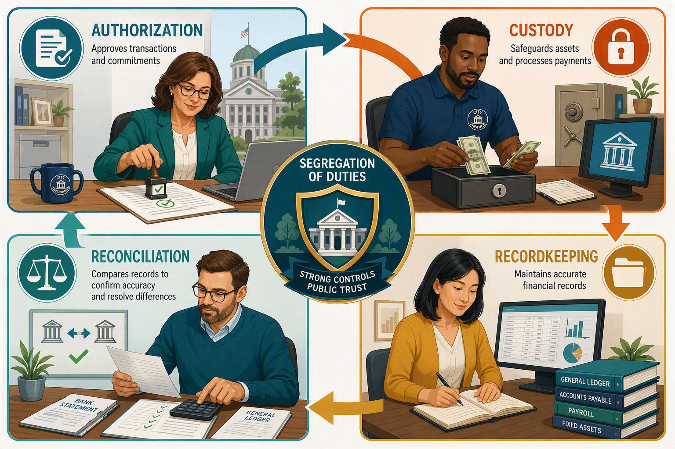
SEGREGATION OF DUTIES
Separate incompatible responsibilities
Avoid giving one person end-to-end control of a transaction.
AUTHORIZE
Approve the transaction
CUSTODY
Handle cash, checks, or assets
RECORD
Enter and maintain records
RECONCILE
Compare records and investigate differences
Notes:
[Sources]
- Internal source: Audit Roadmap - Updated with Top 10 Findings.pptx
- https://www.gao.gov/greenbook
- Visual on this slide was generated with Microsoft Copilot.
[/Sources]

Slide 17
WHEN STAFFING IS LIMITED
Use compensating controls that are precise and visible
The reviewer needs information, authority, and evidence.
BANK ACTIVITY
DISBURSEMENTS
Independent review of statements and transfers
Detailed claims and invoice review
PAYROLL
JOURNAL ENTRIES
Exception report for employee and pay changes
Independent review of manual entries
ACCESS
ANALYTICS
Periodic access review and timely removal
Variance review with documented follow-up
Notes:
[Sources]
- Internal source: Audit Roadmap - Updated with Top 10 Findings.pptx
- https://www.gao.gov/greenbook
[/Sources]

Slide 18
DOCUMENTATION
Show who did what, when, and what they concluded
Strong evidence makes the control repeatable and auditable.
WHO
WHAT
WHEN
Who performed and reviewed?
What was reviewed or approved?
When did the control operate?
EXCEPTIONS
RESOLUTION
RETENTION
What exceptions were identified?
How were exceptions resolved?
Where is the evidence retained?
SIGN-OFF ALONE IS NOT ENOUGH IF THE REVIEW PERFORMED IS UNCLEAR.
Notes:
[Sources]
- https://www.gao.gov/greenbook
[/Sources]

Slide 19
PART 3
Internal control over AI
Apply proven control principles to rapidly changing AI tools and workflows.
Notes:
[Sources]
- https://www.coso.org/_files/ugd/719ba0_08f358f2c8f946fa9d26bd51d37b7117.pdf
[/Sources]

Slide 20
AI IN LOCAL GOVERNMENT FINANCE
New capability, new risk, familiar control framework
COSO applies the five internal control components to Generative AI governance.
POSSIBLE USES
KEY RISKS
Draft reports and communications
Summarize grant requirements
Analyze variances and large datasets
Support research and documentation
Incorrect or fabricated output
Confidential data exposure
Unauthorized “shadow AI”
Bias, manipulation, or model drift
Overreliance without review
AI CHANGES THE RISKS THE CONTROL SYSTEM MUST ADDRESS.
Notes:
[Sources]
- https://www.coso.org/_files/ugd/719ba0_08f358f2c8f946fa9d26bd51d37b7117.pdf
[/Sources]

Slide 21
COSO-ALIGNED AI CONTROLS
Govern the use case from approval through monitoring
Controls should cover people, data, models, outputs, and changes.
CONTROL ENVIRONMENT
Approved tools, accountability, acceptable use, oversight
RISK ASSESSMENT
Inventory use cases; assess impact, sensitivity, reliance
CONTROL ACTIVITIES
Access, human review, testing, approval, change control
INFORMATION + COMMUNICATION
Training; prompts, sources, limitations, decisions
MONITORING
Usage, exceptions, vendor changes, model behavior
Notes:
[Sources]
- https://www.coso.org/_files/ugd/719ba0_08f358f2c8f946fa9d26bd51d37b7117.pdf
[/Sources]

Slide 22
PRACTICAL CONTROL MATRIX
Controls for AI-assisted finance work
Scale rigor to the sensitivity and significance of each use case.
ACCURACY
Independent human verification
DATA PROTECTION
Approved tools; no restricted data
APPROVAL
Knowledgeable review before external use
TRANSPARENCY
Document AI use, prompts, outputs, sources
ACCESS
Limit tools, connectors, agents, permissions
MONITORING
Review usage, exceptions, and changes
Notes:
[Sources]
- https://www.coso.org/_files/ugd/719ba0_08f358f2c8f946fa9d26bd51d37b7117.pdf
[/Sources]

Slide 23
AI GOVERNANCE CASE STUDY
Copilot-assisted finance work
Design controls before expanding the use case.
SCENARIO
Discuss at your table
A city wants to use an approved generative AI tool to draft council summaries, analyze budget variances, summarize grant agreements, and assist with MD&A drafting.
What could go wrong?
Which data should not be entered?
Who must review the output?
What support should be checked?
What evidence should be retained?
How will use be monitored?
Notes:
[Sources]
- https://www.coso.org/_files/ugd/719ba0_08f358f2c8f946fa9d26bd51d37b7117.pdf
[/Sources]

Slide 24
COMMON CONTROL GAPS
Patterns that create control weaknesses
Focus on the process pattern, not only the individual transaction.
NO EVIDENCE OF REVIEW
ONE PERSON CONTROLS THE CYCLE
Define the review and retain evidence
Separate duties or add independent review
RECONCILIATIONS ARE LATE
POLICIES DO NOT MATCH PRACTICE
Set deadlines, ownership, escalation, review
Update procedures and train staff
ACCESS ACCUMULATES
CONTROL ISSUES REMAIN OPEN
Perform periodic reviews and remove rights
Assign owner, milestone, evidence, follow-up
Notes:
[Sources]
- Internal source: Audit Roadmap - Updated with Top 10 Findings.pptx
- https://www.gao.gov/greenbook
- https://www.coso.org/_files/ugd/719ba0_08f358f2c8f946fa9d26bd51d37b7117.pdf
[/Sources]

Slide 25
90-DAY IMPROVEMENT PLAN
Choose one process and make the control visible
Small, completed improvements beat a long list of intentions.
0–30 DAYS
31–60 DAYS
61–90 DAYS
Select one high-risk process
Map roles and evidence
Identify the most important gap
Redesign the control
Update the procedure
Train the doer and reviewer
Test the control
Correct exceptions
Report results to leadership
Notes:
[Sources]
- https://www.gao.gov/greenbook
- https://www.coso.org/_files/ugd/719ba0_08f358f2c8f946fa9d26bd51d37b7117.pdf
[/Sources]

Slide 26
AUDIT-READY CHECKLIST
Seven practices that make readiness sustainable
Use this as your handoff from the session.
Close and reconcile accounts on a defined schedule
Assign a knowledgeable owner for every audit area
Document key controls and retain evidence of review
Review access and incompatible duties periodically
Communicate grants, contracts, debt, leases, system, and AI changes early
Track requests, adjustments, and control issues to completion
Report control issues and corrective actions to governance
PREPARE • COMMUNICATE • DOCUMENT • REVIEW • IMPROVE
Notes:
[Sources]
- Internal source: Audit Roadmap - Updated with Top 10 Findings.pptx
- https://www.gao.gov/greenbook
- https://www.coso.org/_files/ugd/719ba0_08f358f2c8f946fa9d26bd51d37b7117.pdf
[/Sources]

Slide 27
YOUR TAKEAWAY
A successful audit starts
long before fieldwork.
Know the roadmap. Own management’s responsibilities. Design controls from risk. Govern AI use. Keep evidence. Improve continuously.
Questions + discussion
Bonnie Schwieger | Partner, CPA
Notes:
[Sources]
- Internal source: Audit Roadmap - Updated with Top 10 Findings.pptx
- https://www.coso.org/_files/ugd/719ba0_08f358f2c8f946fa9d26bd51d37b7117.pdf
- Visual on this slide was generated with Microsoft Copilot.
[/Sources]

