Slide 1

ANOKA MUNICIPAL CANNABIS COMPANY
Municipal Cannabis Operations
September 22, 2026
Minnesota Government Finance Officers Association Conference

Slide 2

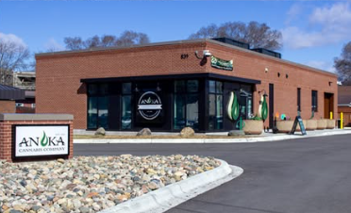
ANOKA MUNICIPAL CANNABIS COMPANY
MISSION
To provide safe, controlled, equitable, and community-centered access to high-quality cannabis products through education, integrity, and care; fostering wellness and responsible use in the city of Anoka.
VISION
To be a model for how cannabis can be locally owned, responsibly regulated and rooted in community values, setting the standard for transparency, inclusion, and public benefit in the emerging cannabis economy.
Notes:
Welcome everyone. Today, I will walk you through our journey in creating Anoka Municipal Cannabis Company. This is our mission and vision to building a community-focused dispensary. Our mission and vision guide every decision, ensuring we serve not just customers but the broader community responsibly.

Slide 3

THE ANOKA EXPERIMENT: A DEFINITIVE REPORT ON MINNESOTA’S FIRST MUNICIPAL CANNABIS ENTERPRISE
Anoka: Minnesota's First City-Run Cannabis Store
Published February 7, 2026 by Marijuana.scool
A City Sells Cannabis

Slide 4


INDUSTRY EDUCATION & NETWORKING
Liquor Manager and I attended Lucky Leaf Cannabis Convention in Minneapolis in 2024 & 2025, which included full day trainings.
It was an eye-opening experience, which showcased the scale of the cannabis industry.
Networked with growers for supply, banks for making us legal with the federal government, and product companies for non-THC merchandising.
Staff put together an Educational Guide for everyone explaining cannabis and all it’s elements.
Notes:
At this time Kevin was just the liquor store manager… now he is the Enterprise Operations Director overseeing Liquor, Golf and Cannabis. Attending the conference was a revelation, I never expected my job as a Finance Director to take me to a “Pot Convention” where I am meeting growers, getting to understanding the banking challenges, and discovering new products that support cannabis sales. Bic lighter guy said the average lighter passes through 10 hands before end-of-life great advertising opportunity we thought.

Slide 5

BUSINESS PLANNING WITH POINTSEVEN CONSULTANTS
Anoka hired Colorado-based PointSeven to create Anoka’s cannabis business plan.
Transparent revenue and expense projections were based on extensive data with clear assumptions.
Estimated $2 million gross profit by year 2 at $105 average sale per customer.
This is a strong increase compared to prior liquor store profits. At the height of COVID the max profit liquor brought in was $300,000 for two stores.
Notes:
The business plan was data-driven, giving City Council confidence in the financial opportunities while remaining conservative.

Slide 6
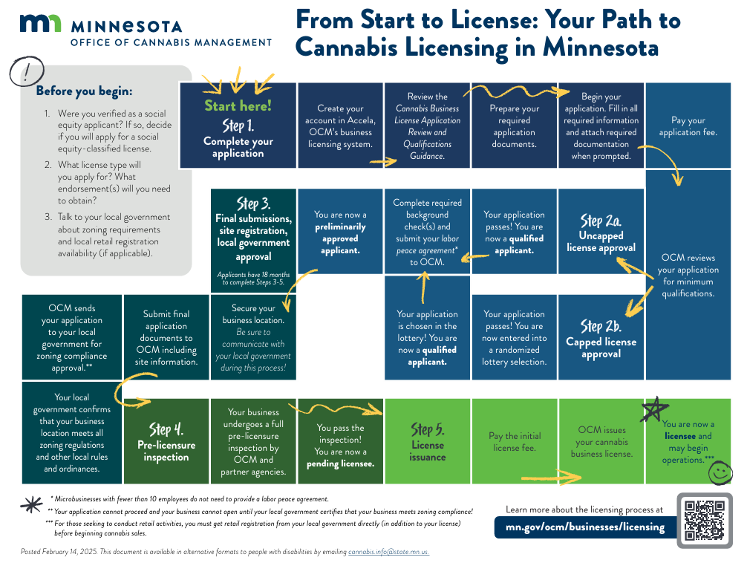
Notes:
With Staff and council excited amount starting this prosperous new adventure, we quickly learned that the process was “hurry up and wait”… all we had to do was follow this “chutes and ladders” path to cannabis licensing. We quickly realized that government-run cannabis shops were an afterthought for legislators, and OCM staff didn’t really understand how private industry works vs government. We were told we needed approval from the local government for zoning and compliance approval …. We said we are the local government…

Slide 7

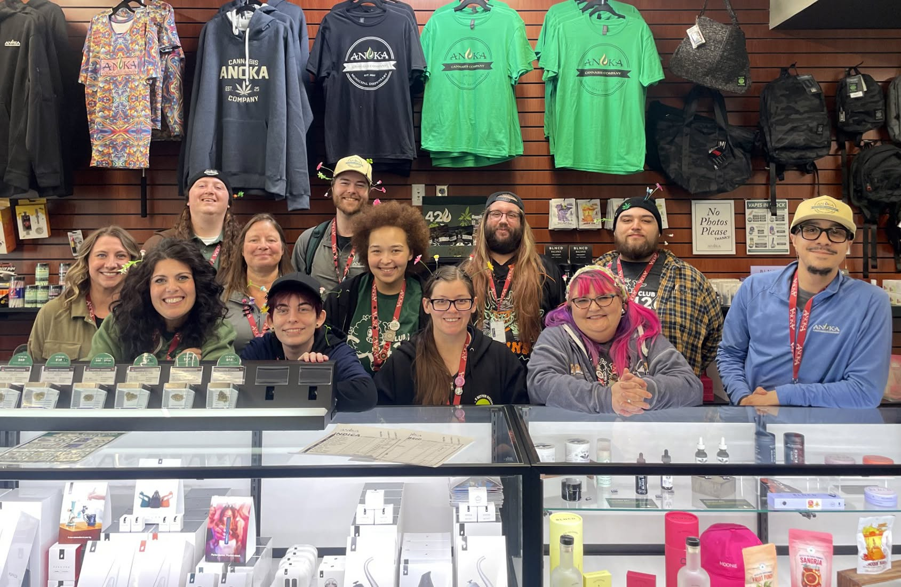


Building the Team
Dispensary Construction & Security
Partnering with Tribal Growers
Cannabis Manager, Stephanie, managed 4 medical dispensaries in Colorado.
Assistant Manager, Jamie, local cannabis business owner focused on education and outreach.
Staff trained police officers on THC impairment detection for community safety.
They wrote our SOP’s from scratch and hired awesome budtenders and receptionists that have a passion for a great team culture.
Fastest city project ever, with RJM as general contractor.
Police Chief suggested a sally port for secure deliveries and cash handling.
$162,000 invested in security, including AI-powered cameras.
2-inch thick, bullet resistant glass and comprehensive surveillance to protect assets.
Connected at Lucky Leaf convention; toured tribal grow facilities.
Witnessed advanced cultivation and manufacturing technologies.
Saw the science and care that goes into every plant.
Notes:
Our team combines deep industry knowledge with strong community connections, making a great foundation. Security was paramount. The sally port ensures safe, contactless product and cash transfers, and modern AI cameras add an extra layer of accountability. Since government budtenders cannot accept tips, we pay more than industry average.

Slide 8

Overcoming Banking Challenges
National banks can’t handle cannabis revenue due to federal laws.
Partnered with The Bank of Elk River for revenue processing via smart safe.
Cash collected, deposited daily, and revenue reported to federal authorities.
Once funds have been reported to the Federal Government by The Bank of Elk River we can then transfer the cash to our USBank partners 4M or PTMA.
Notes:
Banking cannabis revenue is a challenge, but our innovative partnership keeps us compliant and secure.

Slide 9
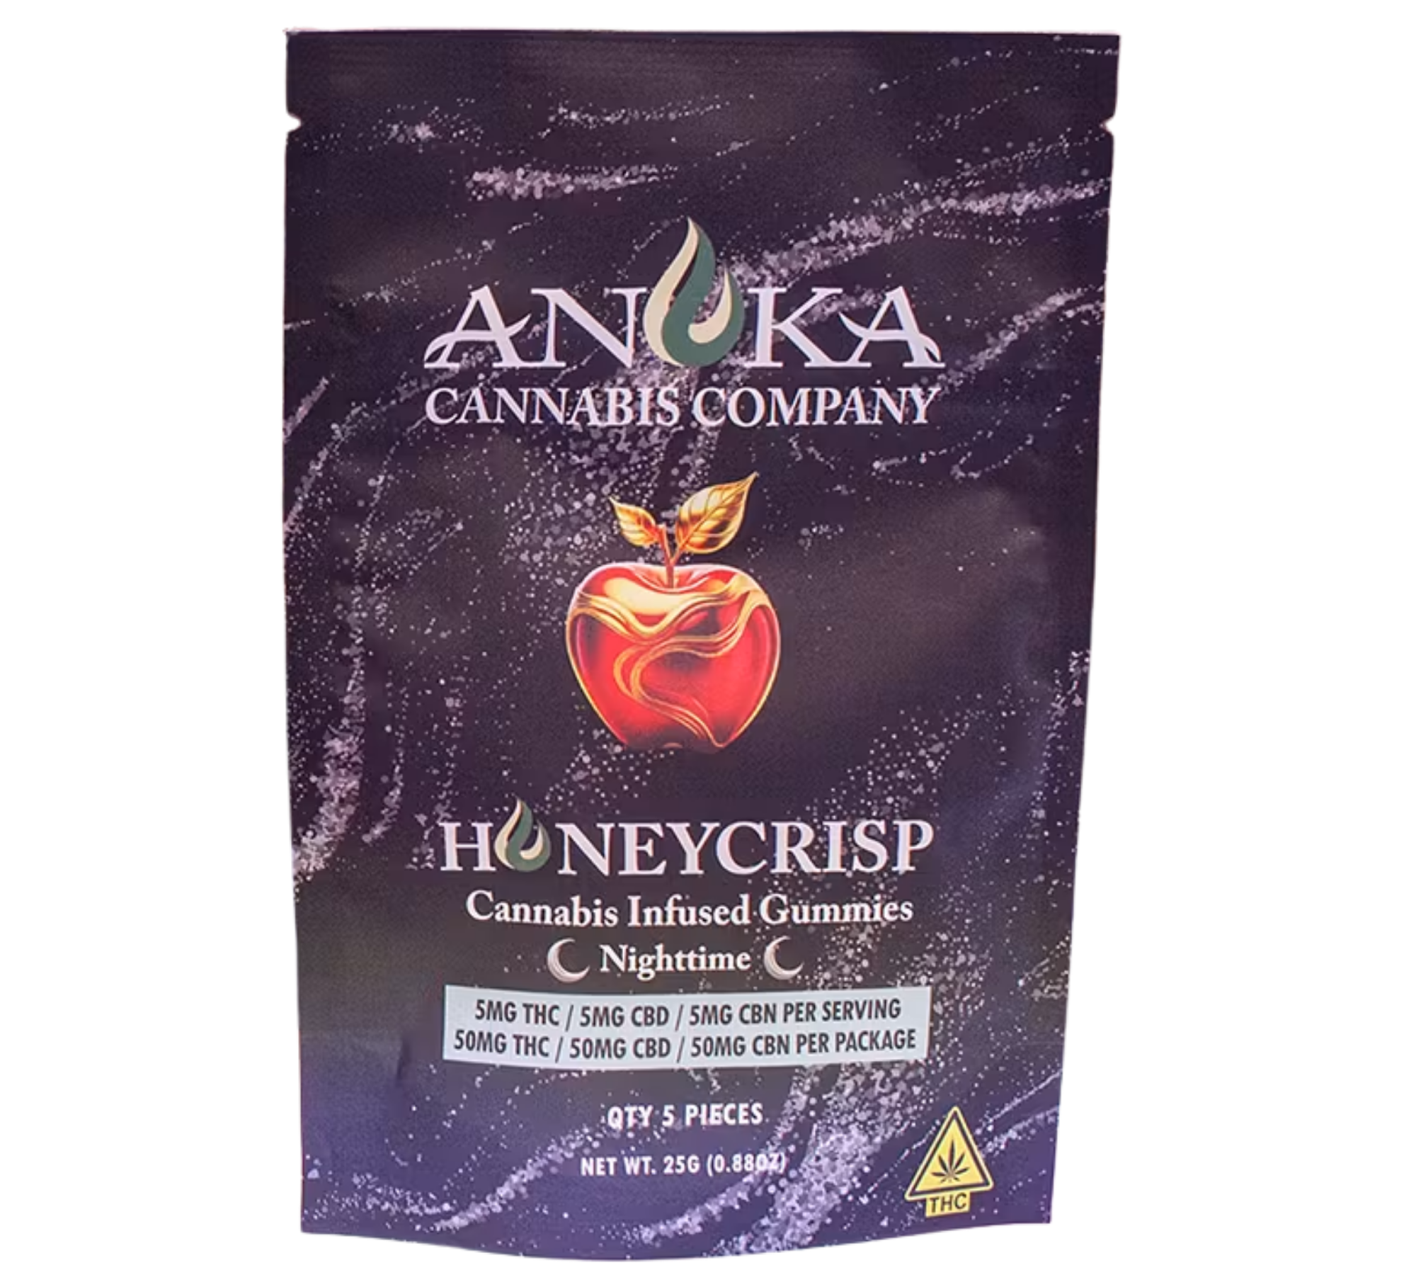
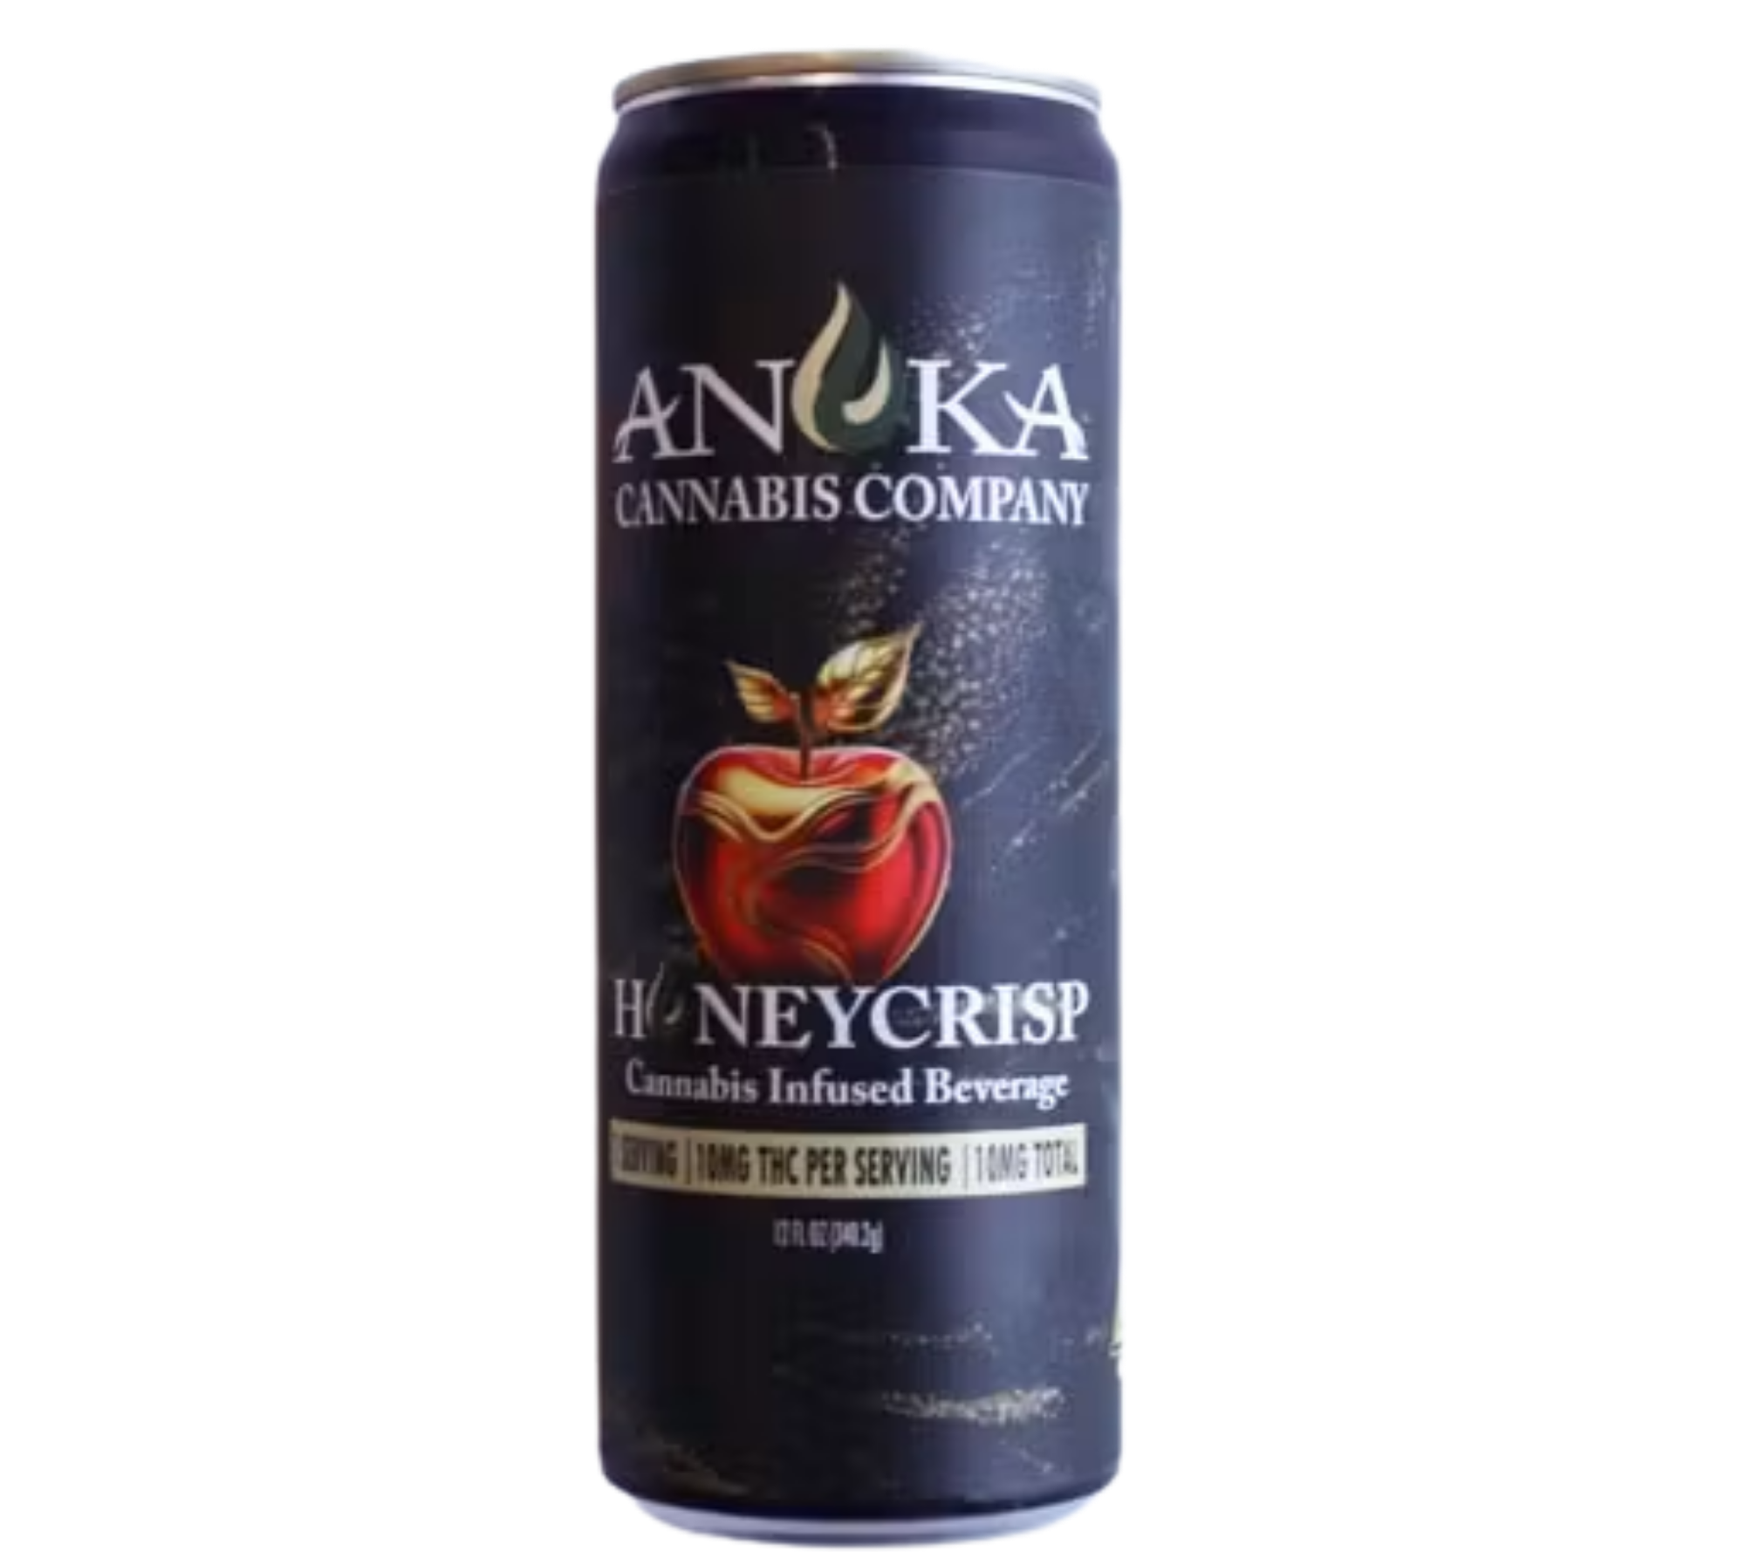
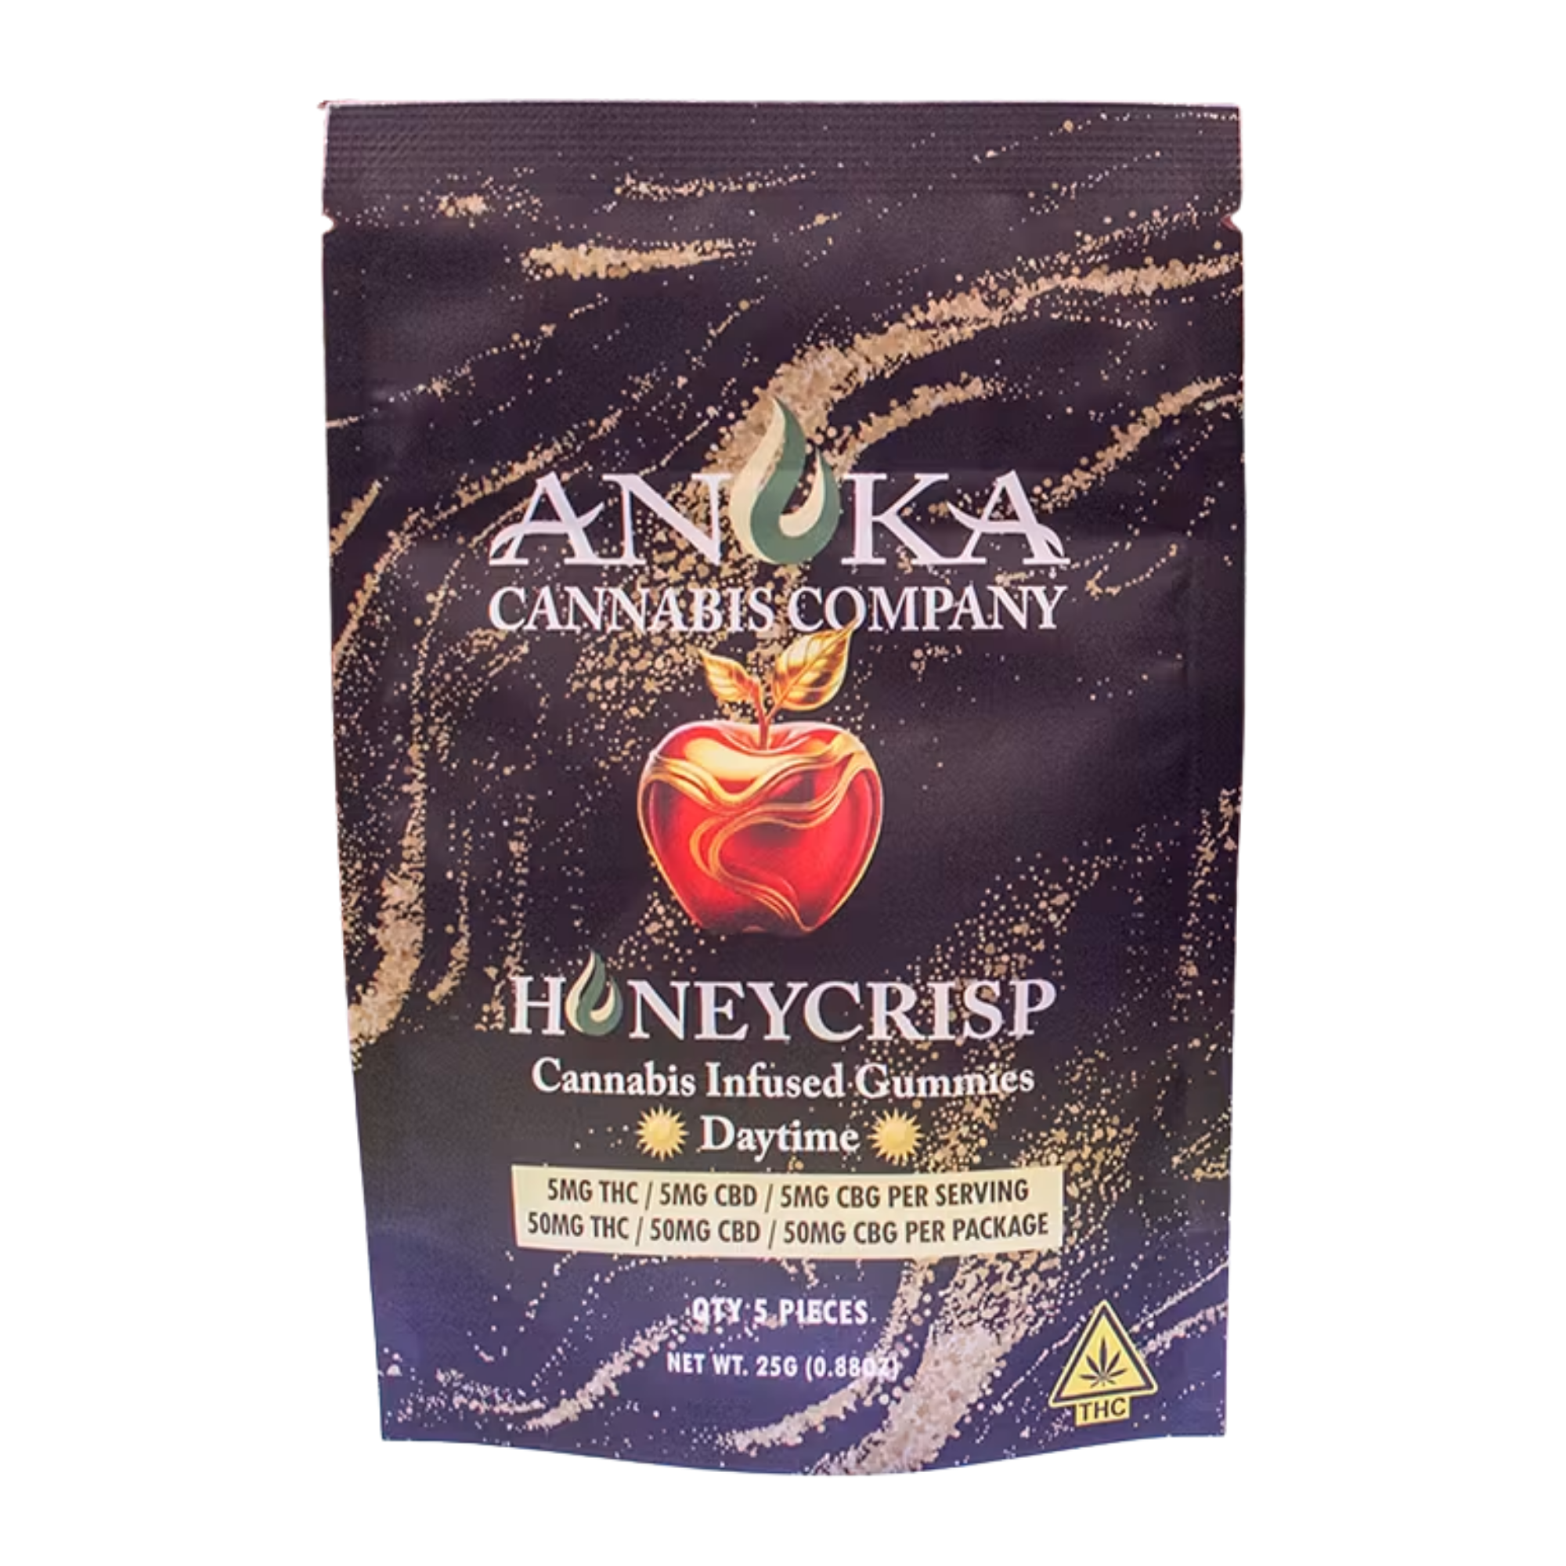
Anoka’s Private Label Gummies
Anoka’s Private Label Beverages
Cost $2.60 each
Retail $12.19 plus tax ($15)
Sell approx. 190/mo ($1,800 profit/mo $29,000 profit/yr)
Cost $6.60 each
Retail $16.26 plus tax ($20)
Sell approx. 240/mo ($2,300 profit/mo $28,000 profit/yr)
Notes:
We had a great time creating our private label. First we had to decide on a flavor it was between Rum Punch for Rum River that runs through the city or Honeycrisp for fall and since Anoka is the Halloween Capital it seemed fitting. Honeycrisp was a clear winner, we couldn’t get the rum flavor right over several taste testing’s . created Daytime and Nightime gummies and a Honeycrisp drink flavor

Slide 10
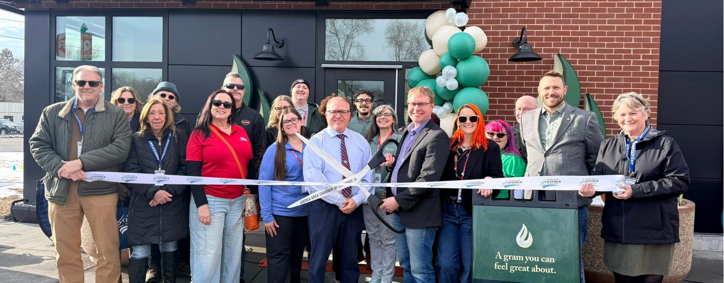
RIBBON CUTTING CEREMONY
February 5th 2026

Slide 11
FINANCIAL SUMMARY
ANOKA CANNABIS COMPANY
February - July 2026
6 Months
REVENUE:
 | Sales | $ 2,649,673
 | Interest | 1,765
 | ATM Revenue | 19,810
 |  | $ 2,671,248
COST OF GOODS SOLD:
 | Product | $ 1,402,420 | 53%
 | Loyalty Redemption | 120,606 | 5%
 | Sales Tax | 486,755 | 18%
 |  | $ 2,009,781
GROSS PROFIT: |  | $ 661,467
OTHER EXPENSES |  | $ 457,426 | 17%
NET PROFIT: |  | $ 204,041 | 8%
2027 Budget includes a transfer from the Cannabis Fund to the General fund in the amount of $243,000
That Transfer:
- Will reduced the levy increase from 4.9% down to 2.9% for 2027.
- The transfer will cover the cost of an embedded social worker for our police department.

Slide 12
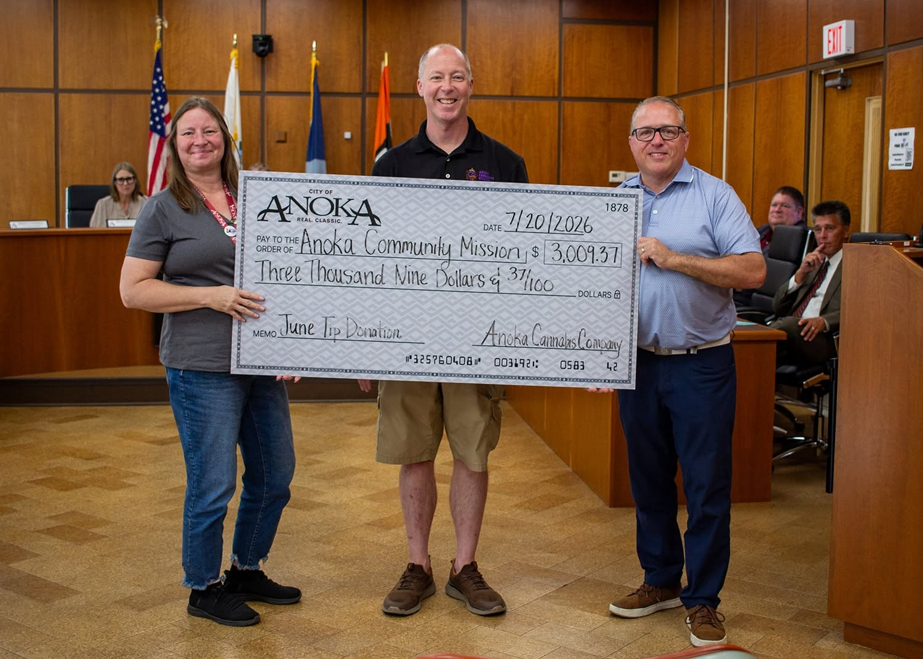
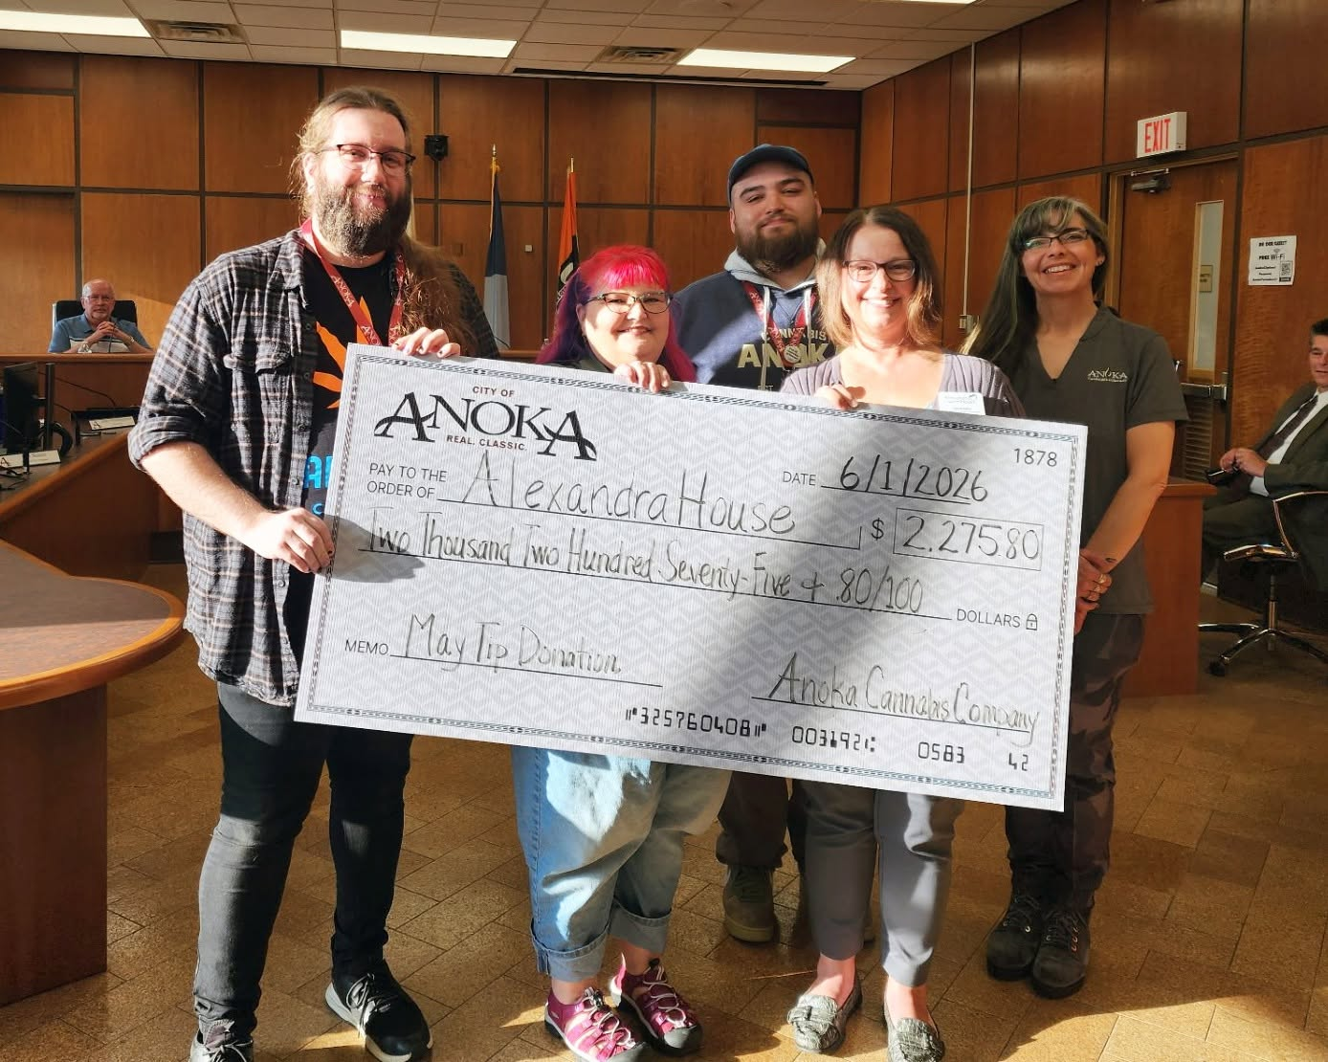
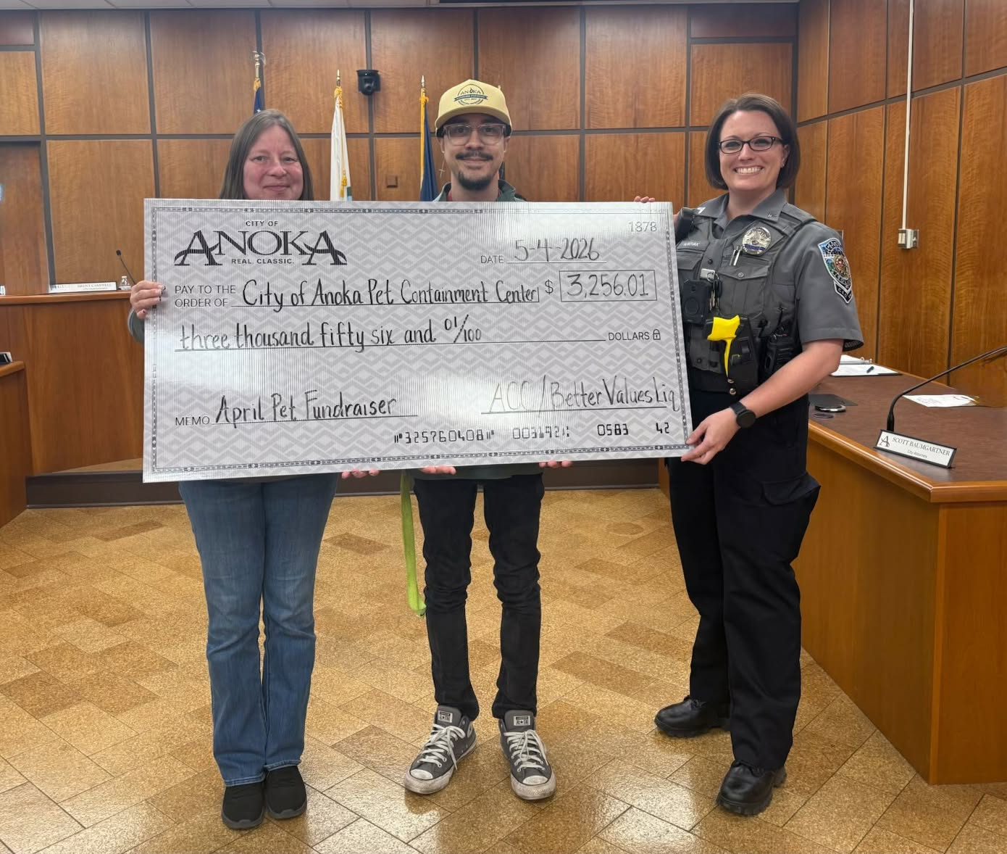
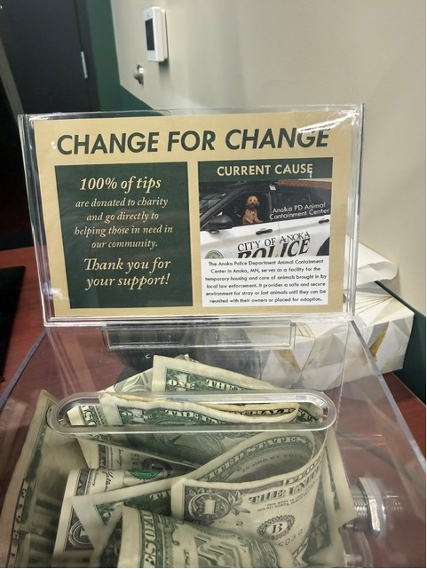
UNEXPECTED REVENUE SUPRISES
Over $18,500 donated as of August 31st 2026
A core value of Anoka Cannabis Company is putting community first. One meaningful way we live out that value is through the tip donations generated by our dedicated Budtenders and the generosity of our Guests. Because we are city‑owned, state law prohibits Budtenders from accepting personal tips—a common practice in the cannabis industry. In response, our staff chose to donate all collected tips to nonprofit organizations serving Anoka and Anoka County.
Notes:
ACBC Food Shelf
Anoka PD Animal Containment facility
Alexandra House
Anoka Community Mission
Operation Green Healing
Firefighters – Bounce house
Has been donated to so far.
We are on pace to collect OVER $29,000 in tip donations in 11 months.
In a cash only business… Anoka brings in over $3,000 per month in ATM fees. We split the service charge with the ATM owner. We are on pace to bring in $40k a year

Slide 13
What’s Next?
During the 2026 legislative session, the Minnesota Legislature amended Minn. Stat. § 342.22, subd. 2, removing the previous limit on the number of cannabis retail establishments a municipality may operate. Under this updated law, cities may now open and operate multiple municipal cannabis dispensaries.
At the March 2026 work session, the Anoka City Council directed staff to explore partnership opportunities with cities that may be uncertain about entering the adult-use cannabis retail market independently or through a private operator.
If your city is interested and can provide or lease space, the City of Anoka is prepared to bring its expertise, operational experience, established Anoka Cannabis Company brand, and trained staff to operate a location within your community. Under this partnership model, net revenue would be shared between our cities, and all charitable donations generated through Anoka Cannabis Company operations within your community would remain local, supporting your nonprofit organizations.
We welcome the opportunity to host tours of Anoka Cannabis Company for elected officials and city staff who wish to learn more about our operations. Enterprise Operations Director Kevin Morelli is also available to participate in work sessions or City Council meetings to provide information and answer questions.
Joint Powers Agreements have a long and successful history in Minnesota municipal government, supporting shared services such as fire protection, public safety, and information technology. As adult-use cannabis is a new and evolving area, the City of Anoka—already a leader in this field—is eager to partner with communities interested in exploring this opportunity collaboratively.

Slide 14

Any Questions?

