Slide 1
Osseo Cannabis
Shane Mikkelson
Police Chief/City Administrator
MN GFOA Conference

Slide 2
Osseo Cannabis
Osseo is 2,800 residents with 1.2 square miles
  4,000,000-dollar budget
Municipal Cannabis started in 2023 before we could get a license

Slide 3
Osseo Cannabis
In April, 2024 I took over as the City Administrator/Police Chief
February 2025 advised by council to move forward with Cannabis.

Slide 4
Osseo Cannabis
April 2025 applied for a license
June 2025 received our preliminary license
November signed contract with Voyageur Cannabis for management services of the store
December 2025 chose location at old Osseo Press building

Slide 5
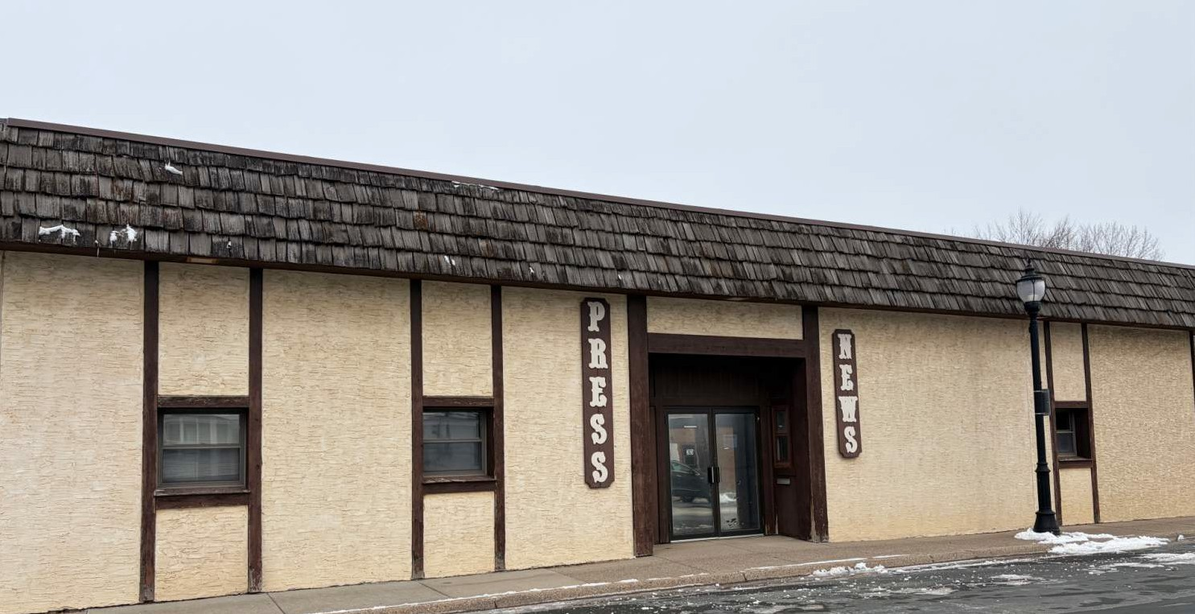
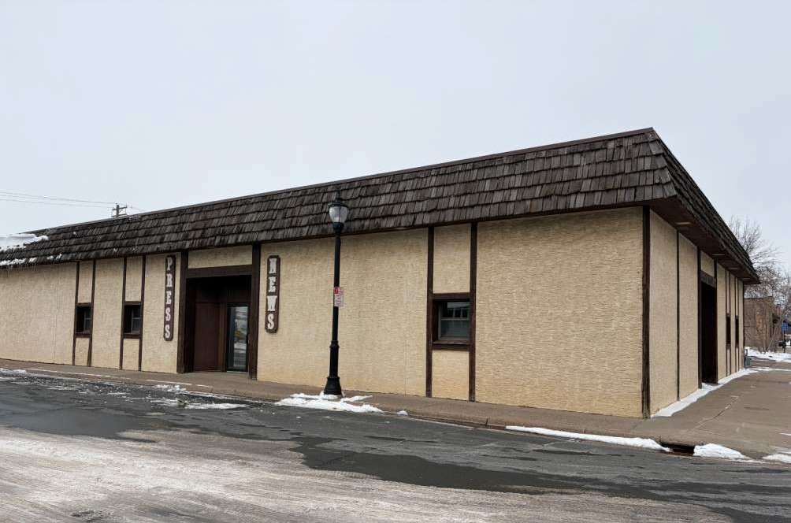
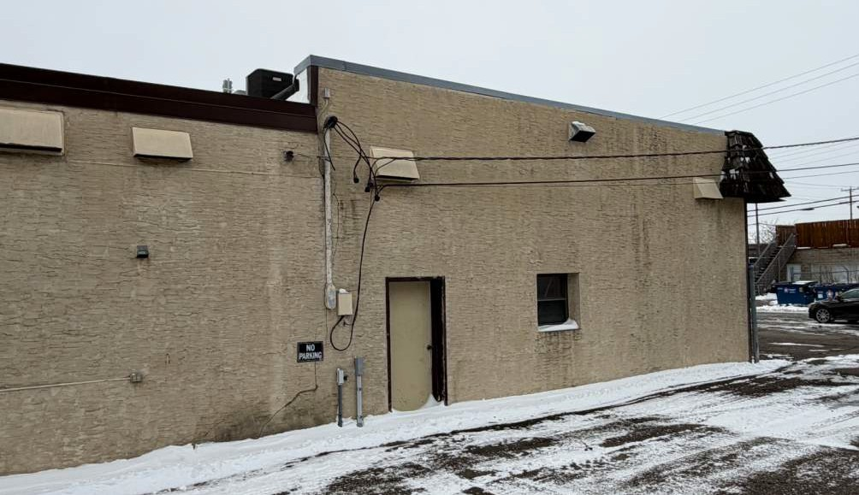
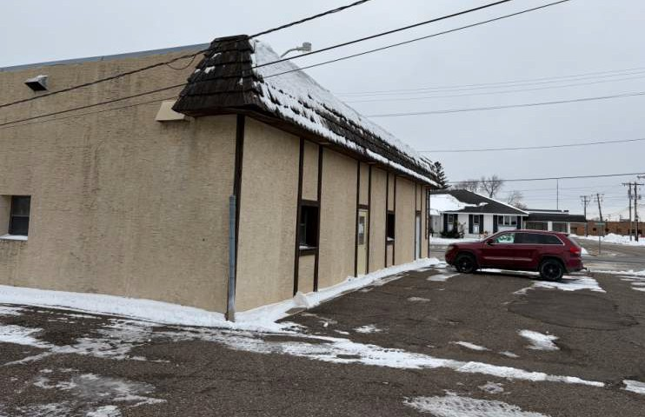
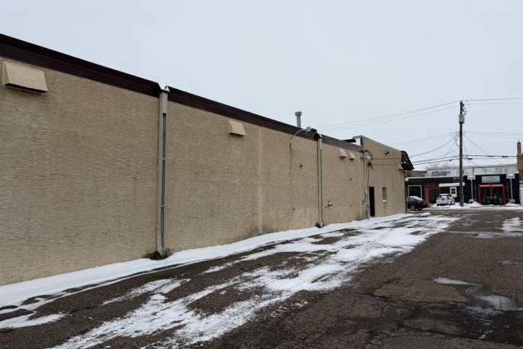

Existing Concept Images Page 04

Slide 6
Osseo Cannabis
February 2026 signed contract with 45North for project management services.
Advised by council that they wanted to open in November 2026.
Started purchasing Security/IT/Fire and demo for building in March 2026

Slide 7
Osseo Cannabis
Then we ran into issues in May 2026
  Started talking about bonding
    We went high at 4,000,000 estimate
    Tax abatement bonding
    Settled at 2,650,000 bond
  Residents started to take notice
  Started to get push back

Slide 8
Osseo Cannabis
End of June we announced we would be having a public hearing on the bonds
Early July council decided to have a public listening session
July council pushes bonding question for more information.

Slide 9
Osseo Cannabis
End of July awarded tax abatement bonding through Park State Bank.
  Ended at 2,650,000 bond. 350,000 per year payment.
Also awarded GCM Construction the general contractor.
We just started construction end of August.

Slide 10
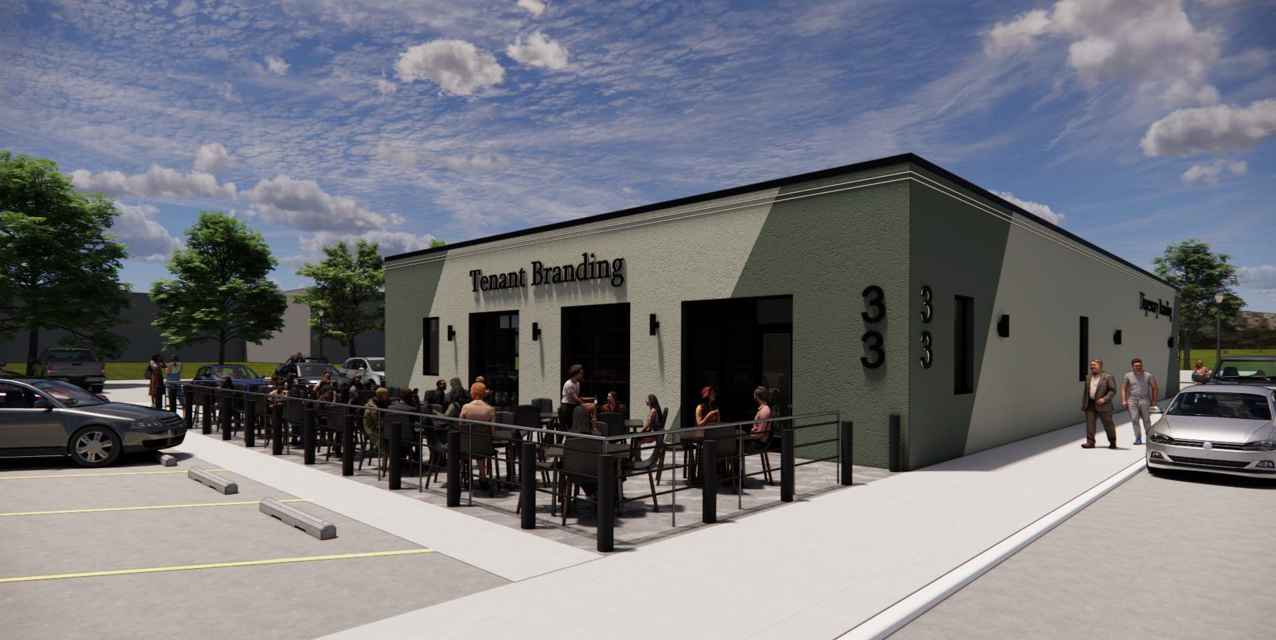
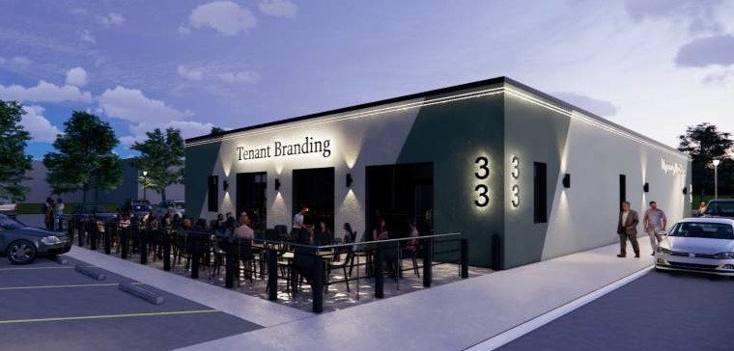

Slide 11
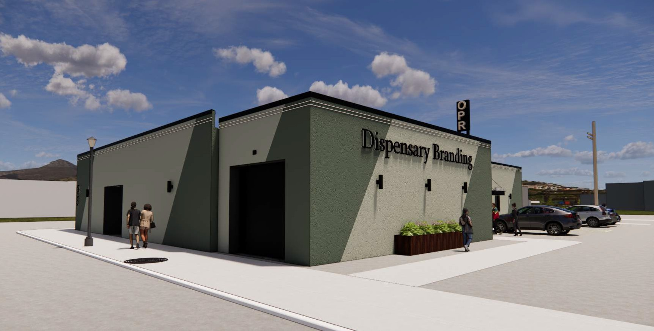
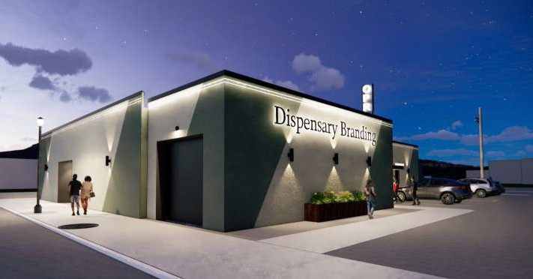

Slide 12
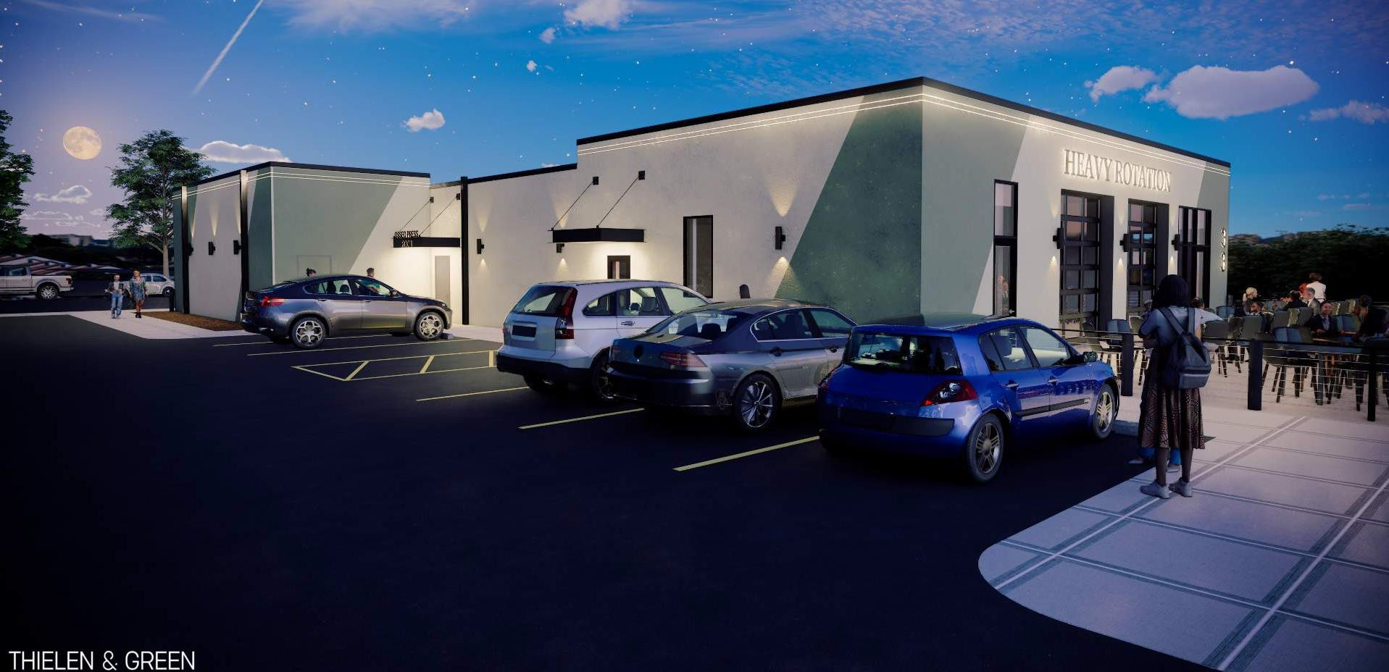









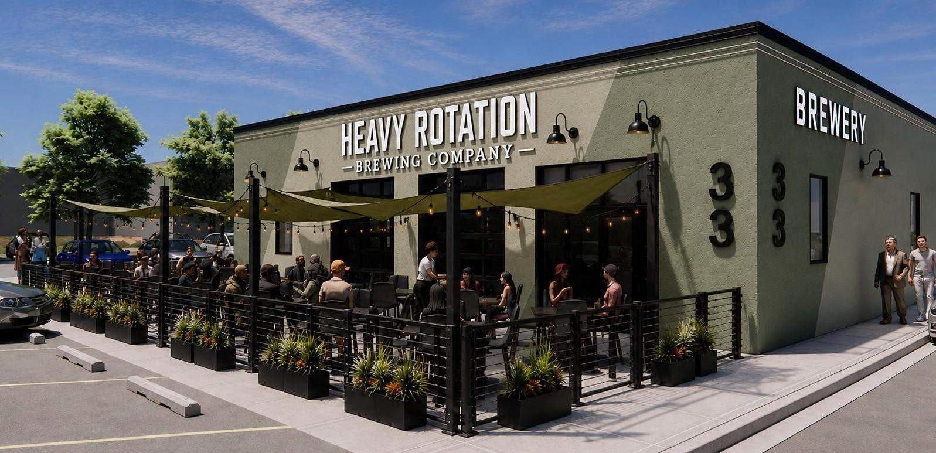

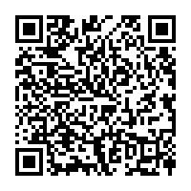
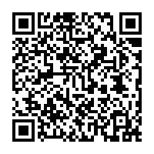
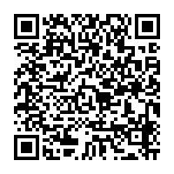
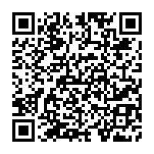
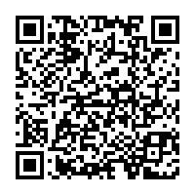


SCAN US!
OPENING LATE 2026

Slide 13
Osseo Cannabis
Lessons learned
    Short time fame is difficult
      A lot for residents
      Expectations of residents today is different
    You may think you know your elected officials
    Communication is key.
    Front end work helps everyone in the end
    Sometimes you have nothing to say

Slide 14
Questions?
Shane Mikkelson
City Administrator/Police Chief
smikkelson@osseomn.gov
763-269-2468

