Slide 1
GASB Update
MNGFOA Annual Conference
September 22, 2026
Andy Hering, CPA
Rebecca M. Petersen, CPA
Partner | ahering@redpathcpas.com
Managing Director | rpetersen@redpathcpas.com

Slide 2
Today’s Agenda
GASB 103 | Financial Reporting Model Improvements
Proposed Implementation Guide | Financial Reporting Model Improvements - Subsidies
GASB 104 | Disclosure of Certain Capital Assets
GASB 105 | Subsequent Events
GASB Projects | Current Projects and Pre-Agenda Research

Slide 3


GASB Statement No. 103
Financial Reporting Model Improvements
Effective for fiscal years beginning after 6/15/2025
2026 Calendar Year Ends

Slide 4
GASB 103 - Overview
GASB 103 intends to improve key components of the financial reporting model to enhance the effectiveness of the model and address certain application issues. Modifications to the following areas are included in the standard:
Presentation of the proprietary fund statement of revenues, expenses, and changes in net position
Unusual or infrequent items
MD&A
Information about major component units in basic financial statements
Budgetary comparison information
Financial trends in the statistical section

Slide 5

GASB 103 – MD&A
Management’s Discussion and Analysis - MD&A
  “The financial managers of governments are knowledgeable about the transactions and events that are reflected in the government’s financial report, the fiscal policies that govern its operations and decision making, and conditions that may have a significant effect on financial position or results of operations”

Slide 6
GASB 103 states that the MD&A should…
Provide an objective and easily readable analysis of the government’s financial activities based on currently known facts, decisions, or conditions
Notes:
the Board believes that an objective of MD&A is to communicate information to a broad range of users

Slide 7

GASB 103 states that the MD&A should…
Be written in a manner that can be understood by users who may not have a detailed knowledge of governmental accounting and financial reporting
Notes:
the Board believes that an objective of MD&A is to communicate information to a broad range of users

Slide 8
GASB 103 states that the MD&A should…
Include explanations and interpretations that help users understand the information provided

Slide 9
GASB 103 states that the MD&A should…
Avoid unnecessary duplication

Slide 10
GASB 103 states that the MD&A should…
Focus on the primary government

Slide 11

GASB 103 states that the MD&A should…
Include explanations that are most relevant to the current year and avoid boilerplate discussion

Slide 12

GASB 103 states that the MD&A should…
Be confined to the following sections:
Overview of the Financial Statements
Financial Summary
Detailed Analyses
Significant Capital Asset and Long-Term Financing Activity
Currently Known Facts, Decisions, or Conditions

Slide 13
GASB 103 – MD&A
1. Overview of the financial statements
The MD&A should include an overview of the basic financial statements, including the relationships of the statements to each other. The overview should focus on the significant differences in the types of information the financial statements provide.
What does the GFOA Certificate of Achievement Checklist say?
This description should either focus on how fund financial statements reinforce information in the government-wide financial statements (e.g., proprietary fund financial statements) or provide additional information (e.g., governmental fund financial statements and fiduciary fund financial statements). In particular, it should describe the relationship between the governmental fund financial statements and the data reported for governmental activities in the government-wide financial statements.
https://gfoa-craftcms.files.svdcdn.com/production/pdfs/COA-Checklist-032625.pdf

Slide 14
GASB 103 – MD&A
2. Financial Summary
Condensed financial information derived from the government-wide financial statements comparing the current year to the prior year for both governmental activities and business-type activities.
Seventeen specific items that should be included in the summary:

Slide 15
GASB 103 – MD&A
2. Financial Summary
Condensed financial information derived from the government-wide financial statements comparing the current year to the prior year for both governmental activities and business-type activities.
What does the GFOA Certificate of Achievement Checklist say?
The GFOA is looking for condensed financial data that is extracted directly from the government-wide statements. The COA checklist includes the same list of 17 specific items that should be included within the condensed data (if applicable).
https://gfoa-craftcms.files.svdcdn.com/production/pdfs/COA-Checklist-032625.pdf

Slide 16
GASB 103 – MD&A
3. Detailed analyses
Analysis of the primary government’s financial position and results of operations, including both government-wide results and each major fund. (yes, paragraph 8.c.(2) of GASB 103 requires an analysis of each major fund)
What does the GFOA Certificate of Achievement Checklist say?
The MD&A should avoid unnecessary duplication. Rather than repeating information and analysis used in one section of the MD&A that is applicable to a different section, governments can simply reference the original discussion of the item.
The GFOA will be looking for the “why” behind changes, along with identification of the magnitude of identified changes (% and $)

Slide 17
GASB 103 – MD&A
4. Significant Capital Asset and Long-Term Financing Activity
Description of significant capital asset and long-term financing activity during the year.
What does the GFOA Certificate of Achievement Checklist say?
The GFOA COA checklist asks about the same items identified in GASB 103. Specific items asked about within the checklist include:
Significant additions and disposals of capital assets
Changes in capital asset policies, commitments and economic factors
A description of the types of long-term liabilities in the current year
Inclusion of GASBs 87, 94, 96 related liabilities, changes in credit ratings and debt limitations
https://gfoa-craftcms.files.svdcdn.com/production/pdfs/COA-Checklist-032625.pdf

Slide 18
GASB 103 – MD&A
5. Currently Known Facts, Decisions, or Conditions
A description of currently known facts, decisions, or conditions that are expected to have a significant effect on financial position or that are expected to produce significant differences from current-period results of operations.
Examples of the types of information that should be included:
Trends in relevant economic and demographic data
Relevant factors used to develop the subsequent year’s budget
Expected changes in budgetary net position or fund balance
Actions that the government has taken related to various long-term liabilities and financing
Actions that other parties have taken that will affect the government in a subsequent period

Slide 19
GASB 103 – MD&A
5. Currently Known Facts, Decisions, or Conditions
What does the GFOA Certificate of Achievement Checklist say?
Examples of items to describe include:
trends in economic and demographic data
factors used to develop the subsequent year's budget
expected changes in budgetary fund balance or net position
actions taken related to postemployment benefits
capital asset improvements
lease/SBITA/PPP liabilities and
actions taken by others (such as legislatures) that will affect subsequent year
https://gfoa-craftcms.files.svdcdn.com/production/pdfs/COA-Checklist-032625.pdf

Slide 20
GASB 103 – MD&A
Management’s Discussion and Analysis - MD&A
  Any questions on the MD&A?

Slide 21
GASB 103 – Unusual or Infrequent Items
Unusual or Infrequent Items
“…transactions and other events that are unusual in nature or infrequent in occurrence.”
these replace special and extraordinary items
Considerations for Unusual or Infrequent Items
Items that are unusual in nature should possess a high degree of abnormality
Items that are unusual in nature should not be related to the ordinary activities of the government
An item is infrequent in occurrence if it would not reasonably be expected to recur in the foreseeable future
Present each item as the last flow of resources before the net change in fund balance/net position
Footnote disclosure required

Slide 22
GASB 103 – Major Component Units
Information about Major Component Units in Basic Financial Statements
Governments should present each major component unit separately in the statements of net position and activities if it does not reduce the readability of the financial statements.
Considerations for Financial Statement Presentation
If readability is impacted by presenting each component unit separately, then a combining statement of major component units should be included in the basic financial statements
The determination of a major component unit should be based on the nature and significance of its relationship to the primary government

Slide 23
GASB 103 – Major Component Units
Determination of Major Component Units
Guidance for determining major component units is provided in GASB codification – 2600.108
Factors to consider in identifying major component units
If the services provided by the component unit to the citizenry are such that reporting as a major component unit is essential to financial statement users
If there are significant transactions with the primary government
If there is a significant financial benefit or burden relationship with the primary government

Slide 24
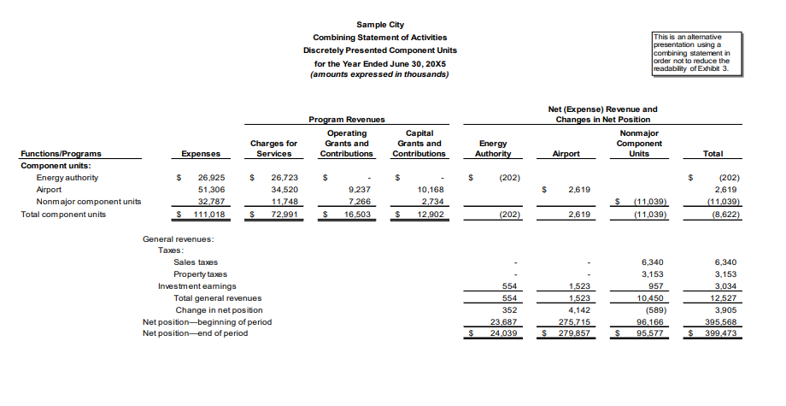
GASB 103 – Major Component Units
Illustrative example of a combining statement
This combining statement would be presented after basic fund financial statements. The total column should tie to the DPCU column on the face of the statement of activities.

Slide 25
GASB 103 – Budgetary Comparison Information
Presentation of Budgetary Comparison Information
Present as RSI for the general fund and each major special revenue fund with a legally adopted budget
Presentation as a basic financial statement is no longer allowed

Slide 26


GASB 103 – Budgetary Comparison Information
Separate columns should be reported for:
Original Budget
Final Budget
Variance between Original and Final Budgets
Actual Amounts
Variance between Final Budget and Actual
An explanation of significant budget variances is required to be presented in the notes to RSI

Slide 27
GASB 103 – Budgetary Comparison Information
Presentation of Budgetary Comparison Information
Present as RSI for the general fund and each major special revenue fund with a legally adopted budget
What does the GFOA Certificate of Achievement Checklist say?
“If there have been no amendments to the budget during the year, has the government presented only one budget column labeled “original and final budget”?”
https://gfoa-craftcms.files.svdcdn.com/production/pdfs/COA-Checklist-032625.pdf

Slide 28
GASB 103 – Proprietary Statement Presentation
Presentation of Proprietary Fund Statement of Revenues, Expenses, and Changes in Fund Net Position
This statement should distinguish between operating and nonoperating revenues and expenses as well as separately report noncapital subsidies (which is a type of nonoperating revenue and expense)

Slide 29
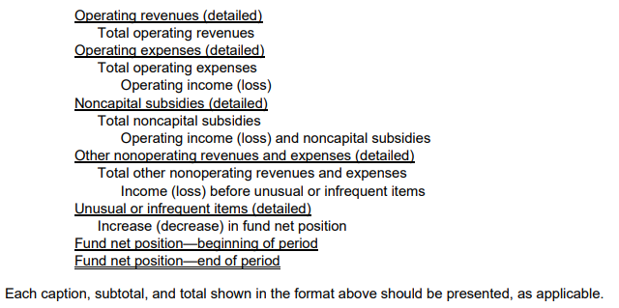
GASB 103 – Proprietary Statement Presentation
Presentation of Proprietary Fund Statement of Revenues, Expenses, and Changes in Fund Net Position

Slide 30
GASB 103 – Proprietary Statement Presentation
Presentation of Proprietary Fund Statement of Revenues, Expenses, and Changes in Fund Net Position
Operating Revenues and Expenses
Operating revenues and expenses are revenues and expenses other than nonoperating revenues and expenses
The nature of operating revenues and expenses may vary based on the nature of the fund – for example, interest revenues would generally be nonoperating, unless the fund’s principal ongoing operations involved making loans to homeowners

Slide 31



GASB 103 – Proprietary Statement Presentation
Presentation of Proprietary Fund Statement of Revenues, Expenses, and Changes in Fund Net Position
Nonoperating Revenues and Expenses are:
Contributions to permanent and term endowments
Revenues and expenses related to financing
Resources from the disposal of capital assets and inventory
Investment income and expenses
Subsidies received and provided

Slide 32
GASB 103 – Proprietary Statement Presentation
Subsidies are:
Resources received from another party or fund, for which the proprietary fund does not provide goods or services and that directly or indirectly keep the proprietary fund’s current or future fees/charges lower than they would be otherwise
Resources provided to another party or fund, for which the proprietary fund does not receive goods or services and that are recoverable through the proprietary fund’s current or future pricing policies
All other transfers

Slide 33
GASB 103 – Proprietary Statement Presentation
Various inflows and outflows – subsidies or not?

Slide 34
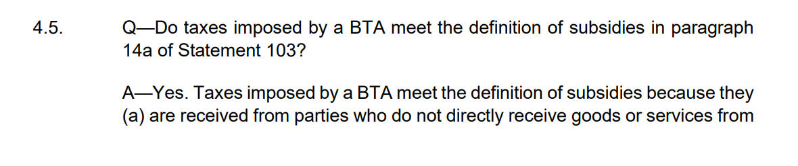
Proposed Implementation Guide
PROPOSED Guidance on Subsidies

Slide 35
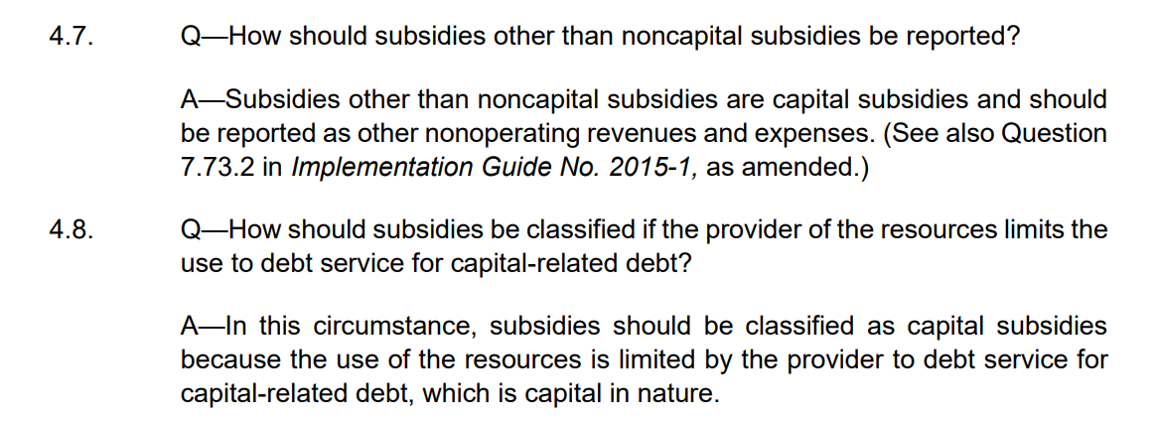
Proposed Implementation Guide
PROPOSED Guidance on Subsidies

Slide 36
GASB 103 – Financial Trends
Financial Trends in the statistical section
Information about changes in net position
For governments engaged only in business-type activities (or only in business-type and fiduciary activities), the financial trend information presented should include revenues by major source, distinguishing between:
  Operating
  Noncapital subsidy
  Nonoperating revenues and expenses

Slide 37
GASB Statement No. 104
Disclosure of Certain
Capital Assets
Effective for fiscal years beginning after 6/15/2025
2026 Calendar Year Ends

Slide 38
GASB 104 – Disclosure of Certain Capital Assets
Objective
To provide users of government financial statements with essential information about certain types of capital assets.
Scope
The statement establishes requirements related to:
Separate disclosure of certain capital assets
Capital assets held for sale

Slide 39
GASB 104 – Disclosure of Certain Capital Assets
Separate Disclosure of Certain Capital Assets
The following should be disclosed – by major asset class – on separate line items within the capital asset footnote:
Lease assets (GASB 87)
Intangible right-to-use assets (GASB 94)
Subscription assets (GASB 96)
Other intangible assets such as easements and software

Slide 40
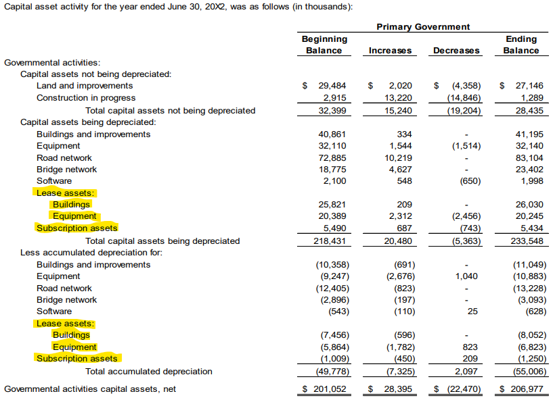
GASB 104 – Disclosure of Certain Capital Assets

Slide 41
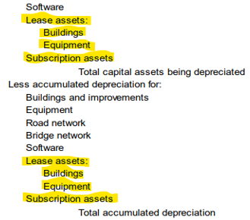
GASB 104 – Disclosure of Certain Capital Assets

Slide 42

GASB 104 – Disclosure of Certain Capital Assets
Footnote disclosures relating to capital assets held for sale
A government should disclose capital assets held for sale – by major asset class – in the notes to the financial statements
Disclosures should include:
Historical cost
Accumulated depreciation
A government should disclose the carrying amount of debt for which capital assets held for sale are pledged as collateral
Disclosures should be made for both governmental activities and business-type activities

Slide 43
GASB 104 – Disclosure of Certain Capital Assets
Capital Assets Held for Sale
A capital asset is a capital asset held for sale if:
The government has decided to pursue the sale of the asset
AND
It is probable that the sale will be finalized within one year of the financial statement date

Slide 44

Capital Assets Held for Sale
Whether the asset is available for immediate sale in its present condition
Market conditions for selling that type of asset
Whether an active program to locate a buyer has been initiated, which may include the asset being put out for bid
Regulatory approvals needed to sell the asset
Factors to consider in determining the probability of sale within one year of the financial statement date

Slide 45
GASB 104 – Disclosure of Certain Capital Assets
Capital Assets Held for Sale
A capital asset held for sale should continue to be reported within the appropriate major class of capital asset
Each reporting period, an entity should evaluate whether a capital asset is a capital asset held for sale

Slide 46
GASB 104 – Disclosure of Certain Capital Assets
Capital Assets Held for Sale
CONSIDER MATERIALITY!
Paragraph B32: “The Board understands that it sometimes may be difficult for governments to identify equipment that meets the criteria to be a capital asset held for sale; however, the Board believes that in those circumstances, the materiality threshold often will be sufficiently high such that the government would not need to go through the process of identifying them.”
Surplus property may not be material, depending on the government’s specific facts and circumstances

Slide 47
GASB 104 – Disclosure of Certain Capital Assets
Capital Assets Held for Sale
Sample Disclosure
Included in capital assets are buildings that are capital assets held for sale. Those buildings are reported in governmental activities. They have a total historical cost of $8.0 million and an accumulated depreciation of $5.0 million, and they are pledged as collateral for debt with a balance of $1.5 million.
Include a disclosure that the Statement was implemented and any financial statement line items that were affected.

Slide 48
GASB Statement No. 105
Subsequent Events
Effective for fiscal years beginning after 6/15/2026
2027 Calendar Year Ends

Slide 49
GASB 105 – Subsequent Events
Objective
To improve the financial reporting requirements for subsequent events.
Scope
The statement:
Defines subsequent events
Establishes accounting and financial reporting requirements related to subsequent events
GASB 105 supersedes paragraphs 8 – 15 of GASB 56

Slide 50
GASB 105 – Subsequent Events
Definition
Subsequent events are transactions or other events that occur:
after the date of the financial statements but
before the date the financial statements are available to be issued
Date of the financial statements
Subsequent Events
Date the financial statements are available to be issued. May be the same date as the auditor’s report.
The date the financial statements are available to be issued is the date:
The financial statements are complete in a form and format that complies with GAAP and
Approvals necessary for issuance have been obtained

Slide 51
GASB 105 – Subsequent Events
Recognized and Nonrecognized Events
A recognized event is a subsequent event that provides evidence about conditions that existed at year-end.
The effects related to recognized events should be incorporated into amounts reported as of the financial statement date
Recognized events should not be disclosed as subsequent events

Slide 52
GASB 105 – Subsequent Events
Recognized and Nonrecognized Events
The effects related to nonrecognized events should not be incorporated into amounts reported as of the financial statement date
Nonrecognized events should be disclosed as subsequent events
(if they meet the definition on the next slide)
Nonrecognized events are subsequent events that do not provide evidence about conditions that existed at year-end.

Slide 53
GASB 105 – Subsequent Events
Recognized and Nonrecognized Events
A nonrecognized event is a subsequent event that results in a significant effect (favorable or unfavorable) and is one of the following:
A debt-related transaction
A government combination or a disposal of operations
A change to the legally separate entities that compose the financial reporting entity
A transaction or other event that is essential to a user’s analysis for making decisions or assessing accountability

Slide 54
GASB 105 – Subsequent Events
Recognized and Nonrecognized Events - Examples
In November, it became known that a major utility customer was in financial trouble and was behind on its payments to ABC City
Based on this information, ABC City recorded a 25% allowance on the 12/31 balance
In April (before the audit was completed), ABC City learned the customer declared bankruptcy and would not be able to pay its bill.
Date of the financials 12/31
Delinquent customer declared bankruptcy prior to audit issuance
Recognized event ➔ adjust the 12/31 receivable amount; do not disclose as a subsequent event

Slide 55
GASB 105 – Subsequent Events
Recognized and Nonrecognized Events - Examples
In April (before the audit was completed), a major utility customer experienced a fire, was forced to shut down, and will not be able to pay its outstanding balance
Date of the financials 12/31
Utility customer otherwise in good standing is forced to close
Nonrecognized event ➔ do not adjust the 12/31 receivable amount; disclose as a subsequent event

Slide 56
GASB 105 – Subsequent Events
Disclosure Requirements
The following information should be disclosed about a nonrecognized event:
A description of the event and its effect
An estimate of the amount of the effect, or the reason why an estimate of the amount cannot be made
Information should be disclosed by reporting unit
Information that is the same for more than one reporting unit should be combined to avoid duplication

Slide 57
GASB 105 – Subsequent Events
Disclosure Requirements – FOR ALL ENTITIES
The date through which subsequent events have been evaluated should be disclosed in the notes regardless of whether recognized or nonrecognized events exist.
Example: Subsequent events have been evaluated for recognition or disclosure through May 15, 2027, the date the financial statements were available to be issued.

Slide 58
Current GASB Projects
Implementation Guidance Update – 2026
Infrastructure Assets
Going Concern Uncertainties and Severe Financial Stress
Revenue and Expense Recognition

Slide 59
Implementation Guidance Update - 2026
The 2026 update project focuses solely on issues related to subsidies as defined in GASB 103
Expected Issuance Date: 3rd Quarter 2026

Slide 60
Exposure Draft - Infrastructure Assets
Objective: to address the issue that the carrying amount of an infrastructure asset does not always reflect its condition
Exposure Draft issued March 2026
Public Comment Period Concluded June 26, 2026
Final Statement Anticipated March 2027
Effective for fiscal years beginning after June 15, 2028 (Calendar Year 2029)

Slide 61
Exposure Draft
Infrastructure Assets
Infrastructure assets are capital assets that are:
Part of a network of assets
Stationary in nature
Maintained or preserved for a significant number of years
Buildings that have a primary purpose that is integral to a network of infrastructure assets but are only an ancillary part of that network should be considered infrastructure assets

Slide 62
Exposure Draft
Infrastructure Assets
A network of infrastructure assets may consist of many components
A component is a separate, distinguishable part of an infrastructure asset that has a specific function in contributing to the service capacity of that asset
Example:
  Infrastructure Asset – Road
  Components – Roadbed, overlay, curb, and gutter

Slide 63
Exposure Draft
Infrastructure Assets
If a component of an infrastructure asset:
has a cost that is significant in relation to the total cost of the infrastructure asset and
the estimated useful life of that component is substantially different from the estimated useful life of the infrastructure asset, then
  the component should be considered a separate infrastructure asset in the determination of depreciation expense
Governments should perform a periodic review of the estimated useful lives and salvage values used in the measurement of depreciation expense

Slide 64
Exposure Draft
Infrastructure Assets
Governments that use the modified approach can continue to do so if the following requirements are met:
Maintain an up-to-date inventory of infrastructure assets
Perform condition assessments and summarize the results using a measurement scale
Estimate each year the annual amount to maintain and preserve infrastructure assets at a specified condition level
Maintain documentation demonstrating that the infrastructure assets are being preserved approximately at or above a specified condition level

Slide 65
Exposure Draft
Infrastructure Assets – Notes to the financial statements
Within the capital asset footnote, infrastructure assets should be divided by network of infrastructure assets
Governments with a policy for monitoring the maintenance and preservation of infrastructure assets should briefly describe that policy in the notes

Slide 66
Exposure Draft
Infrastructure Assets – Notes to the financial statements
For infrastructure assets that have exceeded 80% - 99% of their estimated useful life, disclose the following by network of infrastructure assets:
historical cost
accumulated depreciation
historical cost weighted-average age
For infrastructure assets which have exceeded 100%...
historical cost
accumulated depreciation
historical cost weighted-average age

Slide 67
Preliminary Views
Going Concern Uncertainties and Severe Financial Stress
Objective: to address issues related to disclosures for going concern uncertainties and severe financial stress
Preliminary Views issued March 2025
Exposure Draft anticipated June 2027
Final Statement anticipated mid-2028

Slide 68
Preliminary Views
Going Concern Uncertainties and Severe Financial Stress
Current issue:
Going concern uncertainty is applied inconsistently among governments
Some governments experience severe financial stress but do not dissolve
Some governments dissolve for reasons other than severe financial distress

Slide 69
Preliminary Views
Going Concern Uncertainties and Severe Financial Stress
Severe Financial Stress
Developing a definition
  near or at the point of insolvency
Disclosure requirements
Probable Dissolution
Developing a definition
  if it is probable that a government will cease to exist as a legally separate entity within 12 months from the date the financial statements are available to be issued
Disclosure requirements

Slide 70
Preliminary Views
Revenue and Expense Recognition
Objective: to develop a comprehensive, principles-based model that establishes guidance applicable to a wide range of revenue and expense transactions
Pre-Agenda research started September 2015
Preliminary Views issued June 2020
Exposure Draft (2 parts) mid-2027 and mid-2028
Final Statement anticipated 2030 or 2031

Slide 71
Preliminary Views
Revenue and Expense Recognition
Achieving the objective will include:
Development of guidance applicable to topics for which existing guidance is limited
Improvement of existing guidance that has been identified as challenging to apply
Consideration of a performance obligation approach to GASB’s authoritative literature
Assessment of existing and proposed guidance based on the conceptual framework

Slide 72
Pre-Agenda Research
The following items are currently being considered by GASB as potential future projects
Digital Assets
Financial Reporting Entity Improvements
GAAP Structure
Pension and OPEB Disclosures
Pension and OPEB – effects of deferred outflows and inflows on expense
Revenue and Expense Recognition – note disclosures

Slide 73
Questions?
Andy Hering, CPA
Partner
ahering@redpathcpas.com
Rebecca M. Petersen, CPA
Managing Director
rpetersen@redpathcpas.com

