Slide 1
Fundamentals of Collective Bargaining & Union Negotiations
The Role of the Finance Officer
Minnesota GFOA Conference (2026)
September 22, 2026
Presented by PFM Group Consulting, LLC

Slide 2
Table of Contents
Basics of Bargaining & Impasse Resolution
Role of the Finance Officer
Presenting the Case in Arbitration
Parting Thoughts

Slide 3
The Basics of Bargaining & Impasse Resolution

Slide 4
Three Models of Bargaining
Least Restrictive
Most Restrictive
Bargaining Not Required
Meet and Confer
Binding Interest Arbitration
State law prohibits collective bargaining
Employees have right to organize
Employers obligated to “meet and confer” with union – may unilaterally impose terms of an agreement
Third-party neutral arbitrator determines a final and binding resolution
Employer must implement terms awarded by arbitrator

Slide 5
Key Actors in the Bargaining Process
Management Team
Chief Negotiator/Legal Counsel – leads management team, could be a labor attorney (in-house or external), HR director, or outside consultant
Department Heads – evaluate operational impacts of proposals (including HR director)
Finance Officer – determines available funds, performs costing; messages financial condition
Outside Consultants – comparability, costing, benefits, operations; may provide expert witness testimony
Union Team
Union President – leads union team, often in concert with senior union leadership
Union Counsel – often serves as union-side Chief Negotiator with Union President as client
Outside Consultants – may be independent HR consultants/economists, or from regional/international union
Neutral Third Parties (BMS)
Mediators – attempt to facilitate agreement; lack authority to impose terms on either party
Arbitrators – render interest arbitration awards (i.e., decisions) binding on both parties

Slide 6
Minnesota Bargaining – State Authorization
Collective bargaining in Minnesota is authorized through the Public Employment Labor Relations Act (PELRA), which establishes the following:
  Rules and procedures for bargaining
  Criteria for establishing bargaining units
  Procedures for election of exclusive representatives
  Mechanisms for resolving impasse in collective bargaining
PELRA also created the Bureau of Mediation Services (BMS). BMS is the State agency created to administer PELRA, with the following principal functions:
  Mediation
  Arbitration
  Bargaining unit determinations
  Bargaining unit election certification

Slide 7
Who Is Covered? Essential vs. Non-Essential Employees
“Essential” & “Non-Essential” Employees
ESSENTIAL EMPLOYEES
NON-ESSENTIAL EMPLOYEES
Firefighters
Peace Officers
Corrections/Jail Officers
911 dispatchers
Confidential and Supervisory Employees
Assistant County/City Attorneys
Principals/Assistant Principals
All other public employees not in the essential categories (e.g., most AFSCME, Teamster, and general government bargaining units)
Key Right: May Strike
After a collective bargaining agreement expires and following at least 45 days of BMS-facilitated mediation, non-essential employees may engage in a lawful strike
Parties may voluntarily opt-in to binding interest arbitration
Essential Employees: No Strike Right
May not strike; but have access to binding interest arbitration

Slide 8
Impasse Resolution Processes
Essential Employees
1
2
3
4
Good-Faith
Bargaining
BMS
Mediation
Interest
Arbitration
Arbitration
Award
Impasse Declared
Impasse Resolved
Non-Essential Employees
1
2
3
4
2
Good-Faith
Bargaining
BMS
Mediation
Strike/
Voluntary Arbitration
Settlement/
Arbitration Award
Impasse Declared
Impasse Resolved

Slide 9
Collective Bargaining Timeline
A Real-Life Example, Though Names Have Been Changed
“Springfield” has a rigid deadline for collective bargaining. The city statute calls for all bargaining (including issuance of an interest arbitration award, if necessary) to be completed by end of February for the FY beginning in July
Typically, preparations begin in August, with internal departmental meetings beginning shortly after Labor Day. Negotiations typically span the fall, with mediation and arbitration (when needed) happening January and early February
City Council reviews/approves agreements and/or arbitration awards in March and April
Fall
Jan/Feb
Mar/Apr
Bargaining
Mediation & Arbitration
Council Review/
Approval
Sept
April
Labor Costing
Comparability Analysis
Mediation
Support
Expert Witness Testimony

Slide 10
Bargaining Best Practices
From Perspective of the CFO
Start Early – consider starting preparations 12 months out from contract expiration
Assemble and Empower a Team – coordinate with chief negotiator, assign and meet with department liaisons; identify point person(s) for costing; communicate with outside consultants (if using them)
Generate “Wish Lists” – Charge department liaisons to identify contract language and clauses they want changed (e.g., scheduling, discipline, etc.). You may be able to “horse trade” in final stage of negotiations
Build Baseline Costing Models – the costing models for proposal exchange can and should be built before you go into bargaining
Multi-Year Projections – connect your costing models with existing multi-year projection models. A union claims they need large wage increase to remain competitive with the market? Load that scenario in your multi-year projections. Show the impact on the overall budget
Know the Market – do compensation benchmarking early in the negotiations process, not at the end while you are in impasse
Establish “the Number” – using baseline multi-year projections, what are the wage increases your community can “afford?” This figure can and will change but establish a target early – will be helpful to your chief negotiator
Communicate and be Transparent – communicate with your bargaining team. If funding is tight, let them know, explain the restraints, and if/when things change, communicate accordingly

Slide 11
The Role of the Finance Officer

Slide 12
Role of the Finance Officer
Agenda setting
  Establishing the importance of financial goals relative to other issues
  Financial goal development
    The short-term “number”
    The longer-term framework for fiscal stewardship (e.g., ensuring long-term fiscal impacts of any retirement enhancement are considered, and not ignored as an issue for the “next generation”)
Expectations management through effective financial communications to non-financial audiences
  To quote Mick Jagger, “You can’t always get what you want”
  But ideally, each party will get “what they need”
  Toward this end, transparent and clear communications around financial issues is critical
Scenario costing for reliable budget outcomes

Slide 13
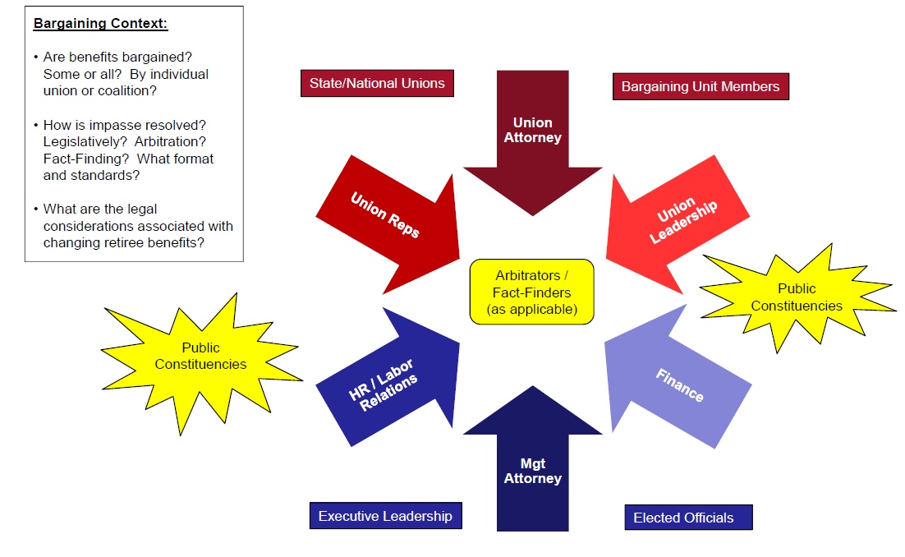
Parties at (and Around) the Bargaining “Table”

Slide 14
Consider “State of the Finances” at the Onset of Bargaining
Some of our clients provide a “State of the Finances” or “Financial Condition” presentation at the onset of bargaining
  Presented to all unions
  May not be applicable or universally appropriate, depends on labor-management dynamics in each community
Such presentations, however, allow management to frame the budget narrative early in the negotiation process
Helps to set expectations with union leadership and rank-and-file membership
General Fund Forecast

Slide 15
Labor Costing Model Architecture and Design
Baseline
Scenario
Assumptions
(Based on User’s Inputs)
Assumptions
(Based on User’s Inputs)
Calculation Module
(Calculated based on employees’ department and labor group and the baseline assumptions)
Calculation Module
(Calculated based on employees’ department and labor group and the scenario assumptions)
Baseline summary
(Projected spending by the type of compensation and benefits as well as by fund, department, and labor group)
Scenario summary
(Projected spending by the type of compensation and benefits as well as by fund, department, and labor group)
Summary of Savings/Costs
(Projected savings/Costs by the type of compensation and benefits as well as by fund, department, and labor group)

Slide 16
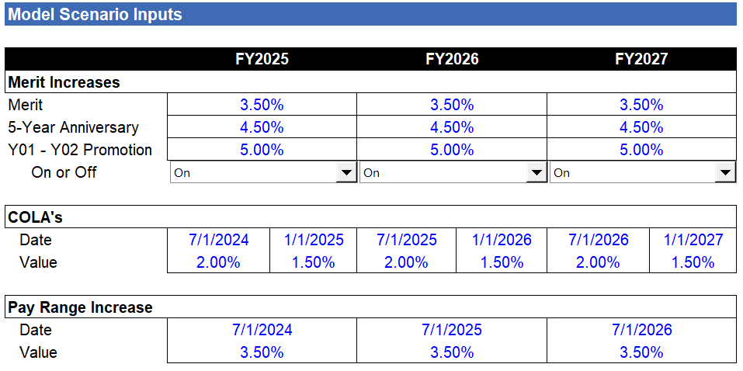
Sample Screenshots from Labor Costing Model (Base Salary)

Slide 17
Sample Screenshots from Labor Costing Model (Other Cash Compensation)
Holiday Pay
Police - FOP
 | 2026 | 2027 | 2028 | 2029 | 2030 | 2031
Number of Days | 10 | 10 | 10 | 10 | 10 | 10
Holiday Bonus | $500 | $500 | $500 | $500 | $500 | $500
Bonus with YOS of: | 4 YOS | 4 YOS | 4 YOS | 4 YOS | 4 YOS | 4 YOS
Bonus for officers hired before: | 1/1/2016 | 1/1/2016 | 1/1/2016 | 1/1/2016 | 1/1/2016 | 1/1/2016
Fire - IAFF
 | 2026 | 2027 | 2028 | 2029 | 2030 | 2031
Hired before: | 1/1/2016 | 1/1/2016 | 1/1/2016 | 1/1/2016 | 1/1/2016 | 1/1/2016
Years of Service | 2 YOS | 2 YOS | 2 YOS | 2 YOS | 2 YOS | 2 YOS
Hourly Rate plus | $4.50 | $4.50 | $4.50 | $4.50 | $4.50 | $4.50
Number of hours | 112 | 112 | 112 | 112 | 112 | 112
Hired after: | 1/1/2015 | 1/1/2015 | 1/1/2015 | 1/1/2015 | 1/1/2015 | 1/1/2015
Years of Service | 1 YOS | 1 YOS | 1 YOS | 1 YOS | 1 YOS | 1 YOS
Hourly Rate plus | $0.00 | $0.00 | $0.00 | $0.00 | $0.00 | $0.00
Number of hours | 84 | 84 | 84 | 84 | 84 | 84
Holiday Bonus | $0 | $0 | $0 | $0 | $0 | $0

Slide 18
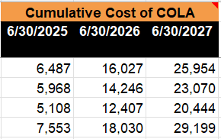
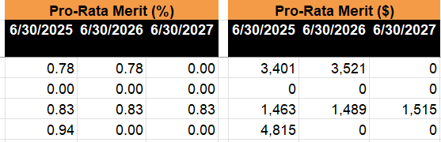
Sample Screenshots from Labor Costing Model (Calculation Module)

Slide 19
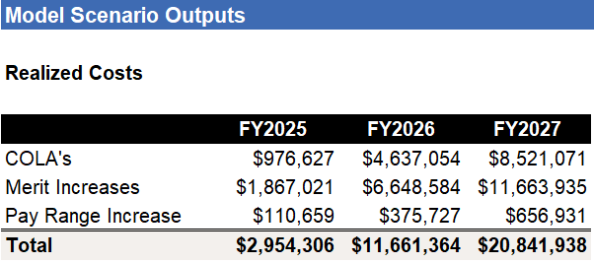
Sample Screenshots from Labor Costing Model (Summaries)

Slide 20
Telling the Costing Story
Costing Components
Compensation based on hourly rates (e.g., overtime)
Healthcare and retirement benefits
Other benefits (e.g., Social Security and Medicare)
Proposals that interact with other proposals (e.g., base wage proposal would impact all other proposals that are based on a % of salary)
Comparison Points
Incremental costs from year to year
Cumulative incremental cost compared to the current fiscal year
Year-over-year cost comparison between local government and union proposals
Total multi-year costs comparison between local government and union proposals over the term of the agreement
Union’s Proposal would cost 7x more than local government’s proposal

Slide 21
Presenting the Case in Arbitration

Slide 22
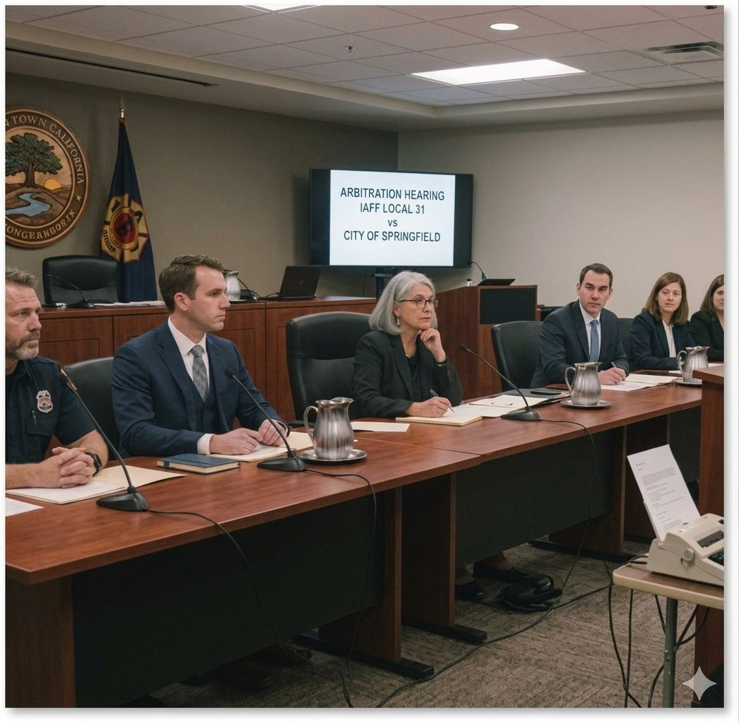
Presenting the Case
Often, communities can reach negotiated settlements without arbitration
  Not always though
Your attorney – whether in-house or outside counsel – will advise you on the appropriate factors the arbitrator will consider, and how to best make the case
Some general factors that arbitrators will consider:
  “Ability to Pay” or Financial Condition
  Comparable Compensation
  Recruitment and Retention
  Economic Context
Note – outputs in the costing model can also be refashioned as exhibits in arbitration

Slide 23
“Ability to Pay”
Emphasize your community’s fiscal constraints, challenges, and risks
  It should not just be a recap of the budget
Key elements to cover may include:
  Expenditure drivers
  Revenue constraints
  Projected changes in fund balance and structural budget imbalances
  Changes in federal/state funds, for example:
    Loss of ARPA dollars
    New unfunded mandates
  Structural economic challenges
Three-Year Average Annual Growth
General Fund vs. Personnel Costs

Slide 24
Historical Revenue Trends
Contextualize revenue trends
The figure below details a client’s real estate tax revenues between 2013 and 2023
  That tax base has been flat since the City’s reassessment in 2013 with the growth of just 0.5% per year over the last decade
  As a result of a flat tax base, the City’s real estate tax revenue generally does not grow unless the City adjusts its rates
Real Estate Tax Collection and Tax Rate
Millage Rate
(per $1,000 of AV)

Slide 25
Fund Balances & Baseline Forecast
If possible, present findings from multi-year baseline forecasts
The figure below summarizes the output of a multi-year projection model, which was presented in an “Ability-to-pay” arbitration hearing
General Fund Surplus / (Deficits) in $ Millions

Slide 26
Compensation Perspectives
The total cost of compensation goes beyond just “base” pay. Consider accounting for these additional costs in comparability analyses:
  Longevity
  Holiday Pay, Shift Differential, Uniform Allowance, Scheduled Overtime, Certification/Training Pay, Education Pay, etc.
  Leave
  Health
  Pension/Retirement
Once a more complete picture of compensation is developed, consider using a career-average analysis over an illustrative 25- or 30-year career that provides insights in career junctures where your jurisdiction may lead or lag the market

Slide 27
Total Cost of Employment
Even if not subject to bargaining, show the “full cost” of employment – provides additional context and perspective for the arbitrator to consider
While the average cost of wages earned per bargaining unit member total $121,266 in the graphic below, the total employment cost per member exceeds $177,000 with the addition of health benefits, retirement, and FICA
$177,138
Average health benefits cost uses a weighted average of bargaining unit health plan enrollment
Excludes members with less than 1 YOS
Average earnings includes average premium for members who received premium pay and average overtime for those who received overtime

Slide 28

Look for the Compensation “Christmas Tree”
Additional pay premiums and allowances are like ornaments on a Christmas tree
  Especially in public safety positions
Make sure to account for these forms of compensation in your benchmarking
Average Earnings | Fire Engineer
Base Pay | $65,288
Longevity | $5,798
Fire Certification Pay | $1,297
EMT/Paramedic Certification | $3,122
Clothing Allowance | $720
Overtime | $18,004
Holiday Premium | $560
High Class Pay | $683
Education Pay | $1,540
Leave Buy Back | $3,248
Other Compensation | $684
Total | $100,944

Slide 29
Total Direct Cash Compensation
City of “Springfield” – Twenty Five-Year Career Average
Year | Springfield | City #1 | City #2 | City #3 | City #4 | City #5 | City #6 | City #7 | City #8 | City #9 | City #10 | Median | Springfield Lead/ (Lag) % | Springfield Rank
1 | $64,393 | $57,133 | $61,449 | $56,091 | $65,245 | $65,960 | $55,960 | $59,743 | $58,123 | $58,069 | $55,058 | $58,096 | 10.8% | 3 of 11
2 | $67,468 | $60,475 | $64,163 | $58,752 | $65,545 | $67,524 | $59,927 | $63,036 | $63,092 | $62,354 | $59,530 | $62,695 | 7.6% | 2 of 11
3 | $69,054 | $61,987 | $66,591 | $60,221 | $69,116 | $69,126 | $61,425 | $64,927 | $65,805 | $63,914 | $61,734 | $64,421 | 7.2% | 3 of 11
4 | $70,676 | $63,537 | $69,096 | $61,927 | $69,434 | $74,163 | $62,961 | $66,875 | $68,635 | $65,512 | $63,898 | $66,193 | 6.8% | 2 of 11
5 | $72,337 | $65,125 | $71,710 | $66,997 | $73,203 | $77,744 | $64,535 | $68,881 | $71,586 | $65,512 | $69,389 | $69,135 | 4.6% | 3 of 11
6 | $74,036 | $66,753 | $74,407 | $68,667 | $73,608 | $81,454 | $66,148 | $70,948 | $74,664 | $69,500 | $71,677 | $71,312 | 3.8% | 4 of 11
7 | $75,776 | $68,422 | $77,223 | $70,579 | $77,699 | $87,389 | $69,836 | $73,076 | $80,923 | $71,194 | $73,986 | $73,531 | 3.1% | 5 of 11
8 | $77,557 | $73,731 | $80,127 | $75,930 | $78,176 | $91,609 | $71,582 | $76,730 | $84,403 | $73,687 | $76,253 | $76,491 | 1.4% | 5 of 11
9 | $79,380 | $75,574 | $83,159 | $77,818 | $82,515 | $95,980 | $73,372 | $79,032 | $88,032 | $75,529 | $78,541 | $78,786 | 0.8% | 5 of 11
10 | $81,244 | $77,463 | $86,286 | $79,953 | $83,019 | $98,256 | $78,967 | $81,403 | $91,817 | $80,079 | $80,850 | $81,126 | 0.1% | 6 of 11
11 | $83,154 | $79,400 | $90,787 | $83,329 | $83,539 | $103,001 | $78,967 | $83,845 | $95,766 | $80,079 | $83,138 | $83,434 | (0.3%) | 7 of 11
12 | $85,108 | $81,385 | $95,445 | $85,397 | $84,110 | $107,916 | $80,941 | $86,360 | $99,884 | $82,882 | $85,426 | $85,411 | (0.4%) | 7 of 11
13 | $87,109 | $87,593 | $97,593 | $87,717 | $84,682 | $110,476 | $80,941 | $88,951 | $104,178 | $82,882 | $87,714 | $87,715 | (0.7%) | 8 of 11
14 | $89,156 | $81,385 | $99,789 | $92,563 | $85,255 | $133,096 | $82,964 | $91,619 | $113,031 | $85,782 | $90,022 | $90,821 | (1.8%) | 7 of 11
15 | $91,251 | $81,385 | $102,034 | $94,857 | $85,833 | $115,779 | $82,964 | $94,368 | $117,891 | $85,782 | $92,310 | $93,339 | (2.2%) | 7 of 11
16 | $93,395 | $87,593 | $104,330 | $97,408 | $86,428 | $118,525 | $85,039 | $97,199 | $117,891 | $88,786 | $94,598 | $95,899 | (2.6%) | 7 of 11
17 | $95,589 | $87,593 | $106,677 | $99,818 | $87,073 | $121,336 | $85,039 | $97,199 | $117,891 | $88,786 | $94,598 | $95,899 | (0.3%) | 6 of 11
18 | $97,837 | $89,782 | $109,077 | $102,288 | $87,719 | $124,214 | $87,165 | $97,199 | $117,891 | $88,786 | $94,598 | $95,899 | 2.0% | 5 of 11
19 | $100,136 | $89,782 | $111,531 | $105,020 | $88,367 | $127,161 | $87,165 | $97,199 | $117,891 | $91,448 | $94,598 | $95,899 | 4.4% | 5 of 11
20 | $102,488 | $92,027 | $114,041 | $107,616 | $89,019 | $130,177 | $89,344 | $97,199 | $117,891 | $91,448 | $94,598 | $95,899 | 6.9% | 5 of 11
21 | $104,897 | $92,027 | $116,607 | $107,616 | $89,688 | $133,265 | $89,344 | $97,199 | $117,891 | $91,448 | $94,598 | $95,899 | 9.4% | 5 of 11
22 | $107,362 | $94,328 | $119,231 | $107,816 | $90,408 | $136,426 | $91,577 | $97,199 | $117,891 | $94,192 | $94,598 | $95,899 | 12.0% | 5 of 11
23 | $109,886 | $94,328 | $121,913 | $107,816 | $91,128 | $139,662 | $91,577 | $97,199 | $117,891 | $94,192 | $94,598 | $95,899 | 14.6% | 4 of 11
24 | $112,468 | $96,686 | $124,656 | $107,816 | $91,851 | $142,975 | $93,867 | $97,199 | $117,891 | $94,192 | $94,598 | $96,943 | 16.0% | 4 of 11
25 | $115,111 | $96,686 | $127,461 | $108,016 | $92,577 | $146,366 | $93,867 | $97,199 | $117,891 | $97,017 | $94,598 | $97,108 | 18.5% | 4 of 11
25-Year Avg | $88,275 | $80,087 | $95,015 | $86,881 | $82,209 | $107,983 | $78,619 | $84,871 | $98,269 | $80,922 | $83,020 | $83,946 | 5.2% | 4 of 11

Slide 30
Hourly Compensation
For some job titles (e.g., fire/rescue) presenting hourly compensation may be more appropriate
Hourly comparisons also highlight the value of compensation plans with relatively generous leave components

Slide 31
A Note on Internal Wage Comparisons
Across the Country, many communities have some form of “internal comparability” as a factor of consideration in arbitration proceedings
Arbitrators will evaluate the wage increases – or “pattern” – negotiated by other bargaining units in the same jurisdictions
Consider highlighting negotiated settlement with “non-essential” employees

Slide 32
Recruitment and Retention
Often – though not always – recruitment and retention experience will be a favorable factor of consideration in mediation or arbitration
 | FY 2024 | FY 2025 | FY2026
Headcount | 301 | 303 | 313
Separations (all reasons) | 31 | 40 | 27
Quit | 21 | 28 | 15
Retirement | 8 | 7 | 6
Termination | 2 | 3 | 5
Transfer | 0 | 1 | 1
Other | 0 | 1 | 0
Quit Rate | 7.0% | 9.2% | 4.8%
Turnover Rate | 10.3% | 13.2% | 8.6%
State and Local Government
Attrition Rates FY 2026
(Excluding Education)
Quit Rate: 9.5%
Turnover Rate: 17.6%
Source: U.S. Bureau of Labor Statistics,
Job Openings and Labor Turnover Survey

Slide 33
Contextualizing the Economy
The current economic and fiscal outlook can be characterized by a high degree of uncertainty
In addition to the standard challenges of multi-year budget forecasting, in recent years, we have seen increased volatility in major economic data points nationally and regionally:
  Employment growth
  CPI
  GDP
Against this backdrop, multiple exogenous, structural factors are driving economic uncertainty of which local government finance officers have no control:
  Federal policies: decreased funding to states, tariffs, debt levels and interest rates
  Iran War
  Artificial Intelligence
The macroeconomic story is an important consideration to put in front of arbitrators

Slide 34
National Employment Trends
Nationally, the rate of job creation has declined since the post-pandemic rebound in 2021
In 2025, total nonfarm payroll increased by just 116,000 across the entire U.S. economy
Job creation has improved year-to-date in 2026, but with 426,000 new jobs created through July 2026, the U.S. economy is on pace to create 729,000 fewer jobs in 2026 than 2024
Annual Change in Total Nonfarm Employment (U.S.)
2021 through 2026 YTD*
*YTD through July 2026; July 2026 figures are preliminary
Source: U.S. Bureau of Labor Statistics, Current Employment Statistics Survey (National), seasonally adjusted

Slide 35
Consumer Sentiment at Historic Lows
University of Michigan Consumer Sentiment Index
U.S. consumer sentiment, as measured by the University of Michigan Consumer Sentiment Index, is hovering near all-time lows, signaling heightened uncertainty around consumption (i.e., consumer spending) – the largest component of Gross Domestic Product (GDP)
University of Michigan Consumer Sentiment Index
Source: University of Michigan Survey of Consumers
Recessions marked by gray shading

Slide 36
Consumer Price Trends
Be thoughtful of how to contextualize CPI trends
Often, a multi-year perspective can support management’s position in impasse proceedings
Proposed Contract Period
FY 2029
FY 2028

Slide 37
Parting Thoughts

Slide 38
Overcoming Information Asymmetry
Challenges
Approaches
The collective bargaining process can be daunting
Unions may have more experience with negotiations. Unions can leverage outside resources (e.g., negotiators & compensation experts who negotiate agreements in other jurisdictions)
Union-side negotiators may lack understanding of budgetary constraints & costs associated with proposals
Unions may view arbitration (or other impasse procedures) as means to extract compensation increases
Start early. Be inclusive. Include budget, human resources, & operating departments within bargaining team
Perform rigorous and defensible benchmarking
Develop transparent costing models; ensure that stakeholders (management & union) understand outputs & assumptions
Building upon benchmarking & costing analyses, proactively develop arbitration testimony, exhibits, & arguments to be presented in arbitration hearings

Slide 39
The Value of Empathy
Collective bargaining can get personal
There is a value for management team members to put themselves in the “union’s shoes,” even if union leadership will not reciprocate:
  Remember, union presidents are elected. They have constituents. Like any politician, they need to play to their constituencies
  Union negotiators are often hired by union presidents and subject to the same political pressure
  Both need to “save face” with their constituencies
Empathy: the action of understanding, being aware of, being sensitive to, and vicariously experiencing the feelings, thoughts, and experience of another
Source: Merriam-Webster Dictionary

