Slide 1
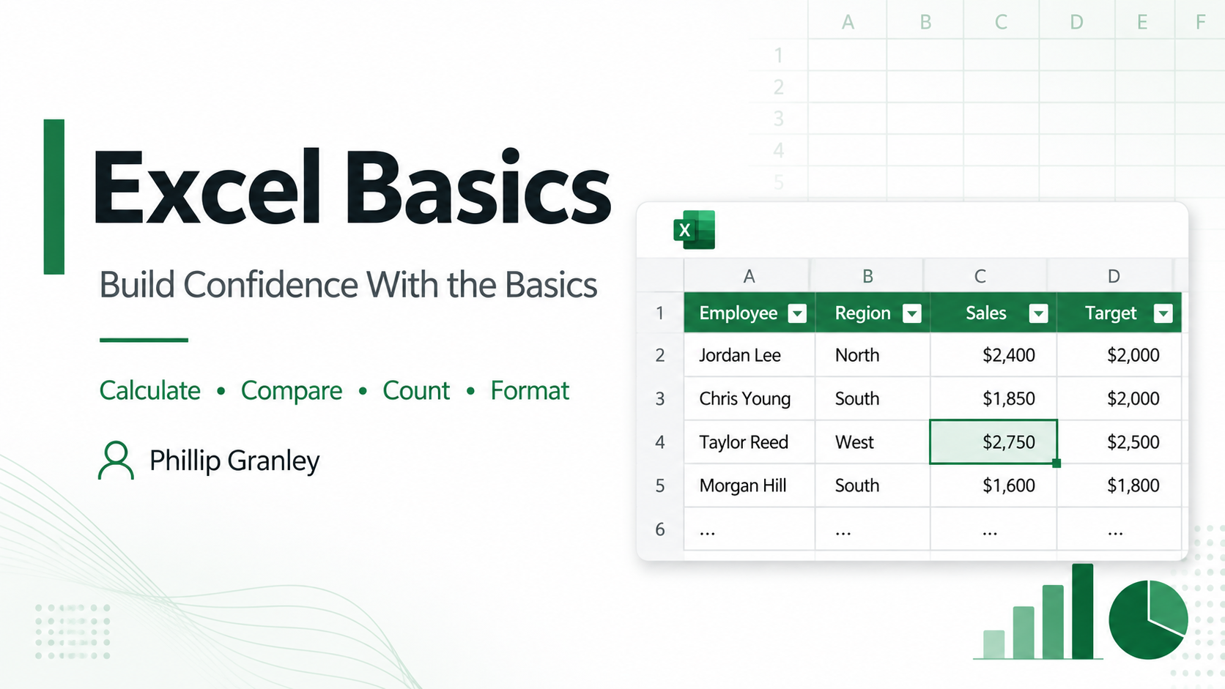

Notes:
This session focuses on basic Excel tools that help you calculate, compare, count, and format data. We will use simple sales examples so you can see what each tool does without working with a large dataset. The goal is not to memorize everything, but to understand what Excel can do and when to use each tool.
https://support.microsoft.com/en-us/excel

Slide 2
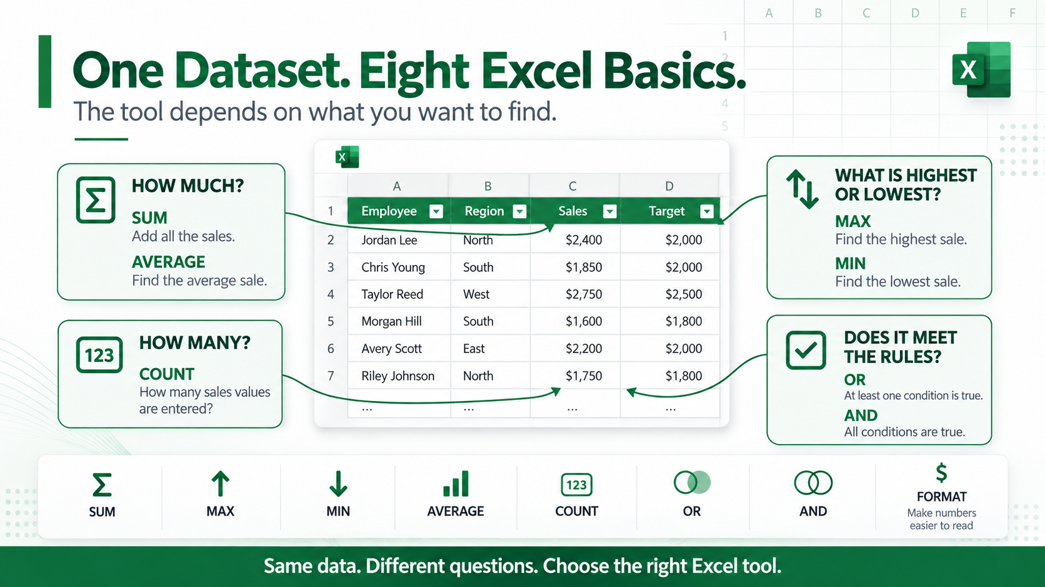
Notes:
The same dataset can answer different questions depending on the Excel tool we choose. SUM adds values, AVERAGE finds the average, MAX and MIN identify the highest and lowest values, and COUNT tells us how many numeric entries we have. OR and AND let us test multiple conditions, while number formatting changes how values are displayed without changing the underlying numbers.
https://support.microsoft.com/en-us/excel

Slide 3
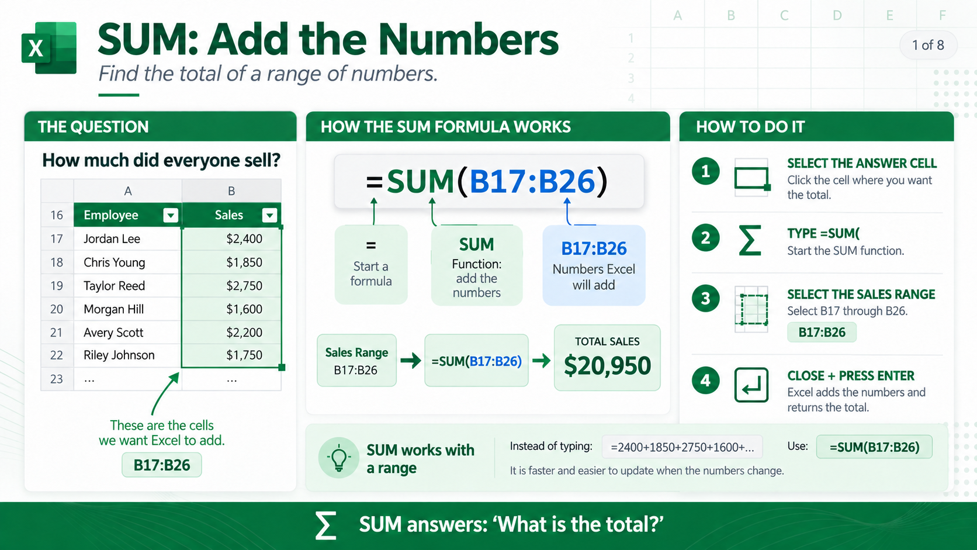
Notes:
SUM adds the numbers in a range and returns the total. In this example, =SUM(B17:B26) adds the sales values in cells B17 through B26 and returns $20,950. Using SUM is faster and easier to maintain than manually adding each value, and the total will recalculate automatically if any of the numbers change.
https://support.microsoft.com/en-us/office/sum-function-043e1c7d-7726-4e80-8f32-07b23e057f89

Slide 4
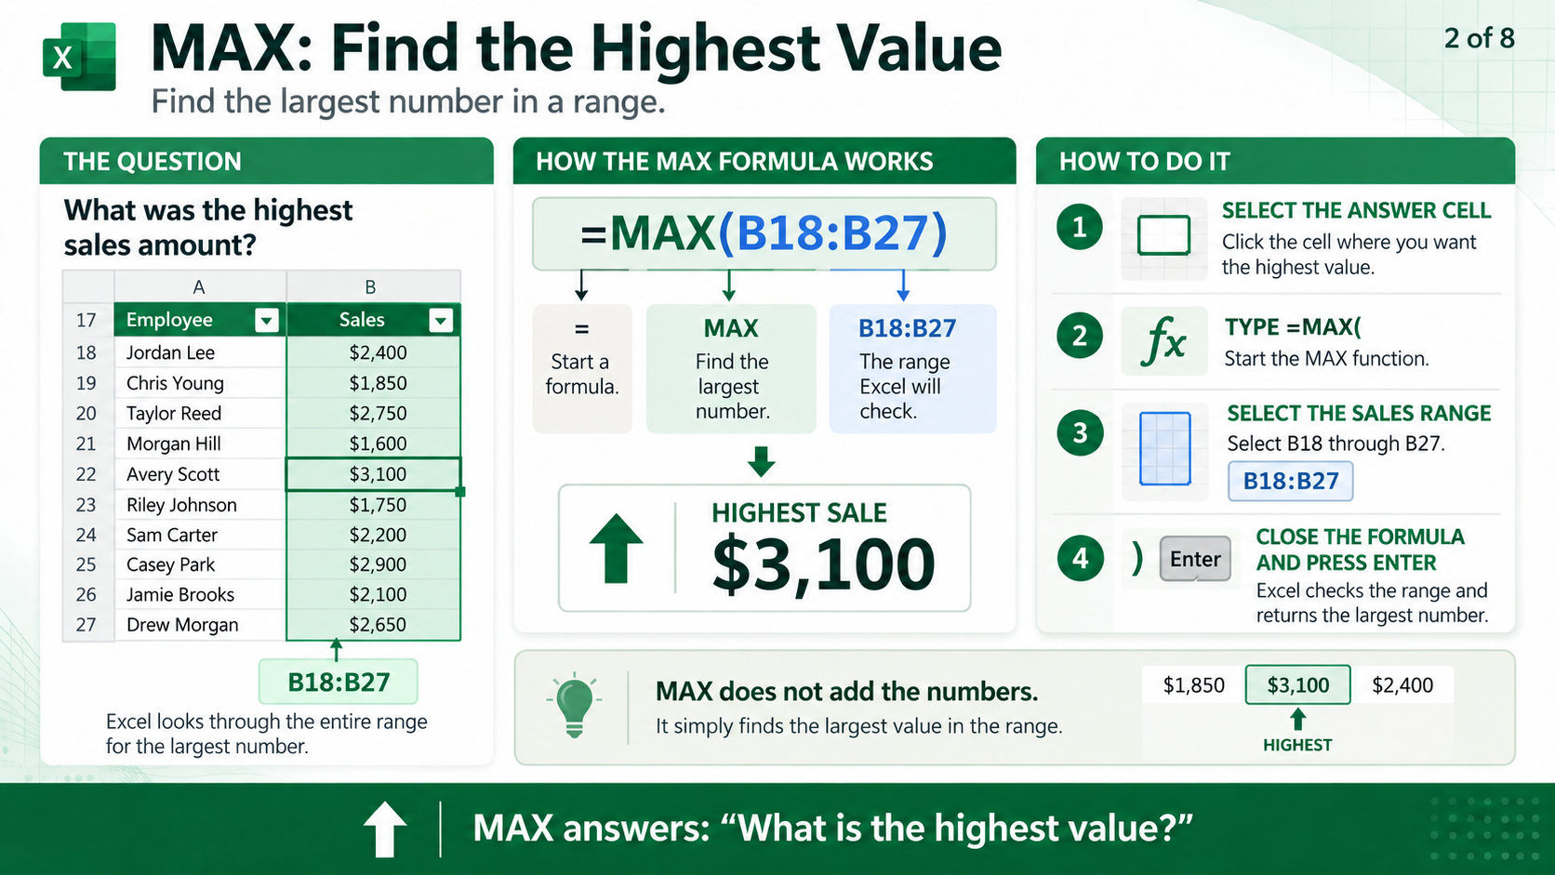
Notes:
MAX searches a range and returns the largest numeric value. In this example, =MAX(B18:B27) checks the sales values and returns the highest sale of $3,100. MAX does not add or sort the numbers; it simply finds the largest value in the selected range.
https://support.microsoft.com/en-us/office/max-function-e0012414-9ac8-4b34-9a47-73e662c08098

Slide 5
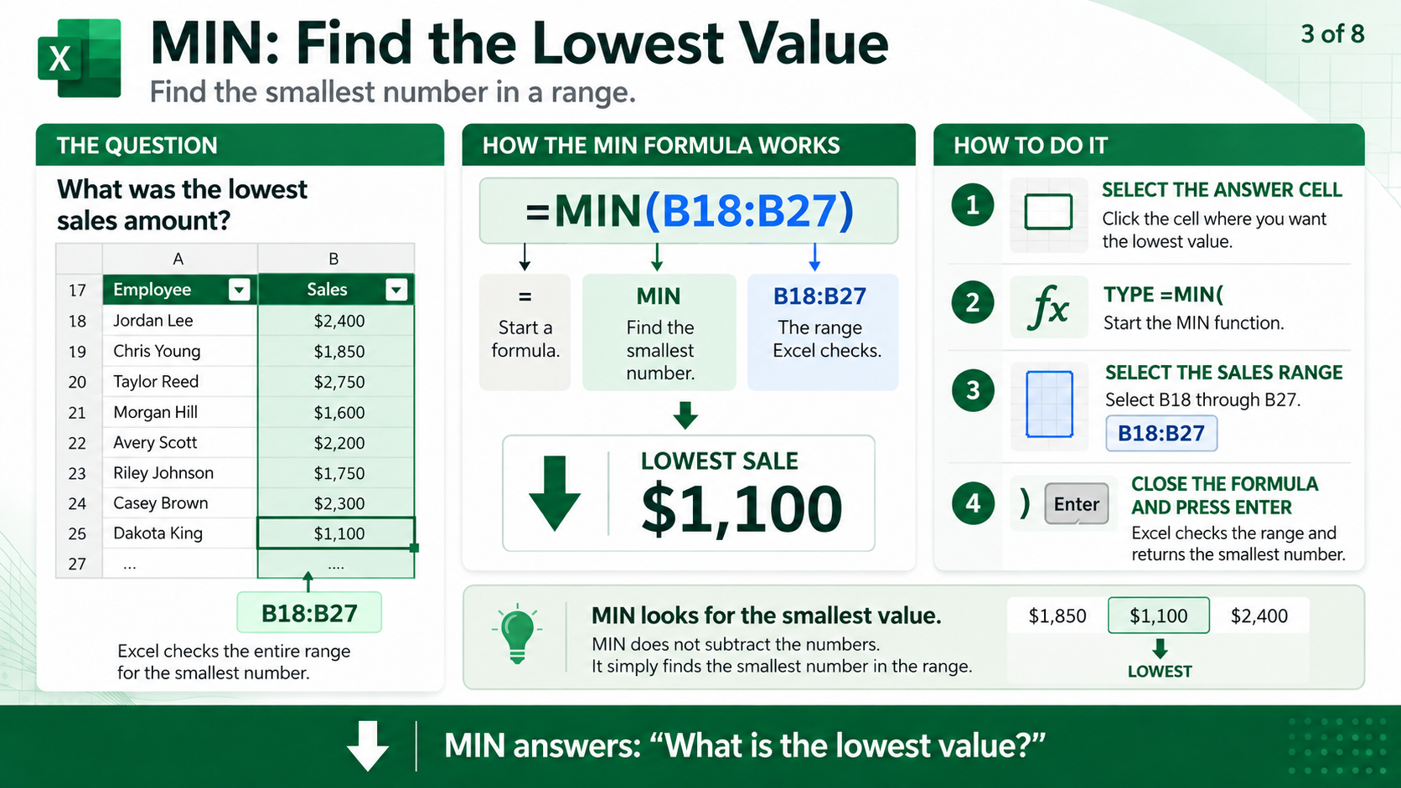
Notes:
MIN works like MAX, except it returns the smallest numeric value in the range. In this example, =MIN(B18:B27) returns the lowest sale of $1,100. MIN means minimum; it does not mean subtract or minus.
https://support.microsoft.com/en-us/office/min-function-61635d12-920f-4ce2-a70f-96f202dcc152

Slide 6
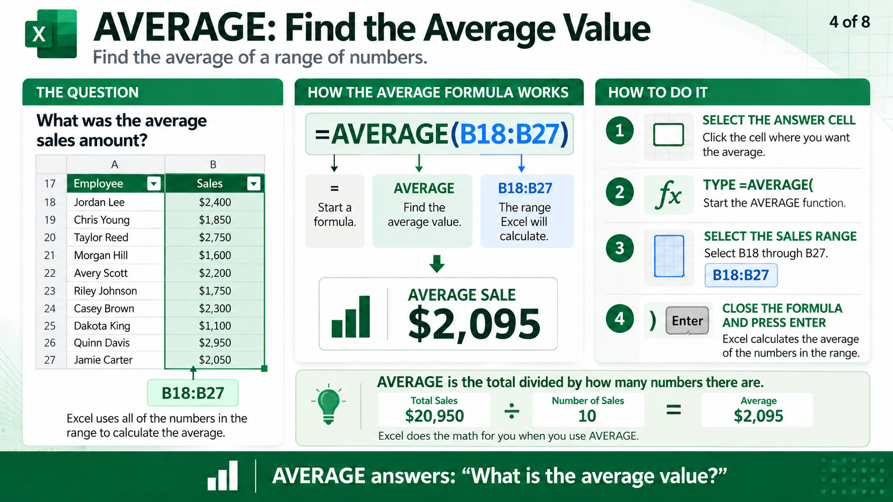
Notes:
AVERAGE calculates the average of the numeric values in a range. In this example, =AVERAGE(B18:B27) returns an average sale of $2,095. Conceptually, Excel is taking the total sales of $20,950 and dividing that by the 10 sales values, but the AVERAGE function performs that work automatically.
https://support.microsoft.com/en-us/office/average-function-047bac88-d466-426c-a32b-8f33-eb960cf6

Slide 7
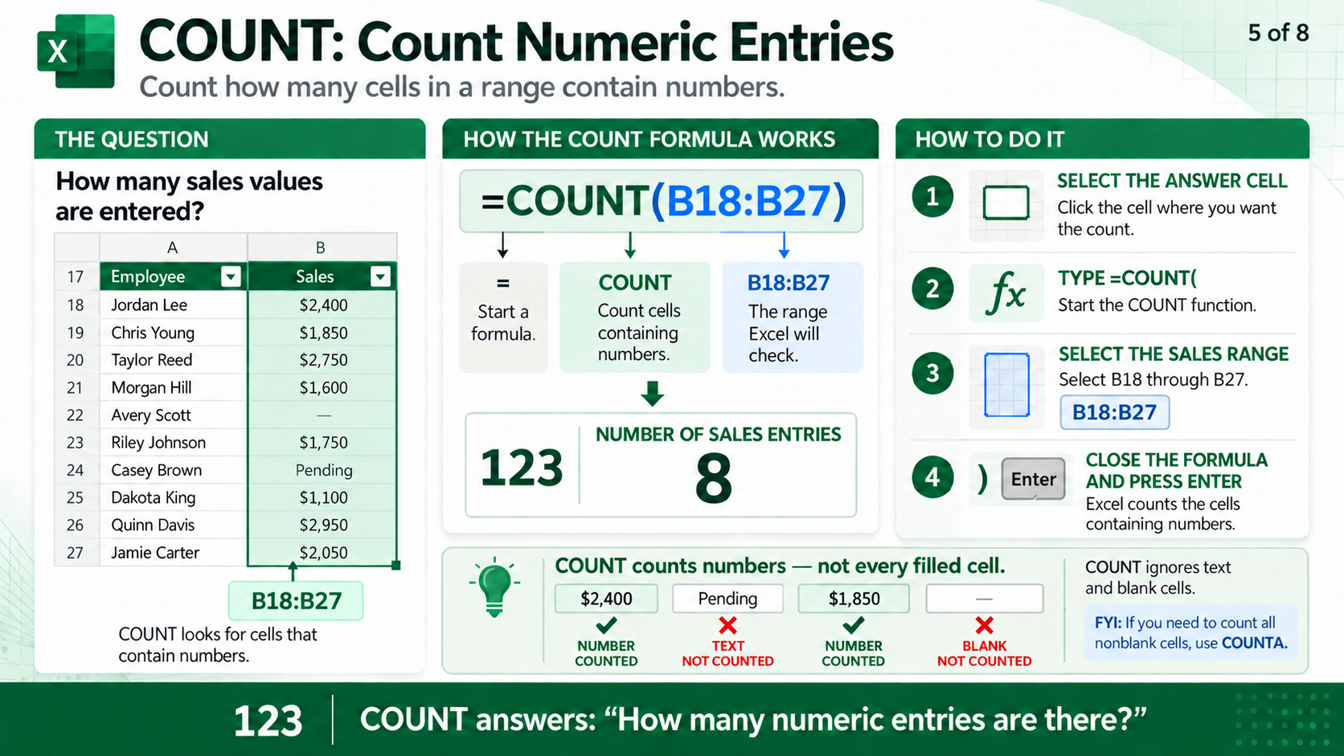
Notes:
COUNT tells us how many cells in a range contain numbers. In this example, =COUNT(B18:B27) returns 8 because eight cells contain numeric sales values. COUNT ignores text such as Pending and also ignores blank cells. If you need to count all nonblank cells instead, you would use COUNTA.
https://support.microsoft.com/en-us/office/count-function-a59cd7fc-b623-4d93-87a4-d23bf411294c

Slide 8
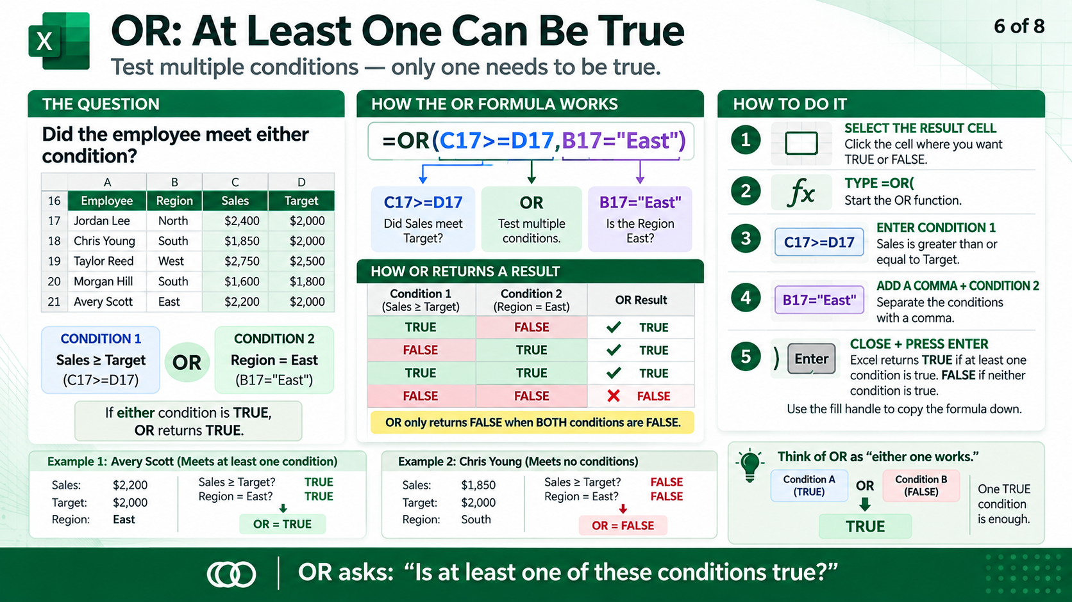
Notes:
OR tests multiple conditions and returns TRUE when at least one condition is true. In this example, =OR(C17>=D17,B17="East") asks whether Sales met or exceeded Target, or whether the employee is in the East region. Only one of those conditions needs to be true for OR to return TRUE. OR returns FALSE only when all conditions are false.
https://support.microsoft.com/en-us/office/or-function-7d17ad14-8700-4281-b308-00b131e22af0

Slide 9
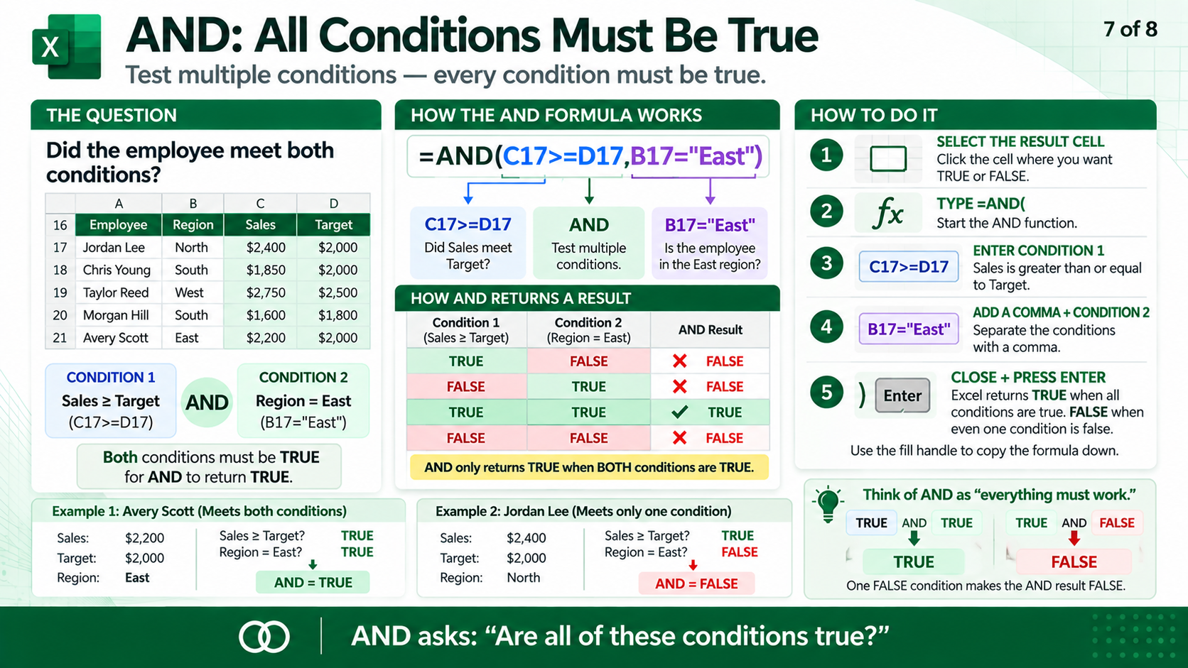
Notes:
AND also tests multiple conditions, but every condition must be true for the result to be TRUE. In this example, =AND(C17>=D17,B17="East") requires Sales to meet or exceed Target and the employee to be in the East region. If even one condition is false, AND returns FALSE. The simple difference to remember is OR means at least one condition must be true, while AND means all conditions must be true.
https://support.microsoft.com/en-us/office/and-function-5f19b2e8-e1df-4408-897a-ce285a19e9d9

Slide 10
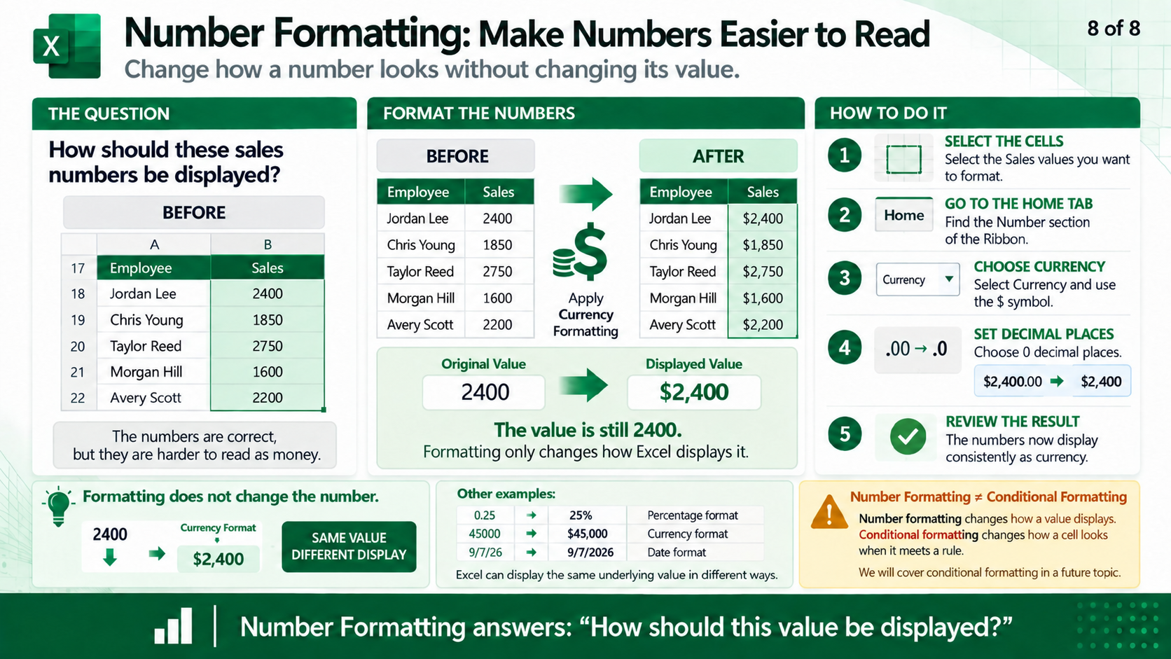
Notes:
Number formatting changes how a value appears without changing the value Excel uses for calculations. For example, the value 2400 can be displayed as $2,400 while Excel still stores the underlying value as 2400. Currency, percentages, dates, and decimal places are all examples of number formatting. This is different from conditional formatting, which changes how a cell looks when it meets a rule.
https://support.microsoft.com/en-us/office/available-number-formats-in-excel-0afe8f52-97db-41f1-b972-4b46e9f1e8d2

Slide 11
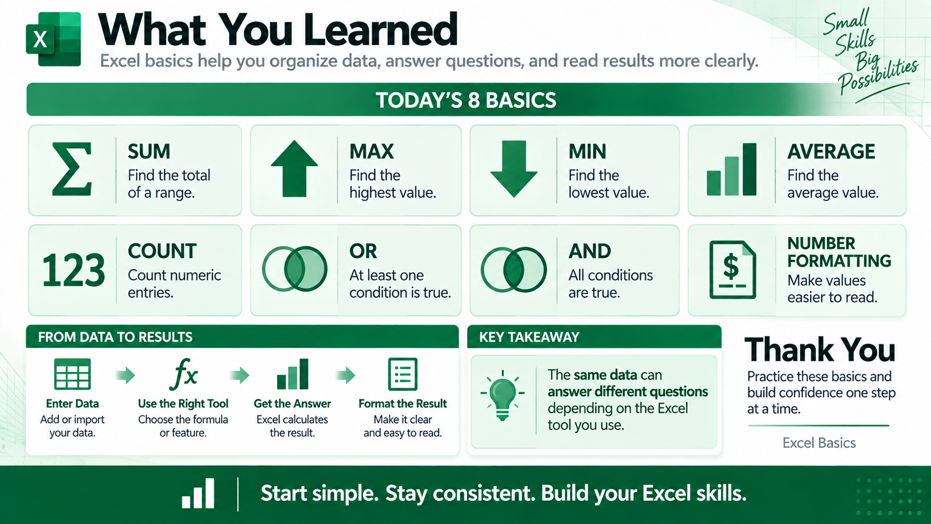
Notes:
The main goal is to understand the question first and then choose the Excel tool that answers it. SUM, MAX, MIN, AVERAGE, and COUNT perform different calculations on numeric data. OR and AND test conditions, while number formatting makes results easier to read without changing their values. These basic skills provide the foundation for more advanced Excel work.
https://support.microsoft.com/en-us/excel

