Slide 1
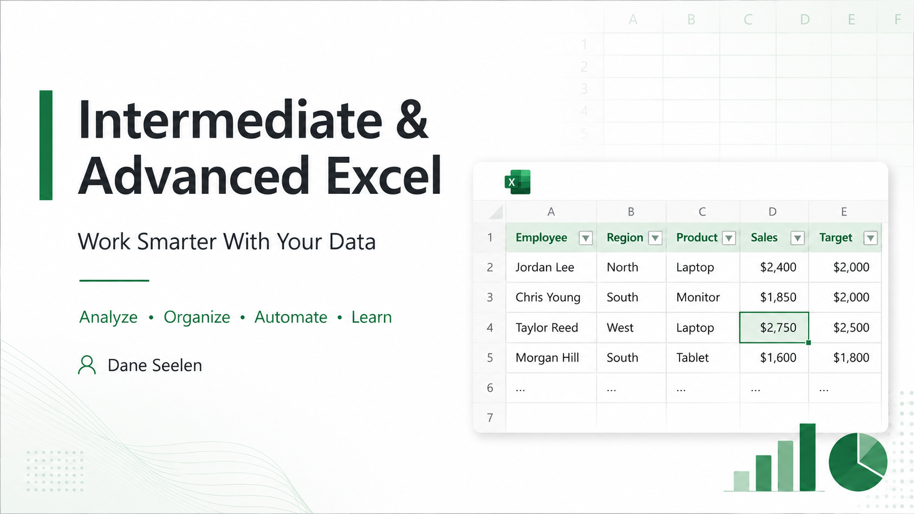

Notes:
This session is about using Excel to work smarter with data, not just memorizing buttons or formulas. We will use the same type of sales data throughout the presentation so the different features feel connected. The overall goal is to analyze, organize, automate, and continue learning as Excel tools change.
https://support.microsoft.com/en-us/excel

Slide 2
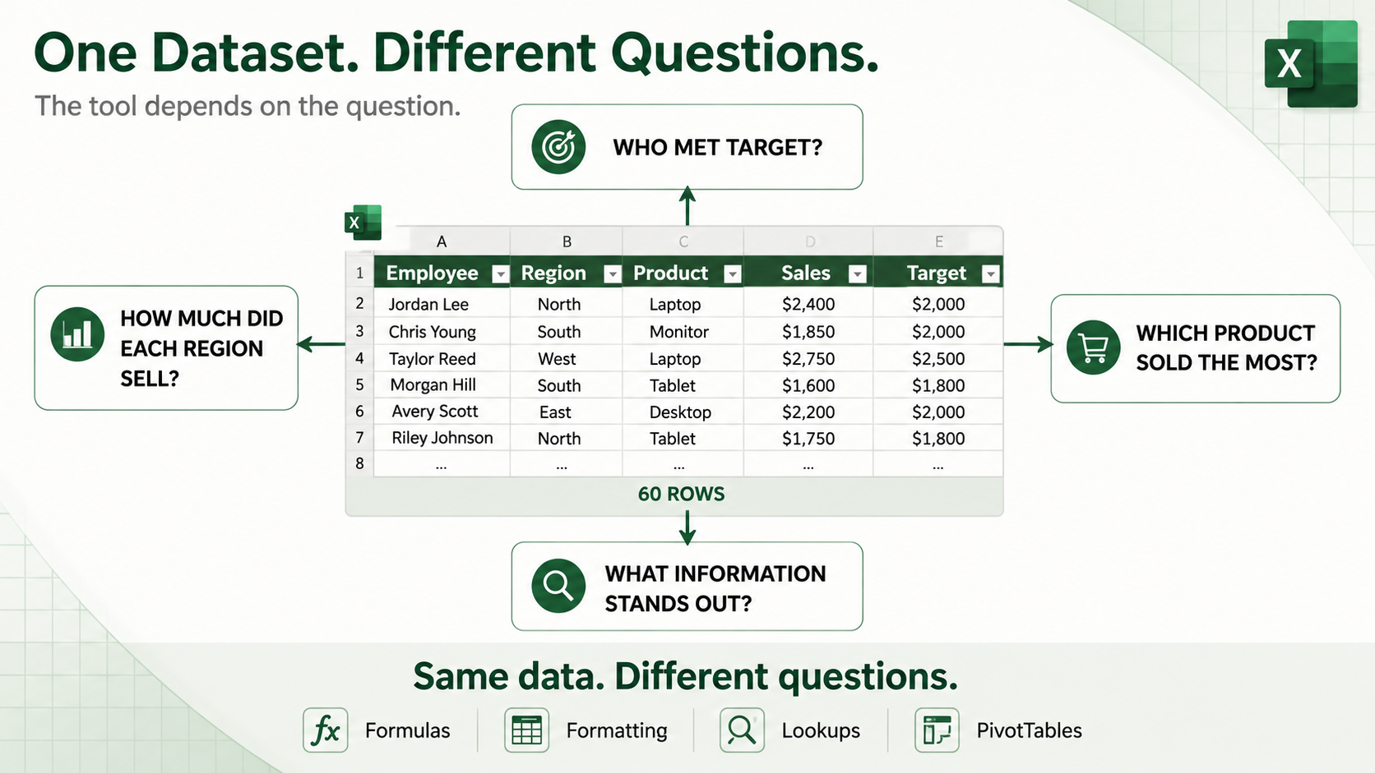
Notes:
Start with the question you want answered before choosing the Excel tool. The same dataset can answer many different questions. We might want to know who met target, how much each region sold, which product sold the most, or what information stands out. Depending on the question, we may use formulas, formatting, lookups, PivotTables, or other Excel tools.
https://support.microsoft.com/en-gb/office/analyze-data-in-excel-3223aab8-f543-4fda-85ed-76bb0295ffc4

Slide 3
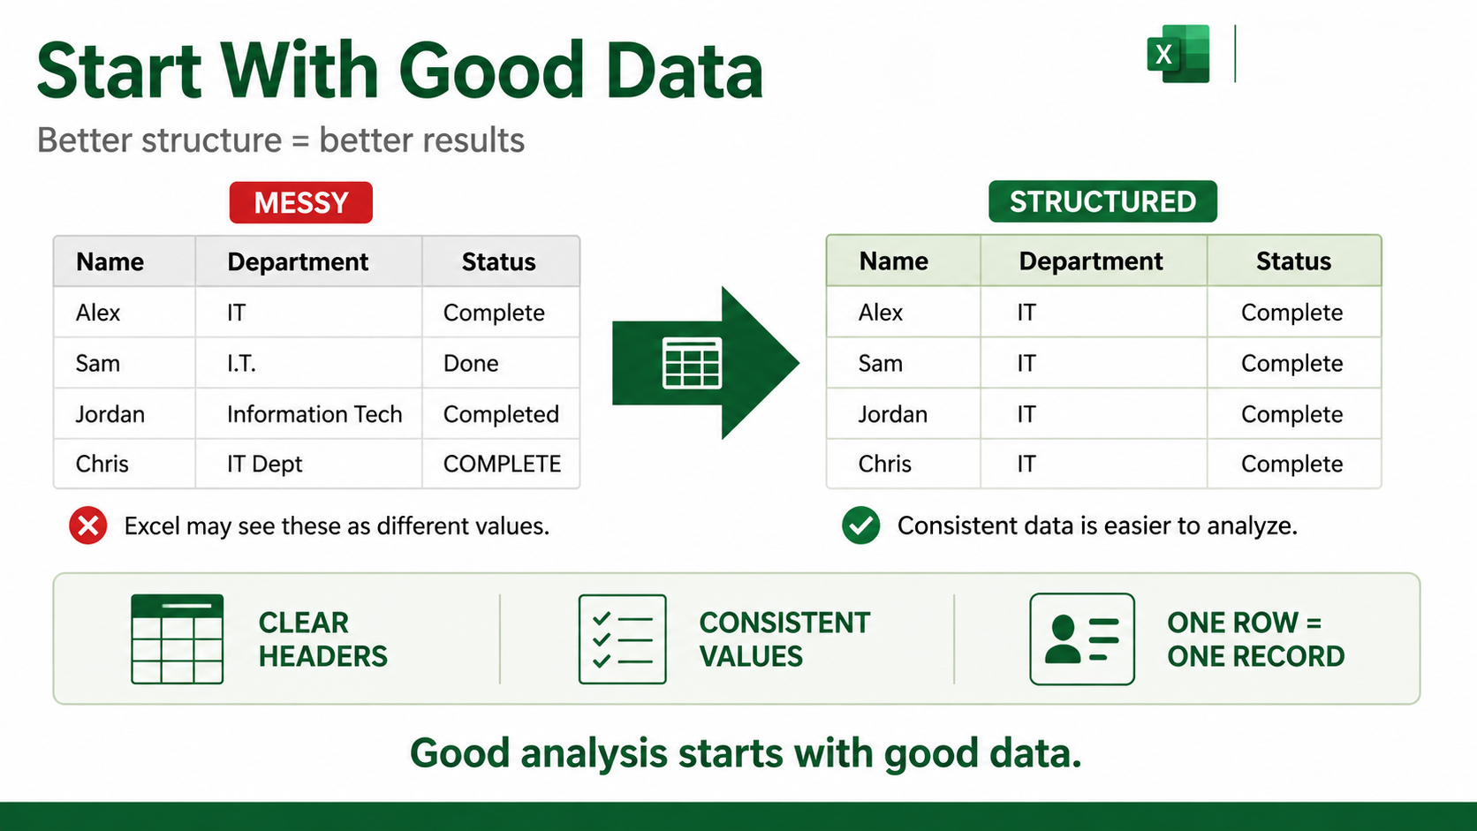
Notes:
Excel works best when data is clean, consistent, and organized in a simple table structure. Each column should have one clear header, and each row should represent one record. Excel may treat entries such as IT, I.T., Information Tech, and IT Dept as different values even if people mean the same thing. Consistent data makes formulas, filters, PivotTables, charts, and Copilot easier to use.
https://support.microsoft.com/en-US/Excel/overview-of-excel-tables
https://support.microsoft.com/en-us/topic/format-data-for-copilot-in-excel-1604c8eb-57f1-4db1-8363-d53336228c65

Slide 4
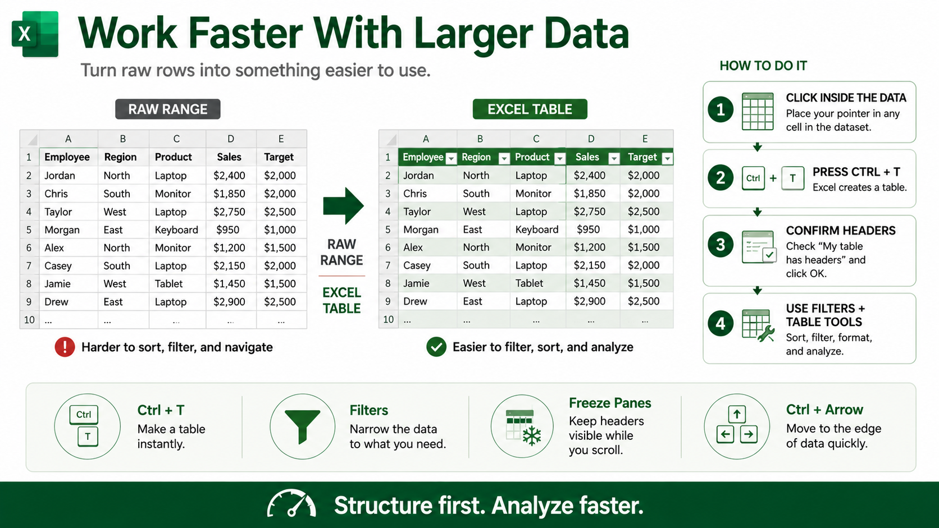
Notes:
Turning a raw range into an Excel Table makes larger datasets easier to work with. Click anywhere inside the data, press Ctrl+T, confirm that the table has headers, and Excel creates the table. Tables provide filter arrows and make sorting, filtering, formatting, and analysis easier. Freeze Panes can keep headers visible while you scroll, and Ctrl+Arrow helps you move quickly to the edge of a data region.
https://support.microsoft.com/en-US/Excel/get-started/create-and-format-tables
https://support.microsoft.com/en-us/excel/get-started/filter-data-in-a-range-or-table-in-excel
https://support.microsoft.com/en-us/excel/get-started/freeze-panes-to-lock-rows-and-columns

Slide 5
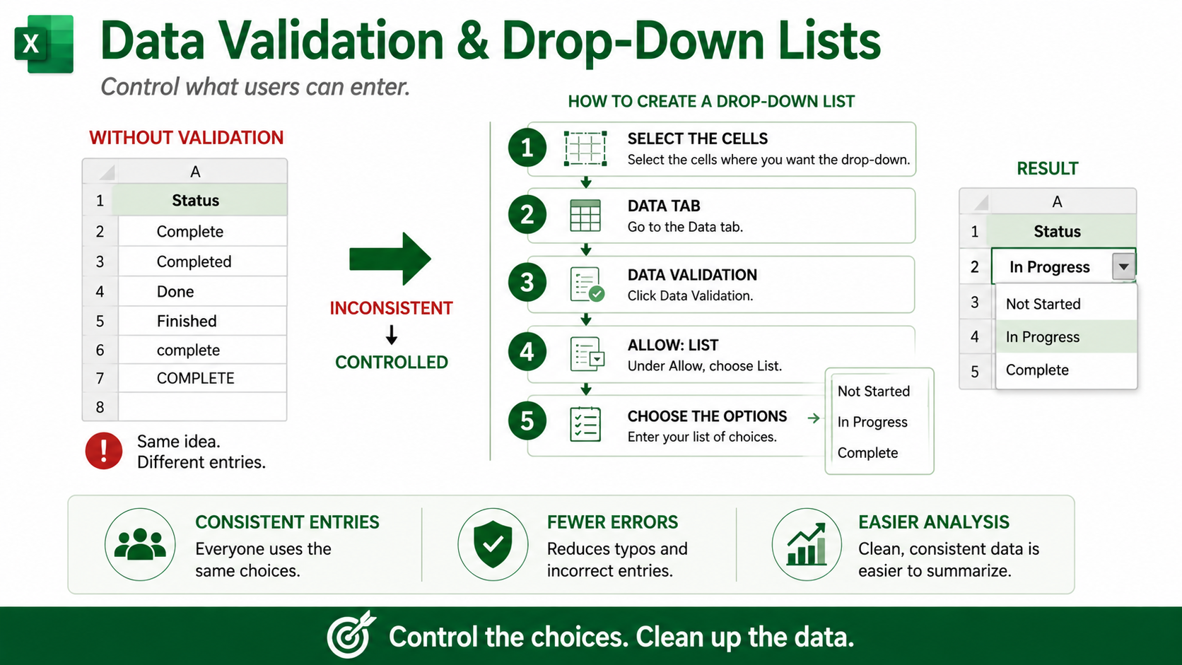
Notes:
Data validation controls what users can enter and helps keep data consistent. A drop-down list is useful when people should choose from known options instead of typing freely. In this example, the allowed choices are Not Started, In Progress, and Complete. The basic process is to select the cells, go to the Data tab, choose Data Validation, select List, and enter or select the allowed options.
https://support.microsoft.com/en-us/excel/get-started/create-a-drop-down-list

Slide 6
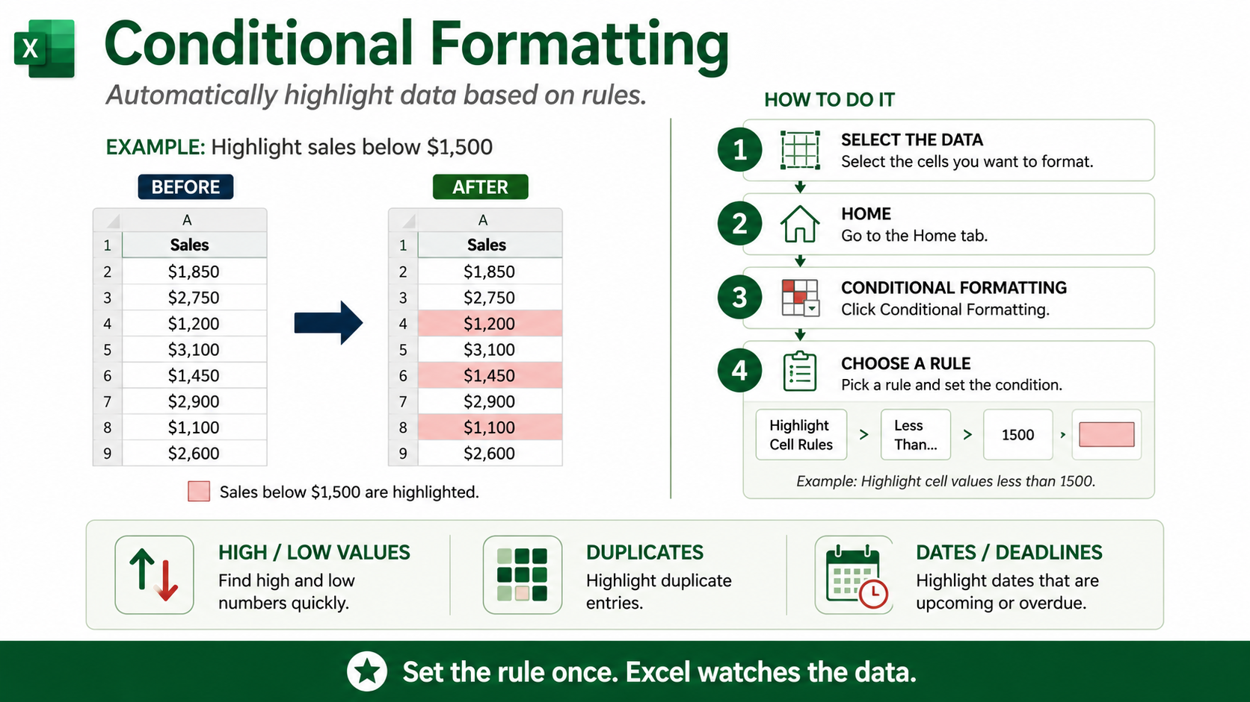
Notes:
Conditional formatting automatically changes how cells look when they meet a rule. It does not change the actual value stored in the cell. In this example, sales below $1,500 are highlighted so low values are easy to identify. Select the data, go to Home, choose Conditional Formatting, select a rule such as Less Than, and enter 1500. Conditional formatting can also be used for high or low values, duplicates, dates, deadlines, and many other conditions.
https://support.microsoft.com/en-us/excel/use-conditional-formatting-to-highlight-information-in-excel

Slide 7
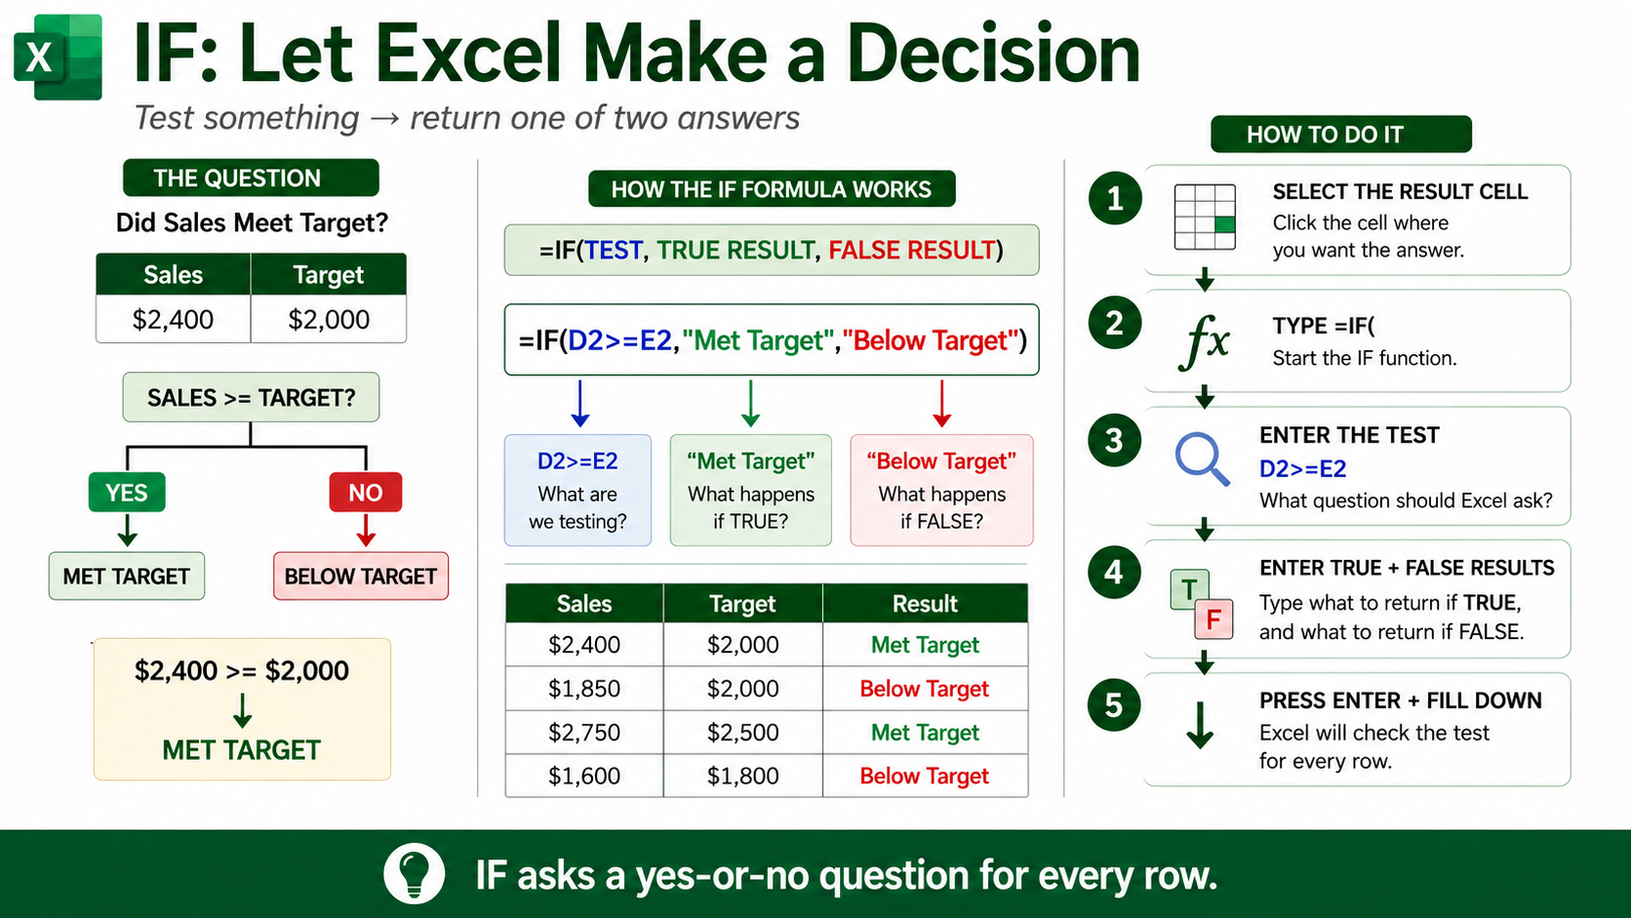
Notes:
IF asks Excel a yes-or-no question and returns one result when the test is TRUE and another result when it is FALSE. In this example, =IF(D2>=E2,"Met Target","Below Target") checks whether Sales is greater than or equal to Target. If it is, Excel returns Met Target. If it is not, Excel returns Below Target. You can then fill the formula down to evaluate every row.
https://support.microsoft.com/en-us/excel/get-started/if-function

Slide 8
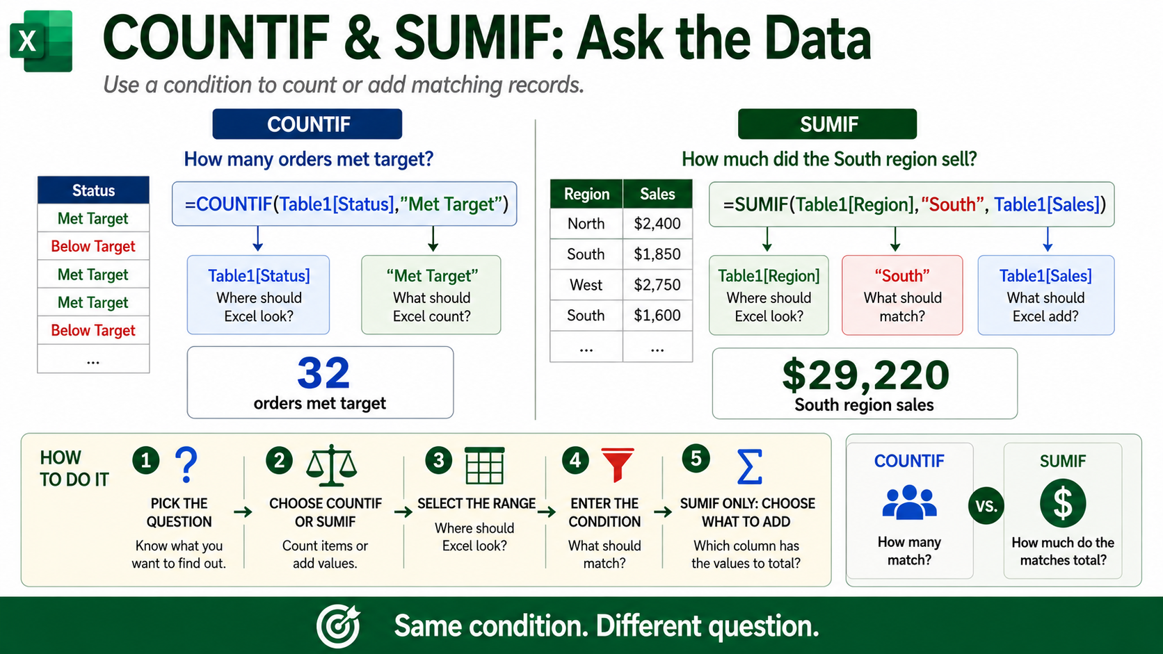
Notes:
COUNTIF and SUMIF both use a condition, but they answer different questions. =COUNTIF(Table1[Status],"Met Target") counts how many rows have a Status of Met Target; the example shown returns 32 orders. =SUMIF(Table1[Region],"South",Table1[Sales]) finds rows where the Region is South and adds the corresponding Sales values; the example shown returns $29,220. COUNTIF answers how many, while SUMIF answers how much.
https://support.microsoft.com/en-US/Excel/get-started/use-the-countif-function-in-microsoft-excel
https://support.microsoft.com/en-us/office/sumif-function-169b8c99-c05c-4483-a712-1697a653039b

Slide 9
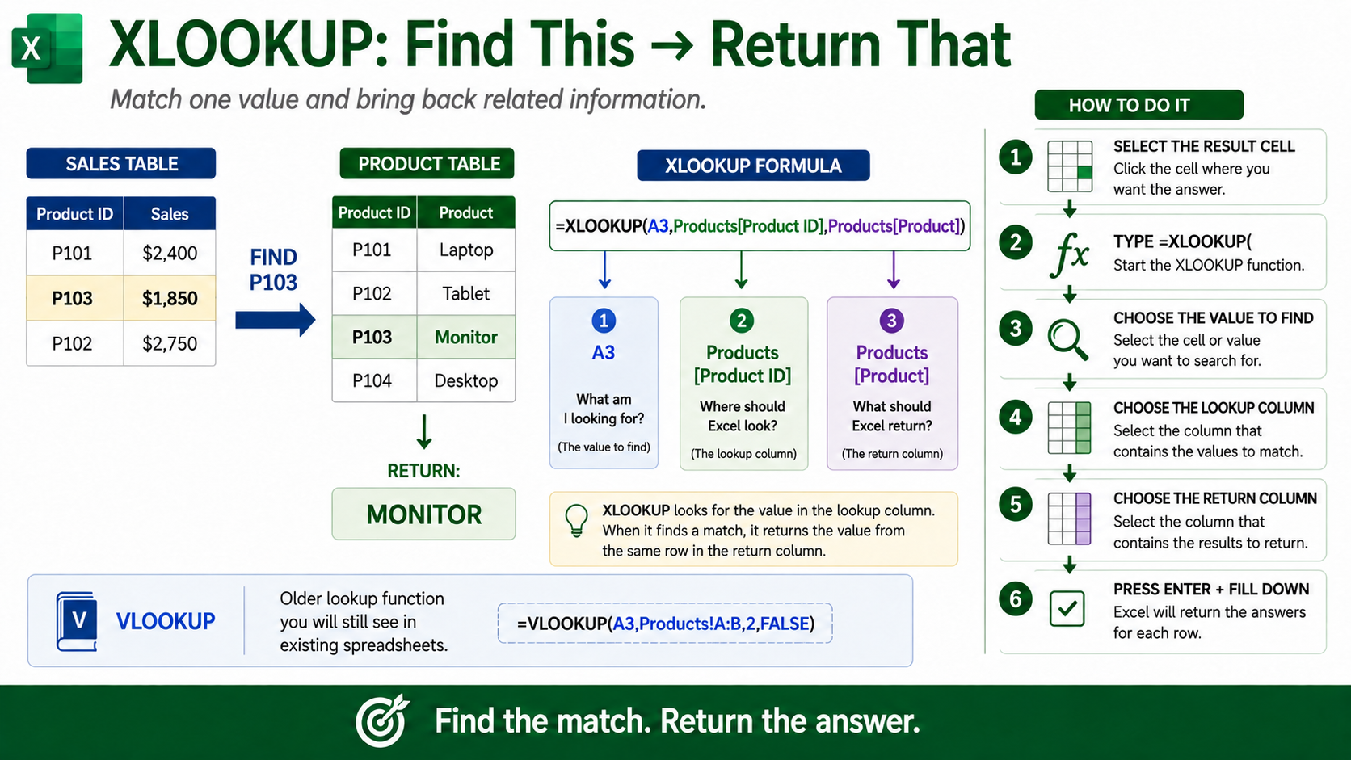
Notes:
XLOOKUP finds a value in one column and returns related information from another column. In this example, =XLOOKUP(A3,Products[Product ID],Products[Product]) uses the Product ID in A3, which is P103, searches the Product ID column, and returns Monitor from the Product column. XLOOKUP is easier to read than many older lookup methods because you directly identify the lookup column and the return column. VLOOKUP is still common in older spreadsheets, so it is useful to recognize it as well.
https://support.microsoft.com/en-us/excel/functions/xlookup-function

Slide 10
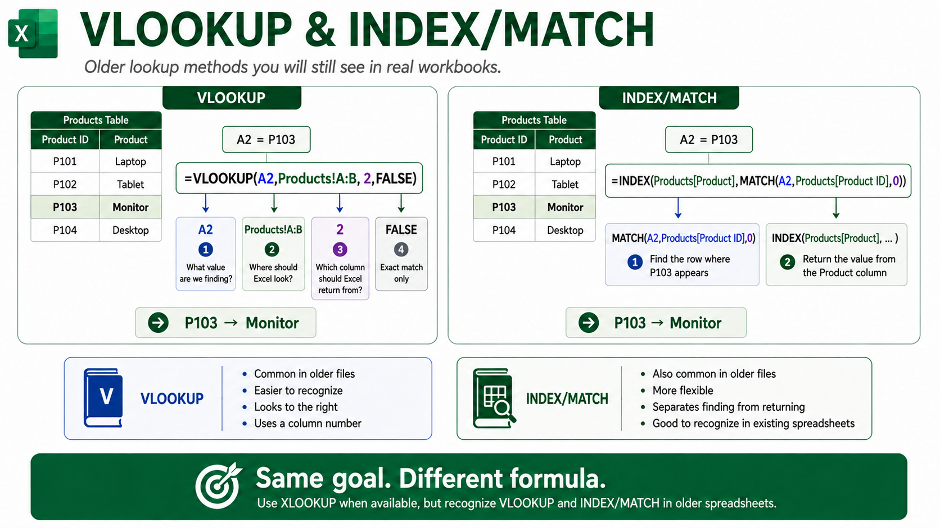
Notes:
VLOOKUP and INDEX/MATCH are older lookup methods that still appear in many existing workbooks. In the VLOOKUP example, =VLOOKUP(A2,Products!A:B,2,FALSE) finds P103 and returns Monitor from the second column. INDEX/MATCH accomplishes the same goal with =INDEX(Products[Product],MATCH(A2,Products[Product ID],0)). MATCH finds the row where P103 appears, and INDEX returns the corresponding value from the Product column. XLOOKUP is often easier to use when available, but VLOOKUP and INDEX/MATCH are still important to recognize.
https://support.microsoft.com/en-us/Excel/functions/vlookup-function
https://support.microsoft.com/en-us/excel/functions/index-function
https://support.microsoft.com/en-us/excel/functions/match-function

Slide 11
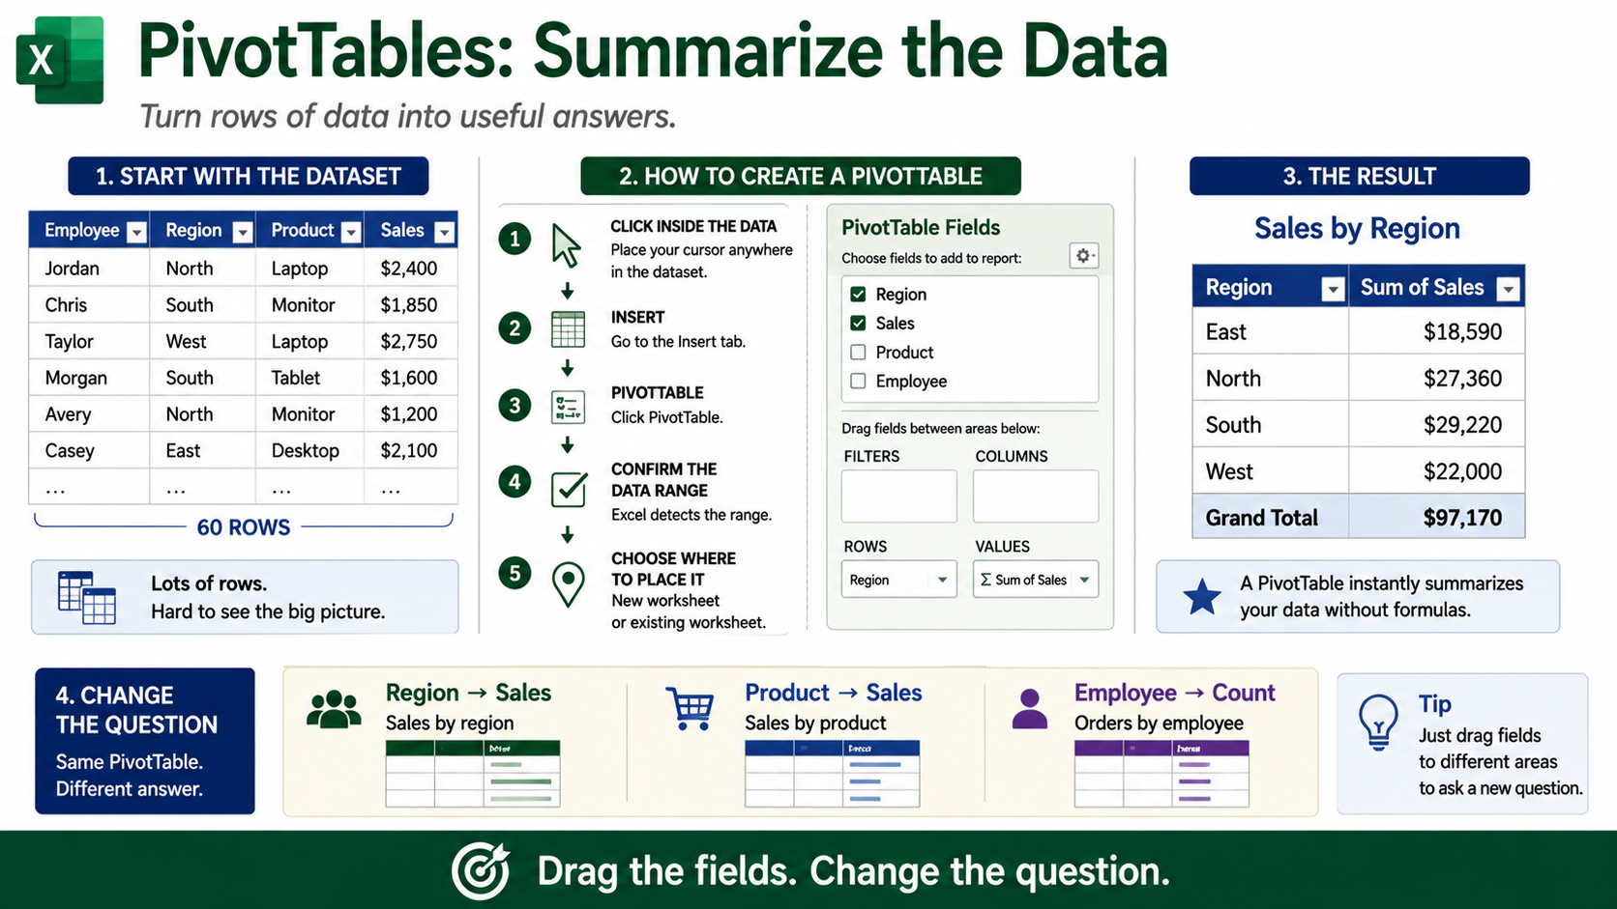
Notes:
A PivotChart turns the PivotTable summary into a visual that is easier to understand quickly. In this example, the Sales by Region PivotTable becomes a clustered column chart. The chart makes it easy to see that South has the highest sales at $29,220. The PivotTable performs the summary, while the PivotChart helps us see the pattern. Filtering the PivotTable can also update the PivotChart.
https://support.microsoft.com/en-US/Excel/get-started/create-a-pivotchart

Slide 12
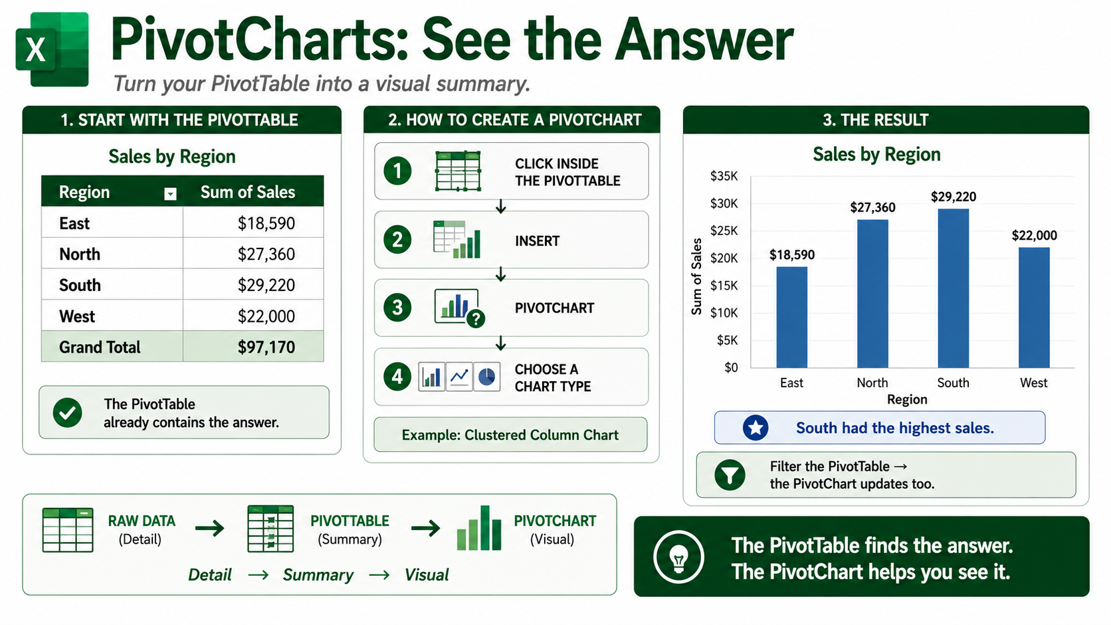
Notes:
A PivotChart turns the PivotTable summary into a visual that is easier to understand quickly.
The PivotTable does the summary work, and the PivotChart helps people see the pattern.
Example: A Sales by Region PivotChart makes it clear which region has the highest sales.
If you filter the PivotTable, the PivotChart can update with the filtered view.
Microsoft help URL: https://support.microsoft.com/en-US/Excel/get-started/create-a-pivotchart

Slide 13
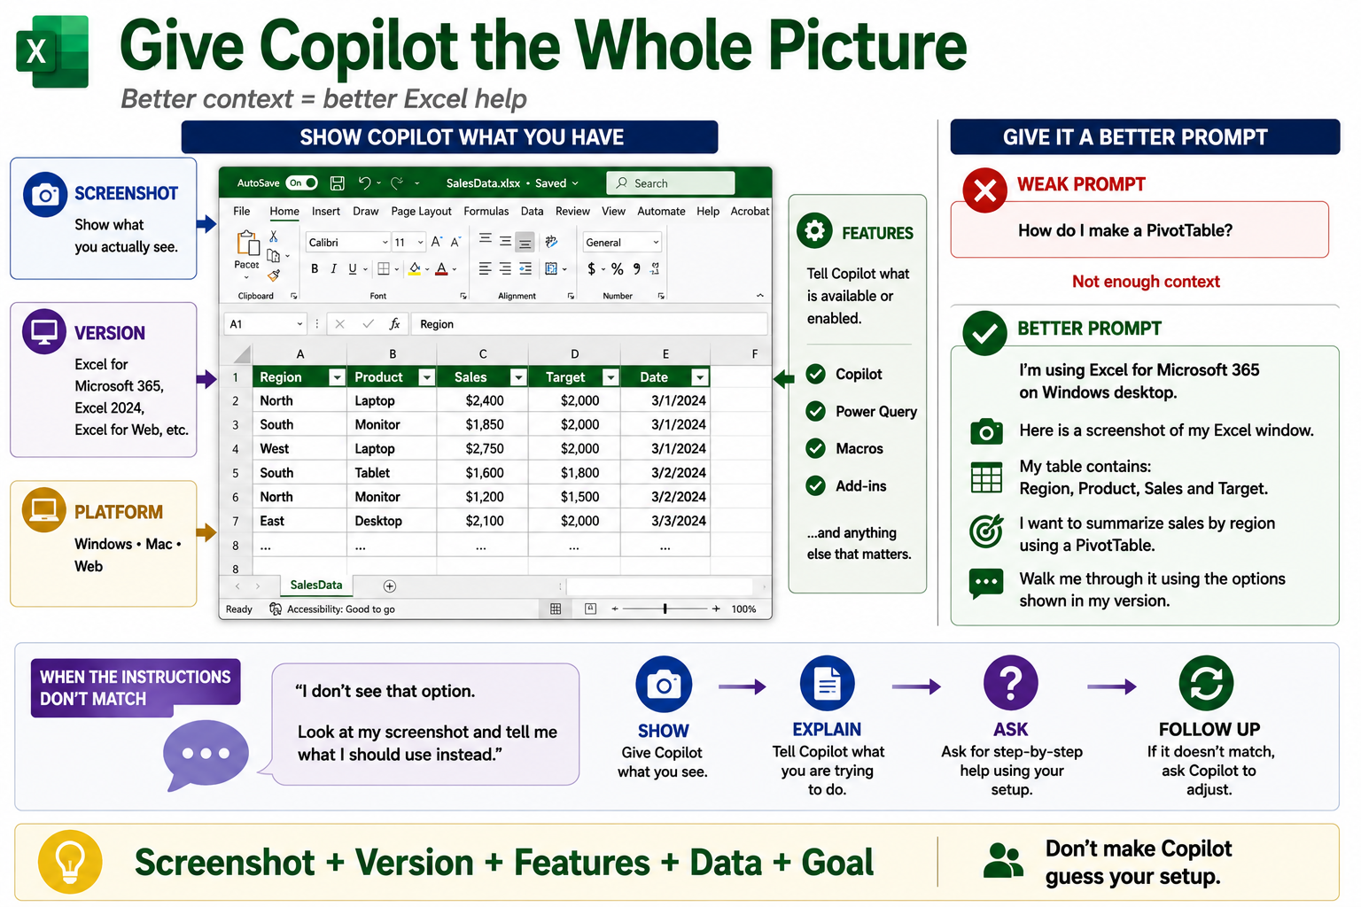
Notes:
Copilot works better when you give it enough context. Instead of simply asking, “How do I make a PivotTable?”, tell Copilot your Excel version, your platform, the features available to you, the columns in your data, and what you are trying to accomplish. A screenshot can also help Copilot understand what you actually see. In the example, the user explains that they are using Excel for Microsoft 365 on Windows, provides a screenshot, identifies the Region, Product, Sales, and Target columns, and asks for help creating a sales-by-region PivotTable using the options available in that version. If the instructions do not match your screen, explain what you see and ask Copilot to adjust.
https://support.microsoft.com/en-US/excel/copilot/get-started-with-copilot-in-excel
https://support.microsoft.com/en-us/excel/copilot/data-insights-with-copilot-in-excel
https://support.microsoft.com/en-us/topic/format-data-for-copilot-in-excel-1604c8eb-57f1-4db1-8363-d53336228c65

Slide 14
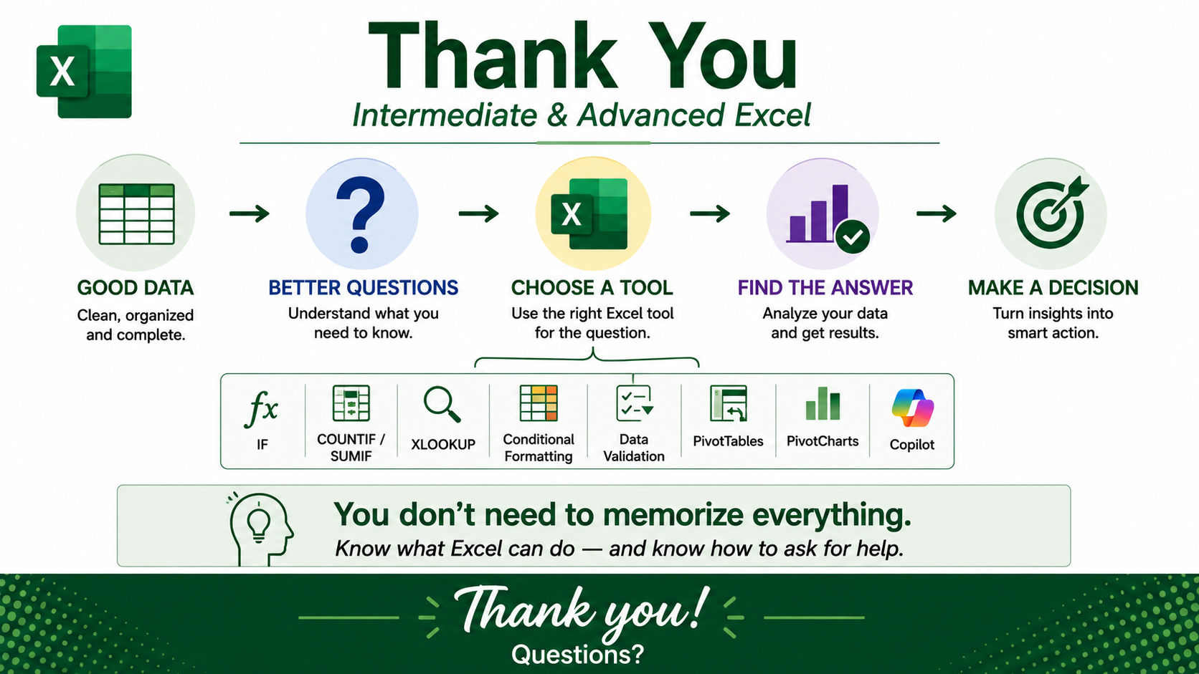
Notes:
The goal is not to memorize every Excel feature. Start with good data, understand the question you are trying to answer, choose the right Excel tool, analyze the result, and then use that information to make a decision. IF can make row-by-row decisions, COUNTIF and SUMIF work with conditions, lookups bring related information together, conditional formatting and data validation help organize data, and PivotTables and PivotCharts help summarize and visualize it. When you get stuck, Microsoft help pages and Copilot can be useful learning tools, but always check the result.
https://support.microsoft.com/en-us/excel

